Slide 1
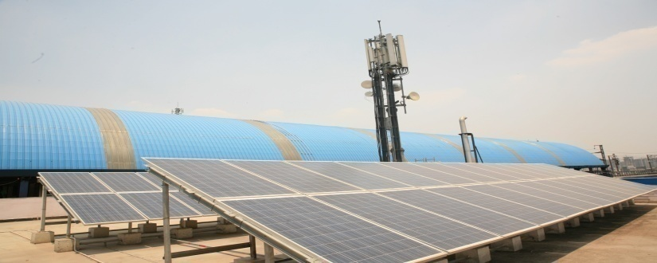
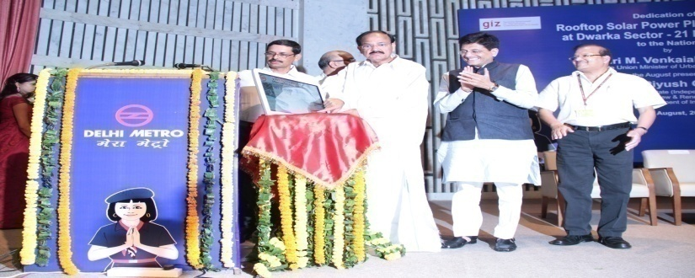
SOLAR ROOF-TOP is A necessity for DELHI METRO
DR. MANGU SINGH
Managing Director, DMRC

Slide 2
Contents
DMRC’ Power Scenario
Types of Roofs
Journey so far
Assessed Solar Potential
Future Plans
Glimpses of Roof Top Solar PV Plants

Slide 3
DMRC’ Power Scenario

Slide 4
DMRC’s POWER SCENARIO
Total demand of around 150 MW
Monthly Electricity Bill – Rs. 46 Crores
(i.e. nearly Rs. 1.5 Crores / day, which is about 45% of our Total expenditure).
As per C.E.A. data, 20% from Renewable source & 80% from Fossil fuels.

Slide 5
Energy Trend for Last 5 years
Financial Year | Energy Consumption (in M.U.) | Energy Expenditure (in Crores) | Average Unit Rate/ kVAh (in Rs.)
2010 – 11 | 425 | 139 | 3.29
2011 – 12 | 578 | 214 | 3.70
2012 – 13 | 597 | 320 | 5.36
2013 – 14 | 634 | 400 | 6.31
2014 – 15 | 680 | 470 | 6.91

Slide 6
Year – wise Tariff Trend
Increase of 110% in 5 years.

Slide 7
Assessed Solar Potential

Slide 8
Assessed Solar Potential of DMRC Sites
Locations |  | Potential (MWp)
Existing Stations and Parking | Elevated Stns. – 101 UG Stns. – 37 | 12.46
Existing Depots and RSS of DMRC | Depots – 6 RSSs – 14 | 15.50
Upcoming Stations and Parking | Elevated Stns – 94 UG Stns – 35 | 9.75
Upcoming Depots and RSS of DMRC | Depots – 7 RSSs – 14 | 12.35
Grand Total |  | 50.00

Slide 9
Types of Roofs

Slide 10
DMRC along with GIZ surveyed its Stations and Depots and then prepared DPRs for different roof tops at 3 locations.
There are 3 following types of roofs in DMRC’s System :-
Flat roof
Curved Roof
Inclined Roof

Slide 11
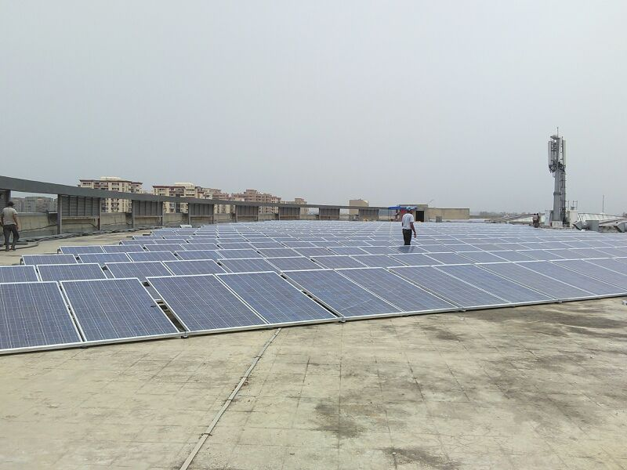
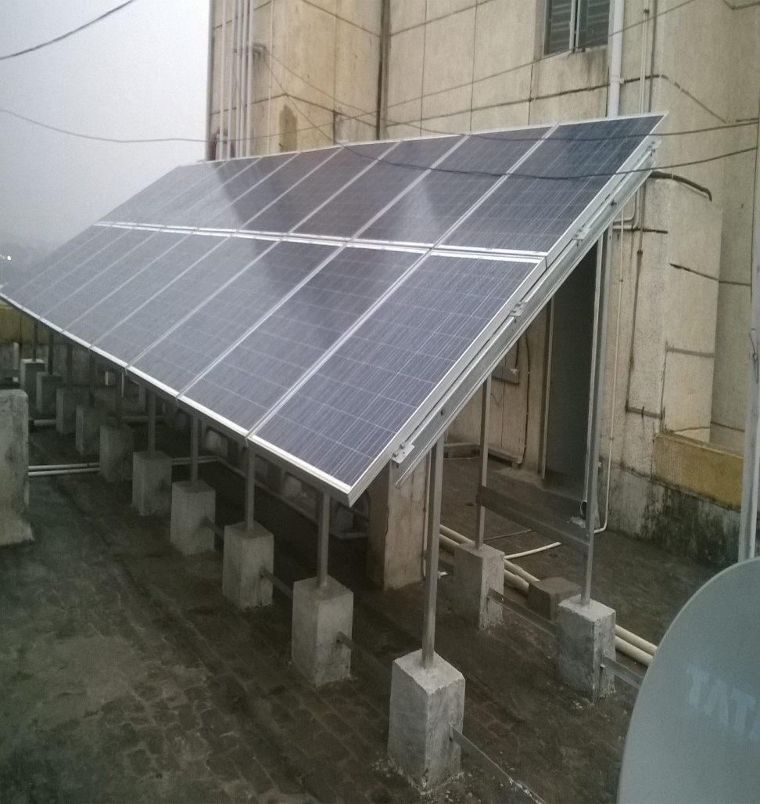
Flat Roof
Single Tier
2- Tier Plant

Slide 12
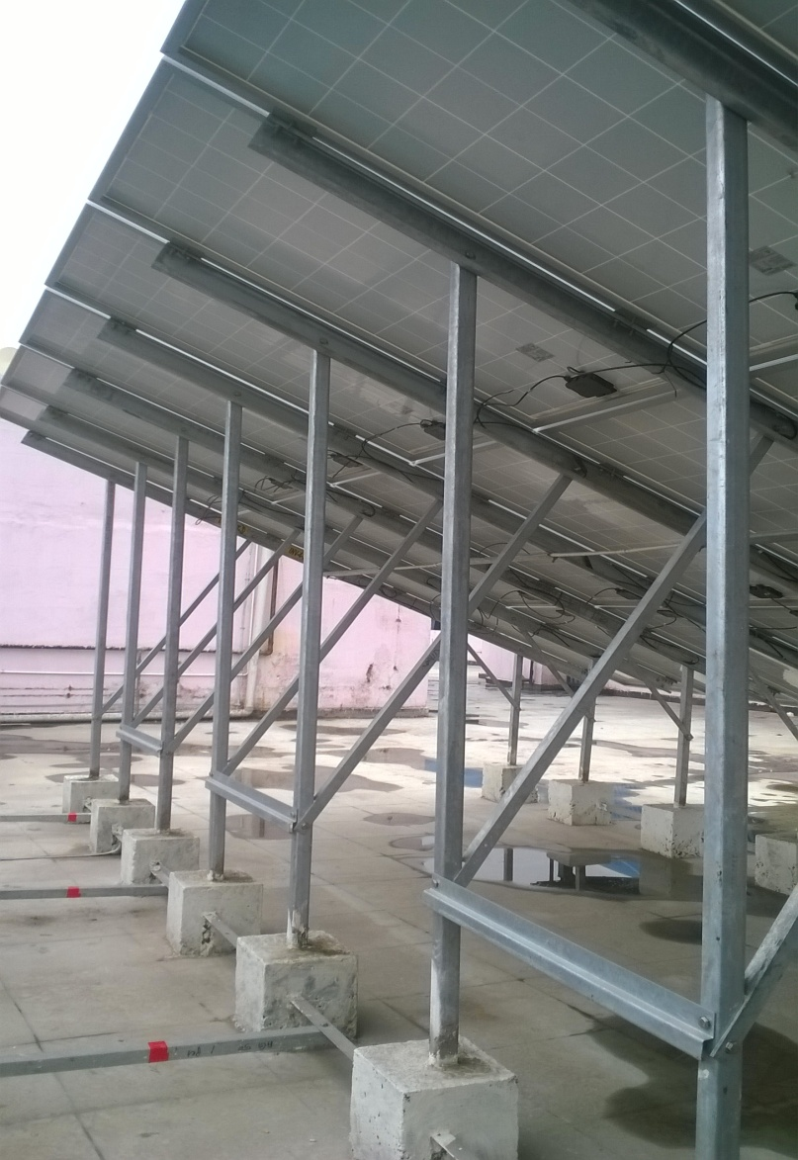
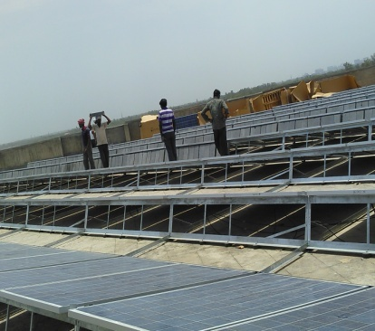

Slide 13
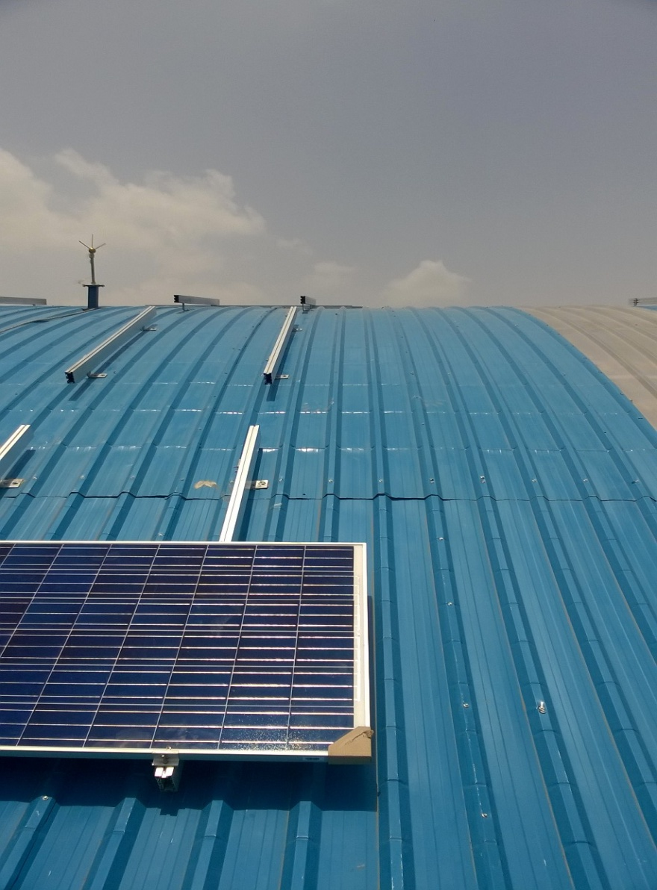
Curved Roof

Slide 14
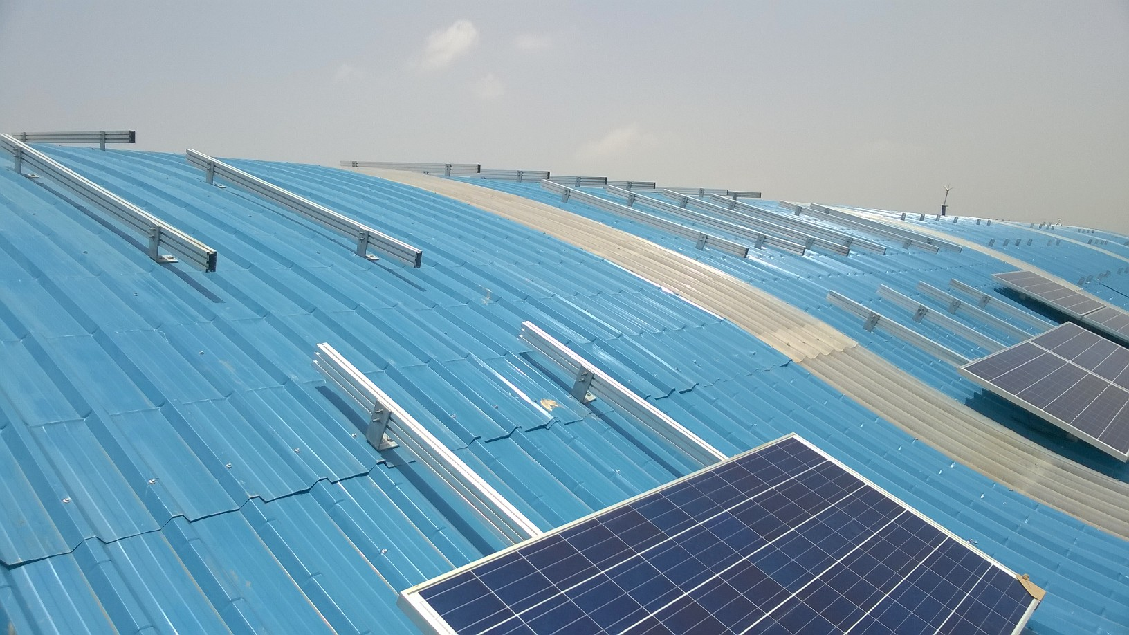

Slide 15
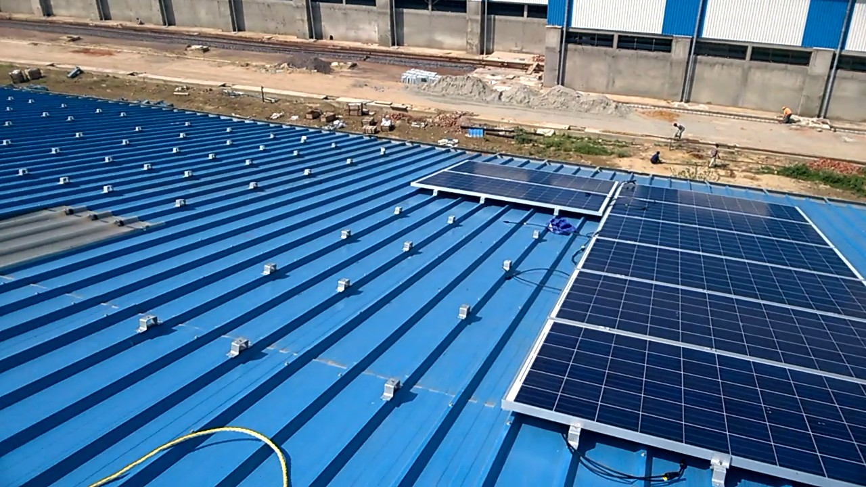
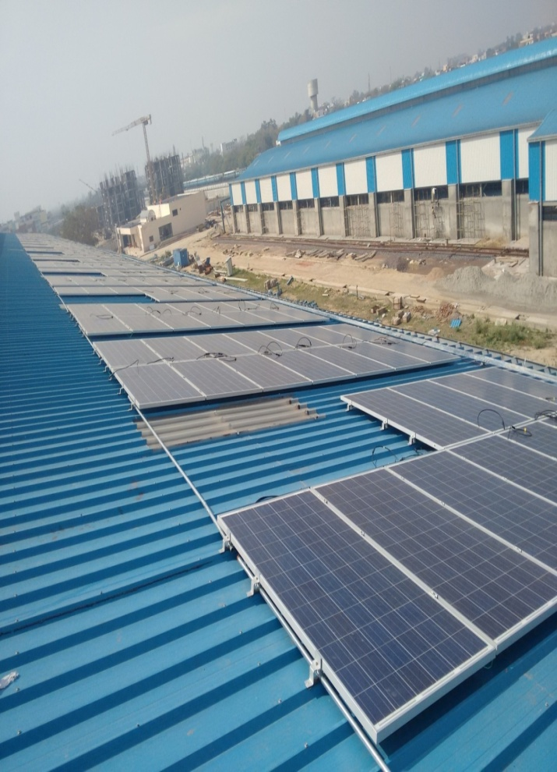
Solar Panels on Inclined Sheds
Inclined Roof

Slide 16
Life Line for Safety of personnel
Special provisions for Sheds

Slide 17
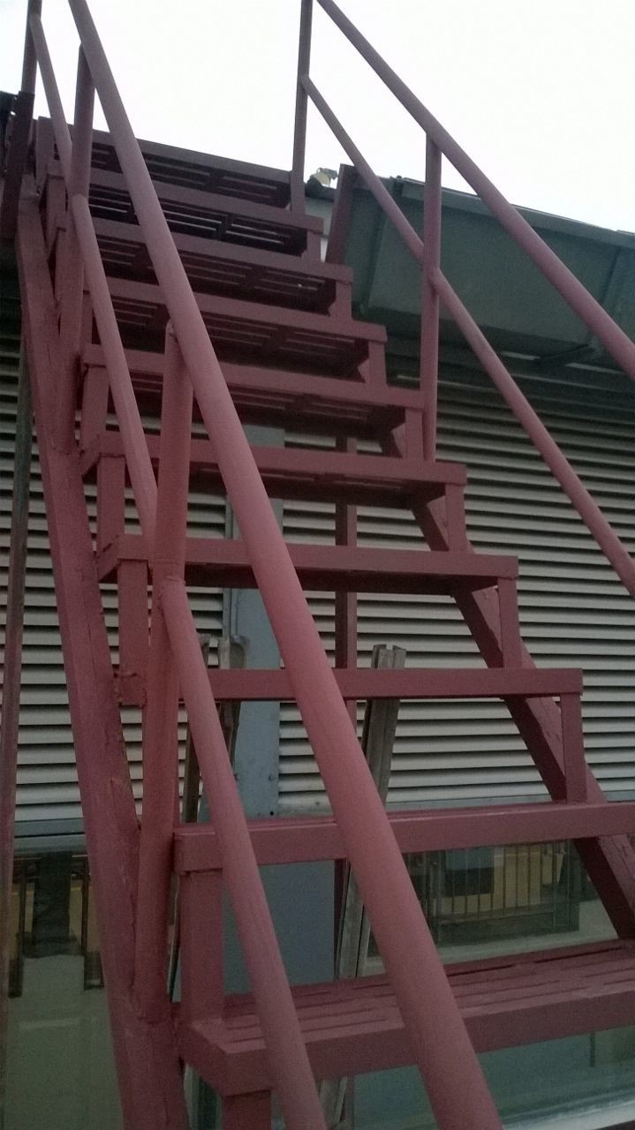
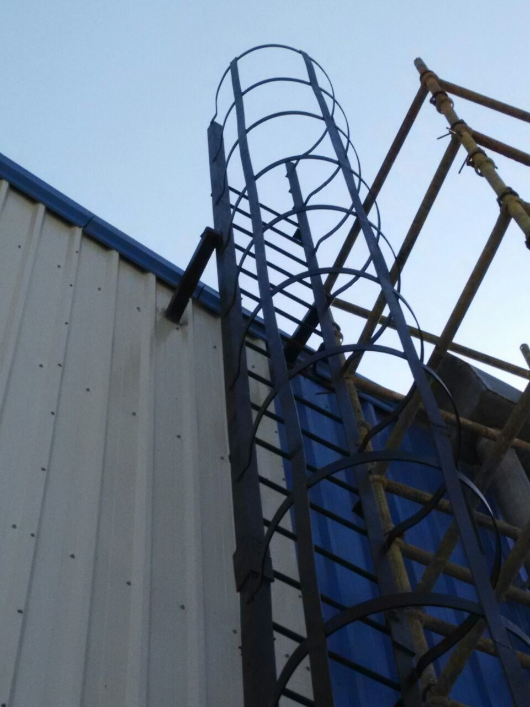
Ladder provided for easy access (Shed Roof)

Slide 18
Journey so far

Slide 19
DMRC’s Journey of becoming solar
Being Environment conscious DMRC started to explore possibility of using Solar Power.
Oct. 2012 – signed MOU with GIZ, Germany
GIZ surveyed Stations and Depot, Prepared Detailed Project Reports for different roof tops at following 3 locations :-
Yamuna Bank Depot (Inclined)
Yamuna Bank station (Curved)
Dwarka Sector – 21 Station (Flat)

Slide 20
Sept. 2013 – MoU signed with SECI, to execute Joint Projects of Solar Power in DMRC Premises.
Feb. 2014 – Power Purchase Agreement for 25 years signed with SEI Superior Pvt. Ltd. under RESCO model,
June 2014 – Installation works started and Plant made operational on 27.06.14.

Slide 21
ADOPTION OF RESCO MODEL
(Energy is sold by developer to DMRC for its own use)
DMRC decided to go with RESCO model.
Plant is grid connected at 415 Volts – DMRC would be able to utilize all the energy generated through the roof top installation.
Metering arrangement is provided to find out units generated for payment to RESCO agency.

Slide 22
Power Purchase Agreements signed till date
Developer | Capacity | Subsidy | Allocation | TARIFF (in Rs.)
 | (kWp) | @ | By | Levellized | 1st Year | 25th Year
SEI Superior Solar | 500 | 30% | SECI | 6.94 | 6.00 | 8.36
Jakson Engineers | 250 | 30% | SECI | 6.00 | 6.00 | 6.00
Sukam Power System | 250 | 30% | SECI | 5.845 | 5.845 | 5.845
SEI SunScope Energy | 1235 | 15% | DMRC | 6.73 | 6.73 | 6.73
SEI SunScope Energy | 1500 | 15% | DMRC | 6.248 | 6.00 | 6.35
Consortium of Purshotam Industries & Rays Power Experts | 7000 | 15% | DMRC | 6.248 | 6.00 | 6.35
Total | 10,735 | or 10.7 MWp
Pooled Levellized Tariff : Rs. 6.32 / kWhr

Slide 23
APPROVALS FROM M.N.R.E.
Entitled DMRC as implementing agency for National Solar Mission.
Granted Central Financial Assistance (CFA) of Rs. 25.50 Crores (15% of Benchmark Cost) for installing 20 MWp of Solar Plants in two installments for 10 MWp each.
For SECI tendered plants – 30% subsidy from MNRE is availed.
Of 30% subsidy – 3% is retained by SECI (as consultancy fees) 27% to be released in stages linked to plant performance in first 2 years.

Slide 24
Details of sanctioned CFA by MNRE
S. No. | Aggregate Capacity | Benchmark Cost per MWp | 15% of Benchmark Cost per MWp | Estimated CFA approved
1 | 10 MWp | Rs. 9.0 Crores | Rs. 1.35 Crores | Rs. 13.5 Crores
2 | 10 MWp | Rs. 8.0 Crores | Rs. 1.20 Crores | Rs. 12.00 Crores
Total Approved CFA |  |  |  | Rs. 25.5 Crores

Slide 25
Solar Plants Commissioned at DMRC Sites
S. No. | Location | Capacity (in kWp) | Commissioned on
1 | Dwarka Sector – 21 | 500 | June 2014
2 | Pragati Maidan | 85 | Jan. 2015
3 | Anand Vihar | 115
4 | Metro Enclave | 50
5 | Faridabad RSS | 50 | April 2015
6 | Yamuna Bank Depot | 225 | May 2015
7 | Yamuna Bank Stn. Bldg | 100
8 | ITO | 9 | June 2015
 | Grand Total | 1,134 | (say 1.1 Mwp)

Slide 26
Solar Plant Installations in Advanced stage
S. No. | Location | Capacity (in kWp) | Status
1 | Ajronda Depot | 450 | EIG Cleared
2 | Faridabad Stations (9 Nos.) | 1200
 | Grand Total | 1,650 | (say 1.65 MWp)

Slide 27
Future Plans

Slide 28
To become CARBON – NEUTRAL
By installing 400 MWp Off-site Solar Plant to meet present energy demand.
In Delhi, there is no provision / regulations for Banking of Power.
DISCOMs and DERC are being approached to facilitate feeding of Power from Off-site Solar Plant (during day time) and purchase commensurate Power from DISCOMs in Delhi through out the day (24 hrs.).

Slide 29
Glimpses of Roof Top Solar PV Plants

Slide 30
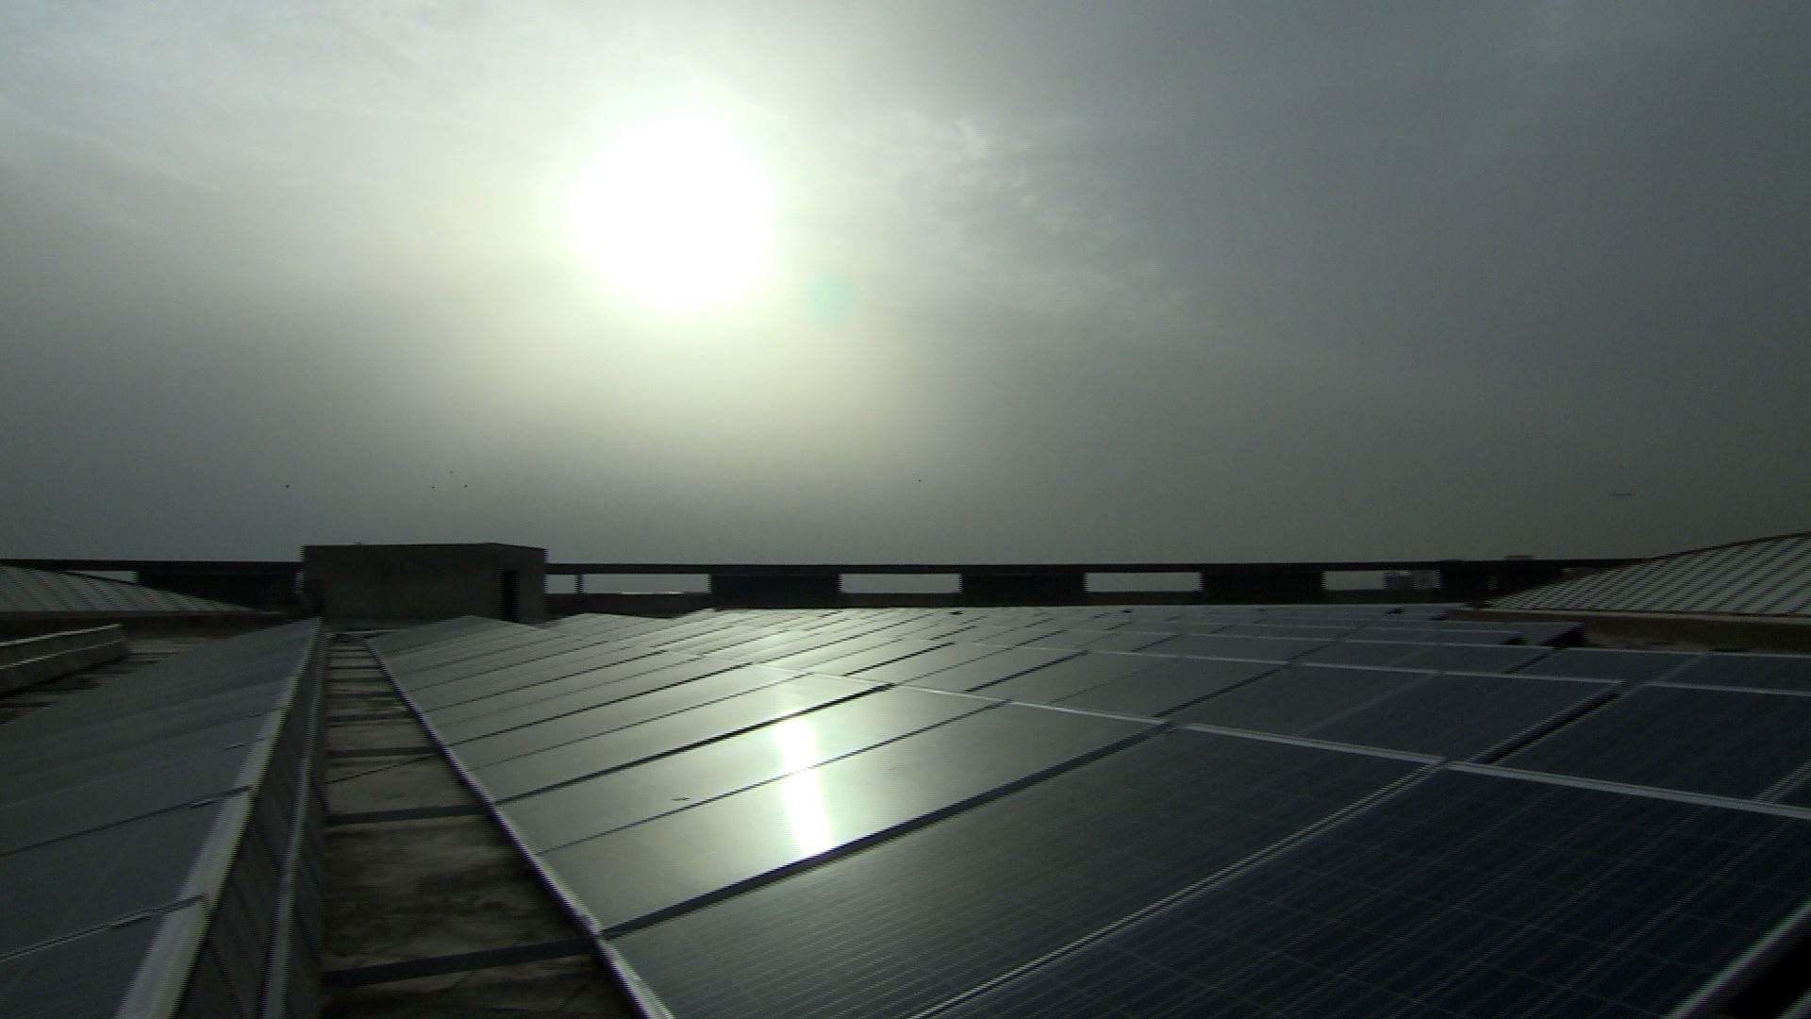
First 500 kWp Solar Power Plant at DWARKA Sec 21 Metro Station

Slide 31
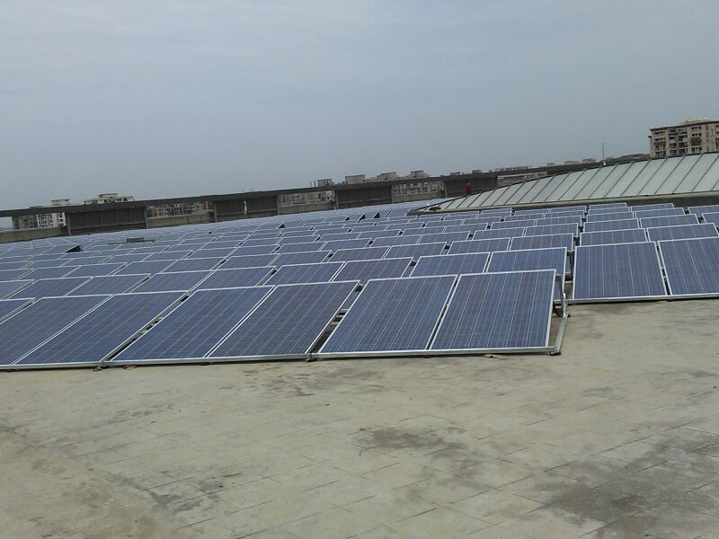
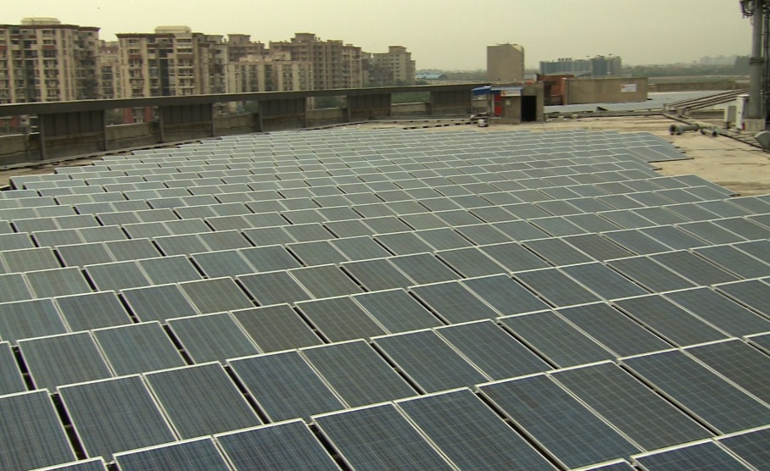
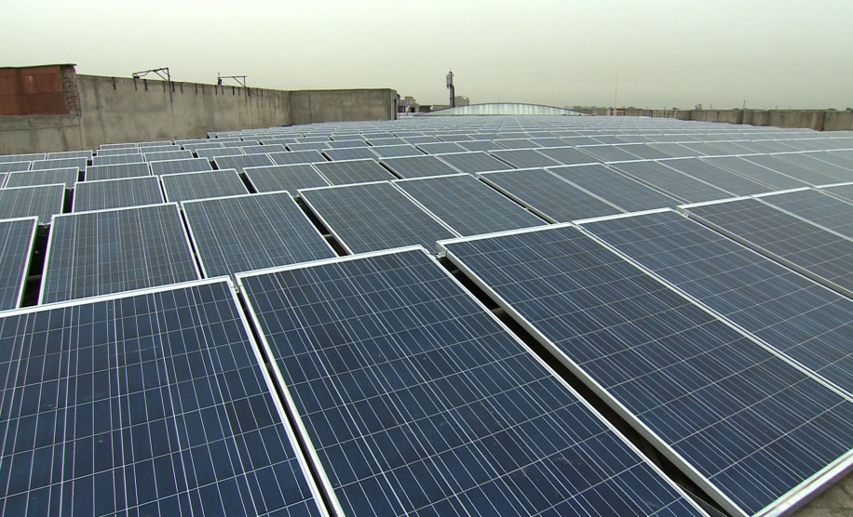
500 kWp Plant at DWARKA Station
(13º Delta Rack, Non-penetration structure)

Slide 32
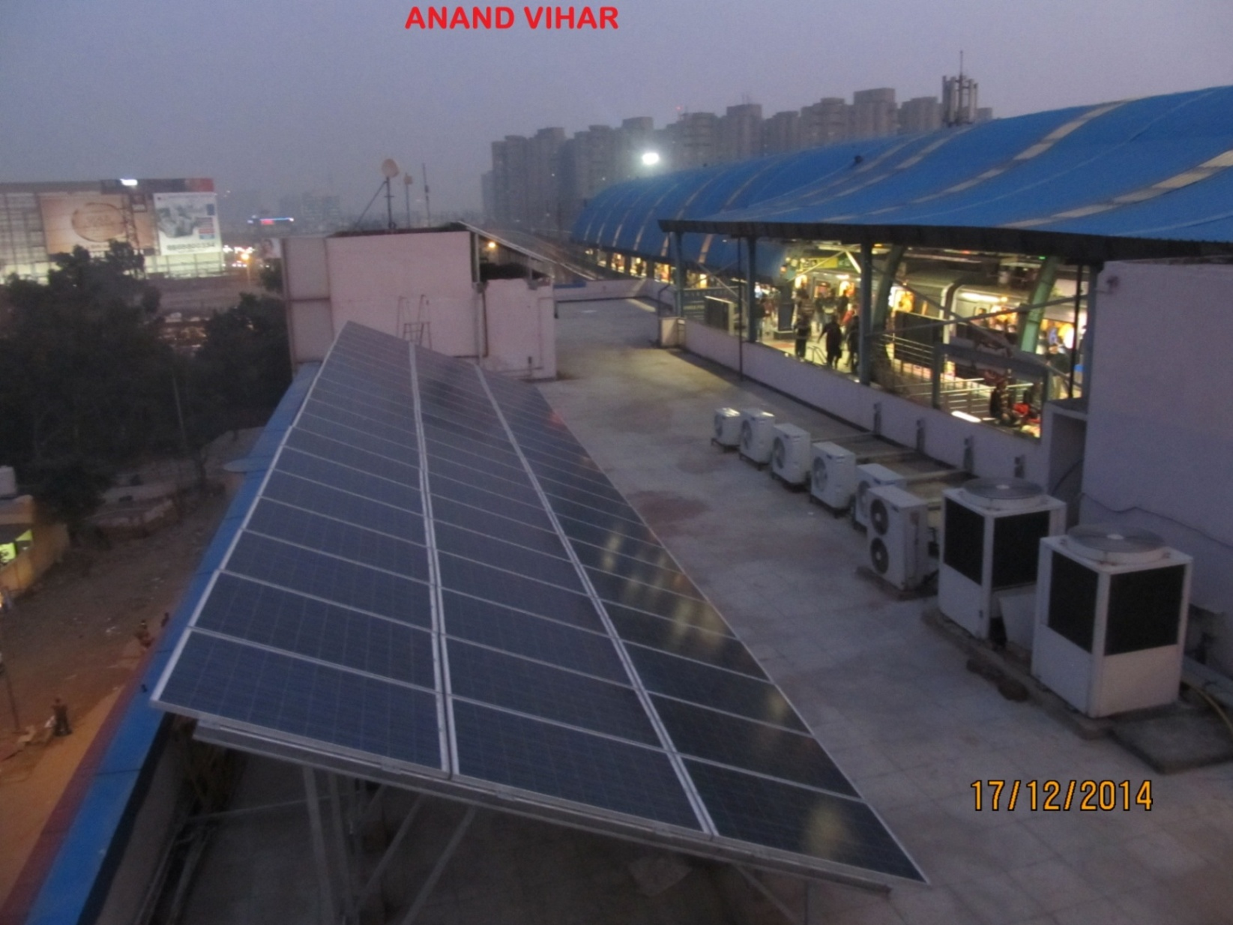
115 kWp Plant at ANAND VIHAR Station
(3 Tier Module, 24º Angle, with Foundation Blocks)

Slide 33
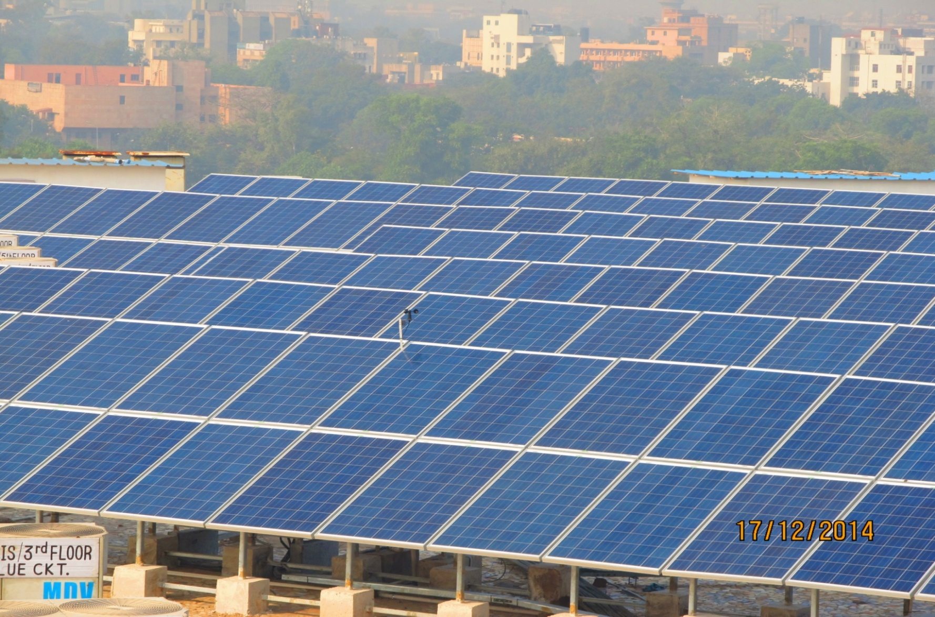
85 kWp Plant at Pragati Maidan Station
(2 Tier Module, 24º Angle, with Foundation Blocks)

Slide 34
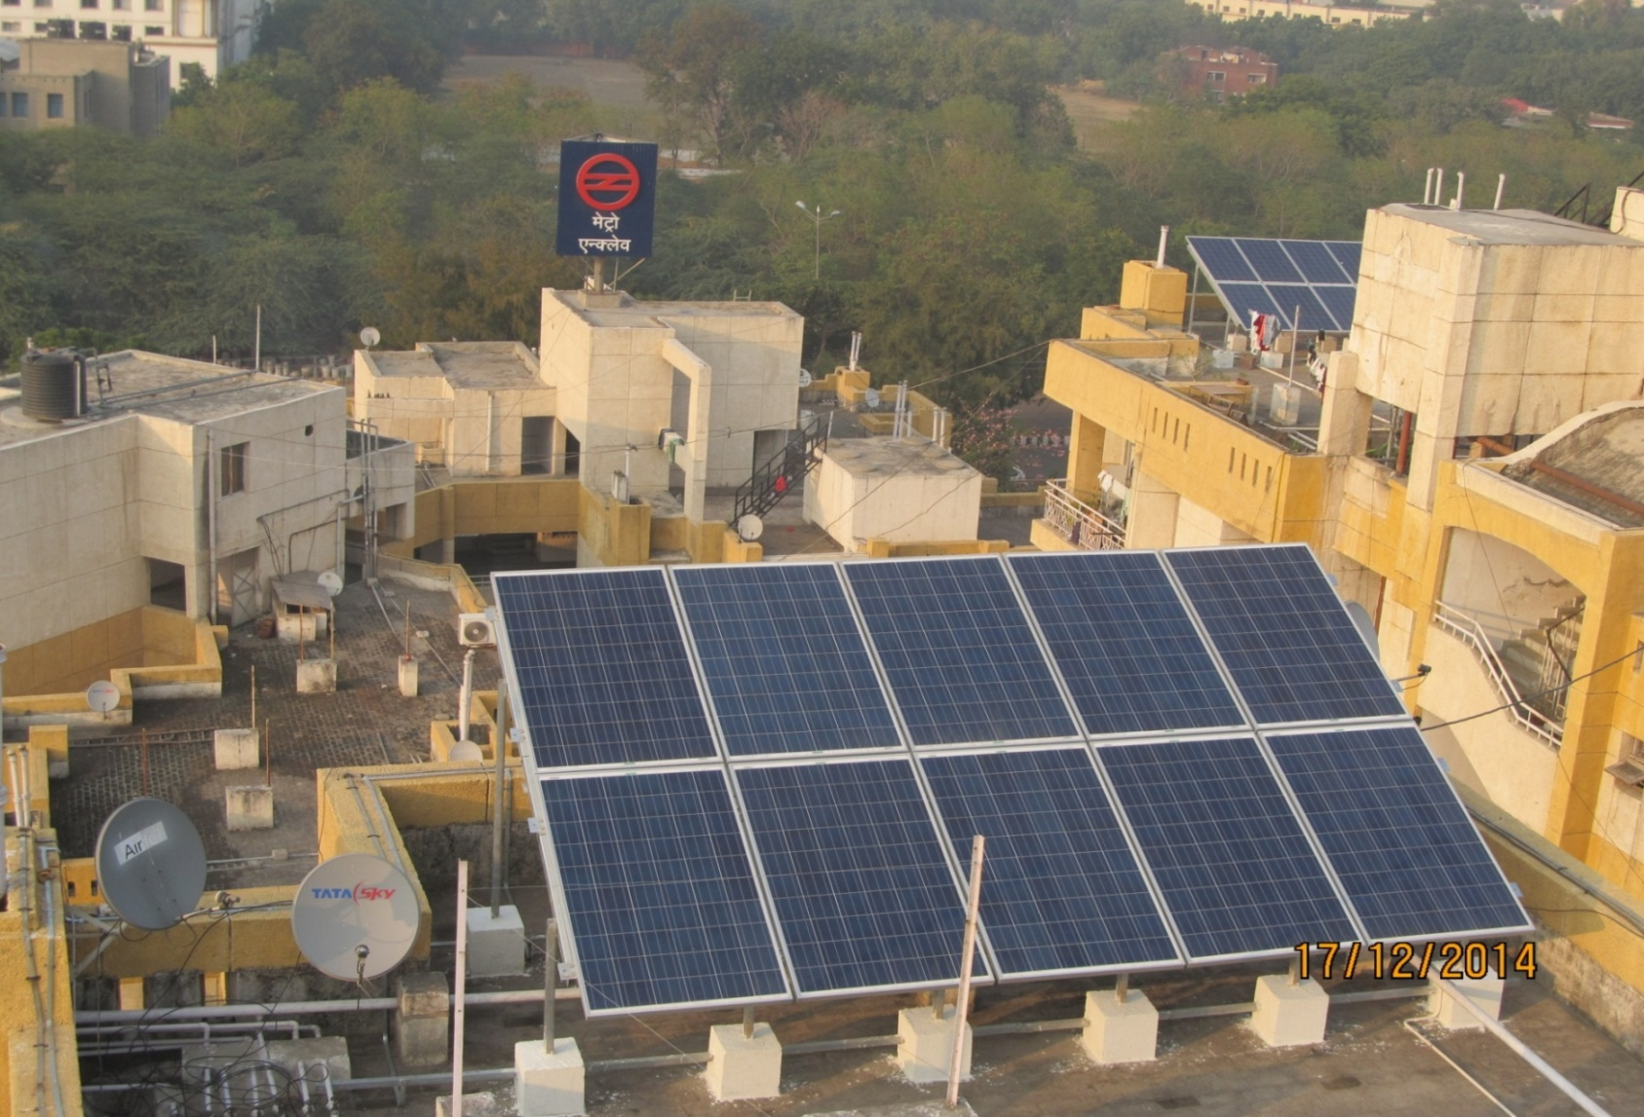
SOLAR PLANT at METRO ENCLAVE
(with Net Metering)

Slide 35
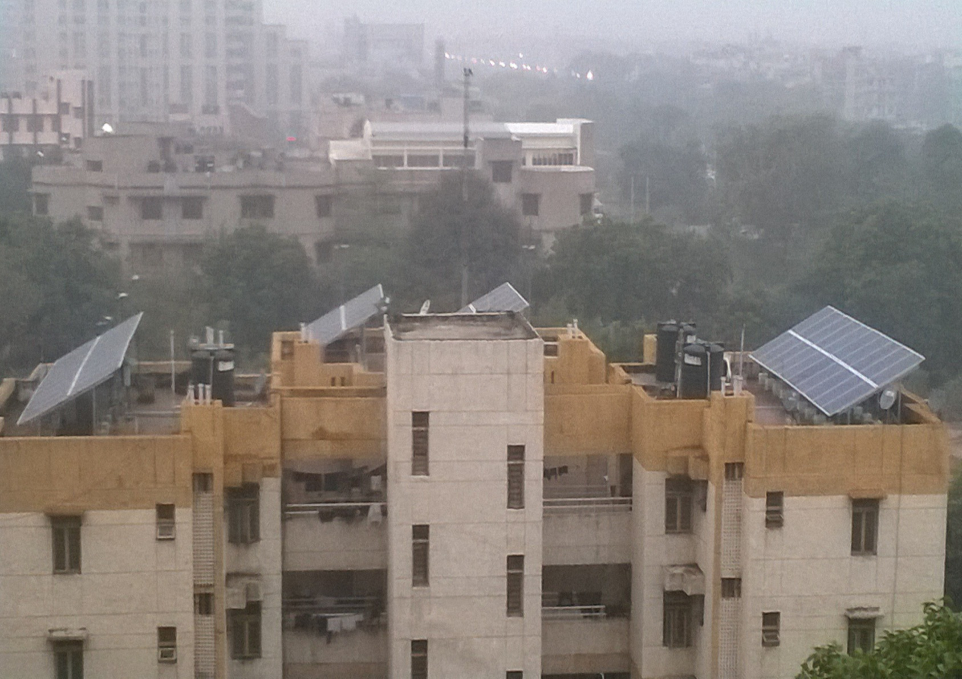
SOLAR PLANT at METRO ENCLAVE

Slide 36
Work in progress at Ajronda Depot

Slide 37
Ajronda Depot Inspection Shed

Slide 38
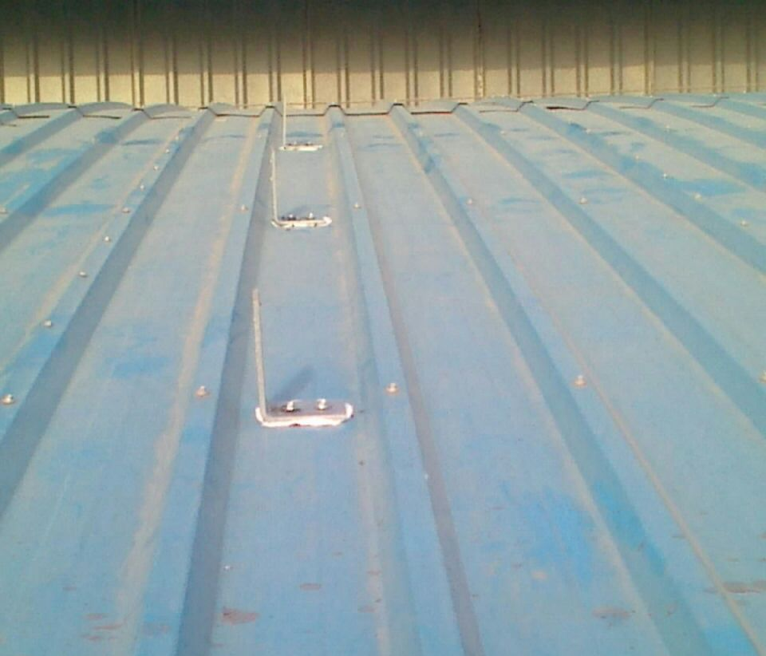
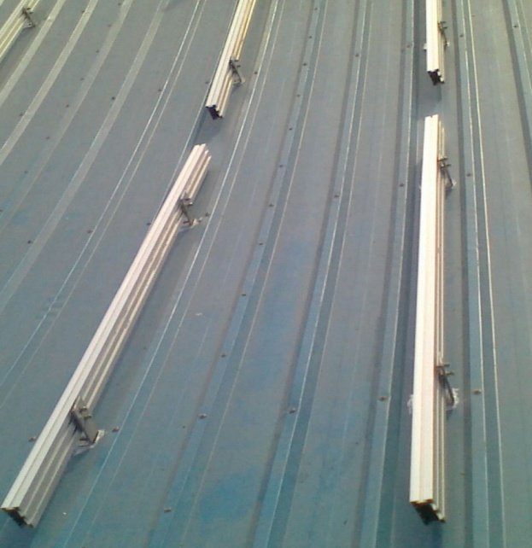
Panel installation on Depot Shed (Curved Roof)
Clamps
Purlin

Slide 39
Thank You !!
DMRC Ltd.
Metro Bhawan
Fire Brigade Lane
Barakhamba Road
New Delhi-110001

