Slide 1
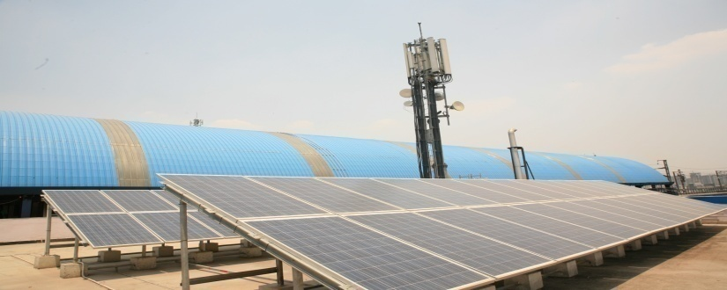
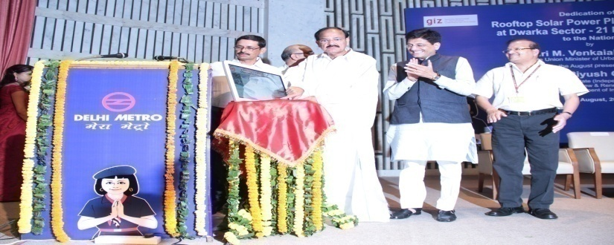
Potential Induced Degradation
Performance Monitoring
of
Solar Power Plants.

Slide 2
CONTENTS
PROPOSED SOLUTIONS
BRIEF ON PID
CONCLUSION
OVERVIEW OF SOLAR PROJECTS IN DMRC
PERFORMANCE MONITORING OF PLANTS

Slide 3
OVERVIEW OF SOLAR PROJECTS IN DMRC

Slide 4
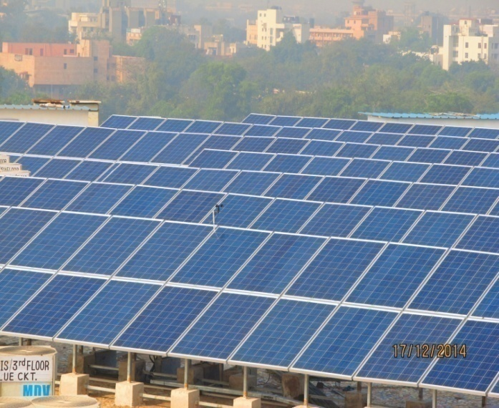
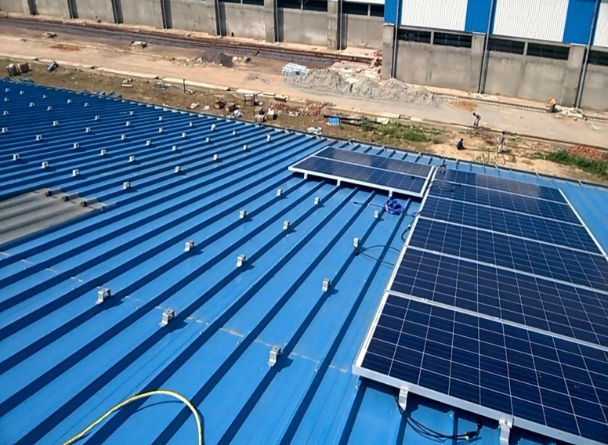
Solar Power Projects in DMRC
In an effort to reduce carbon footprints, DMRC decided to use all roof tops to instal solar panels for renewable energy.
As a first step, DPRs were prepared to assess solar potential by surveying stations & depots.
27th June 2014, first roof top solar plant of 500kWp capacity commissioned (in association with SECI).
It was on RESCO Model – In which investment was by Developer and only roof space was given by DMRC.

Slide 5
Types of Roofs
DMRC sites have following 3 different type of roof tops :-
Flat roof
Inclined Roof
Curved Roof

Slide 6
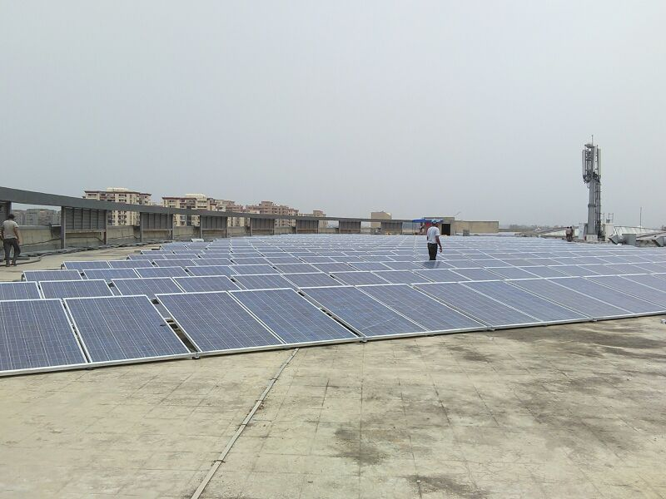
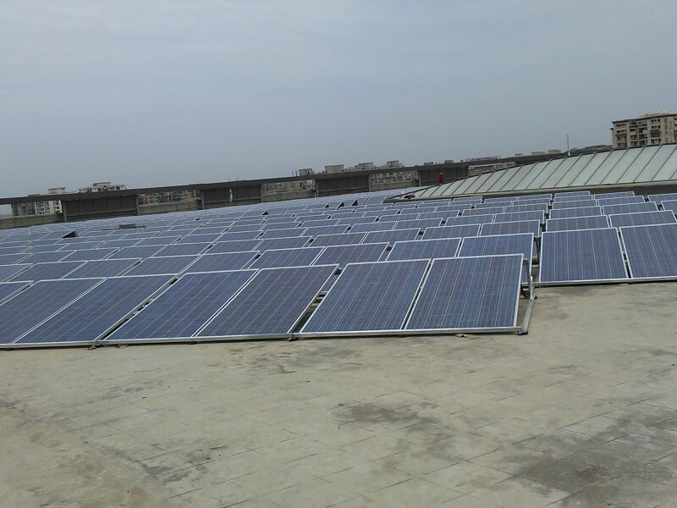
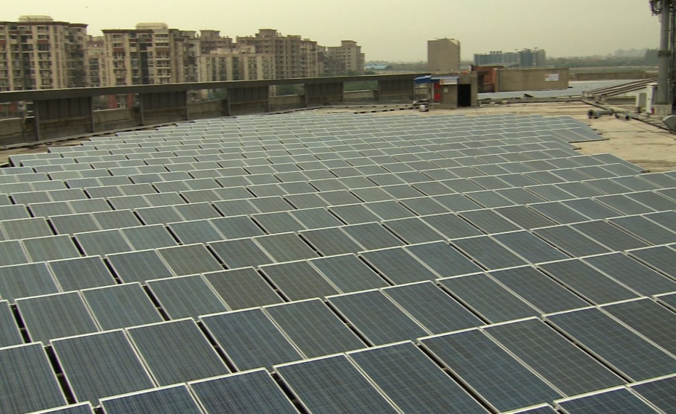
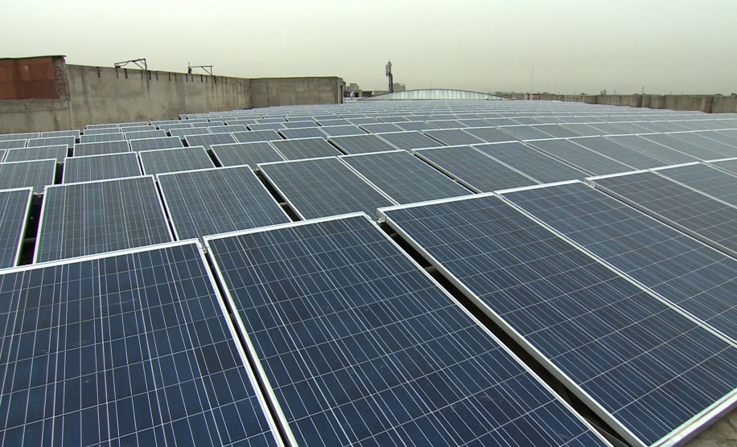
500 kWp - DWARKA 21 Station
(13º Delta Rack)

Slide 7
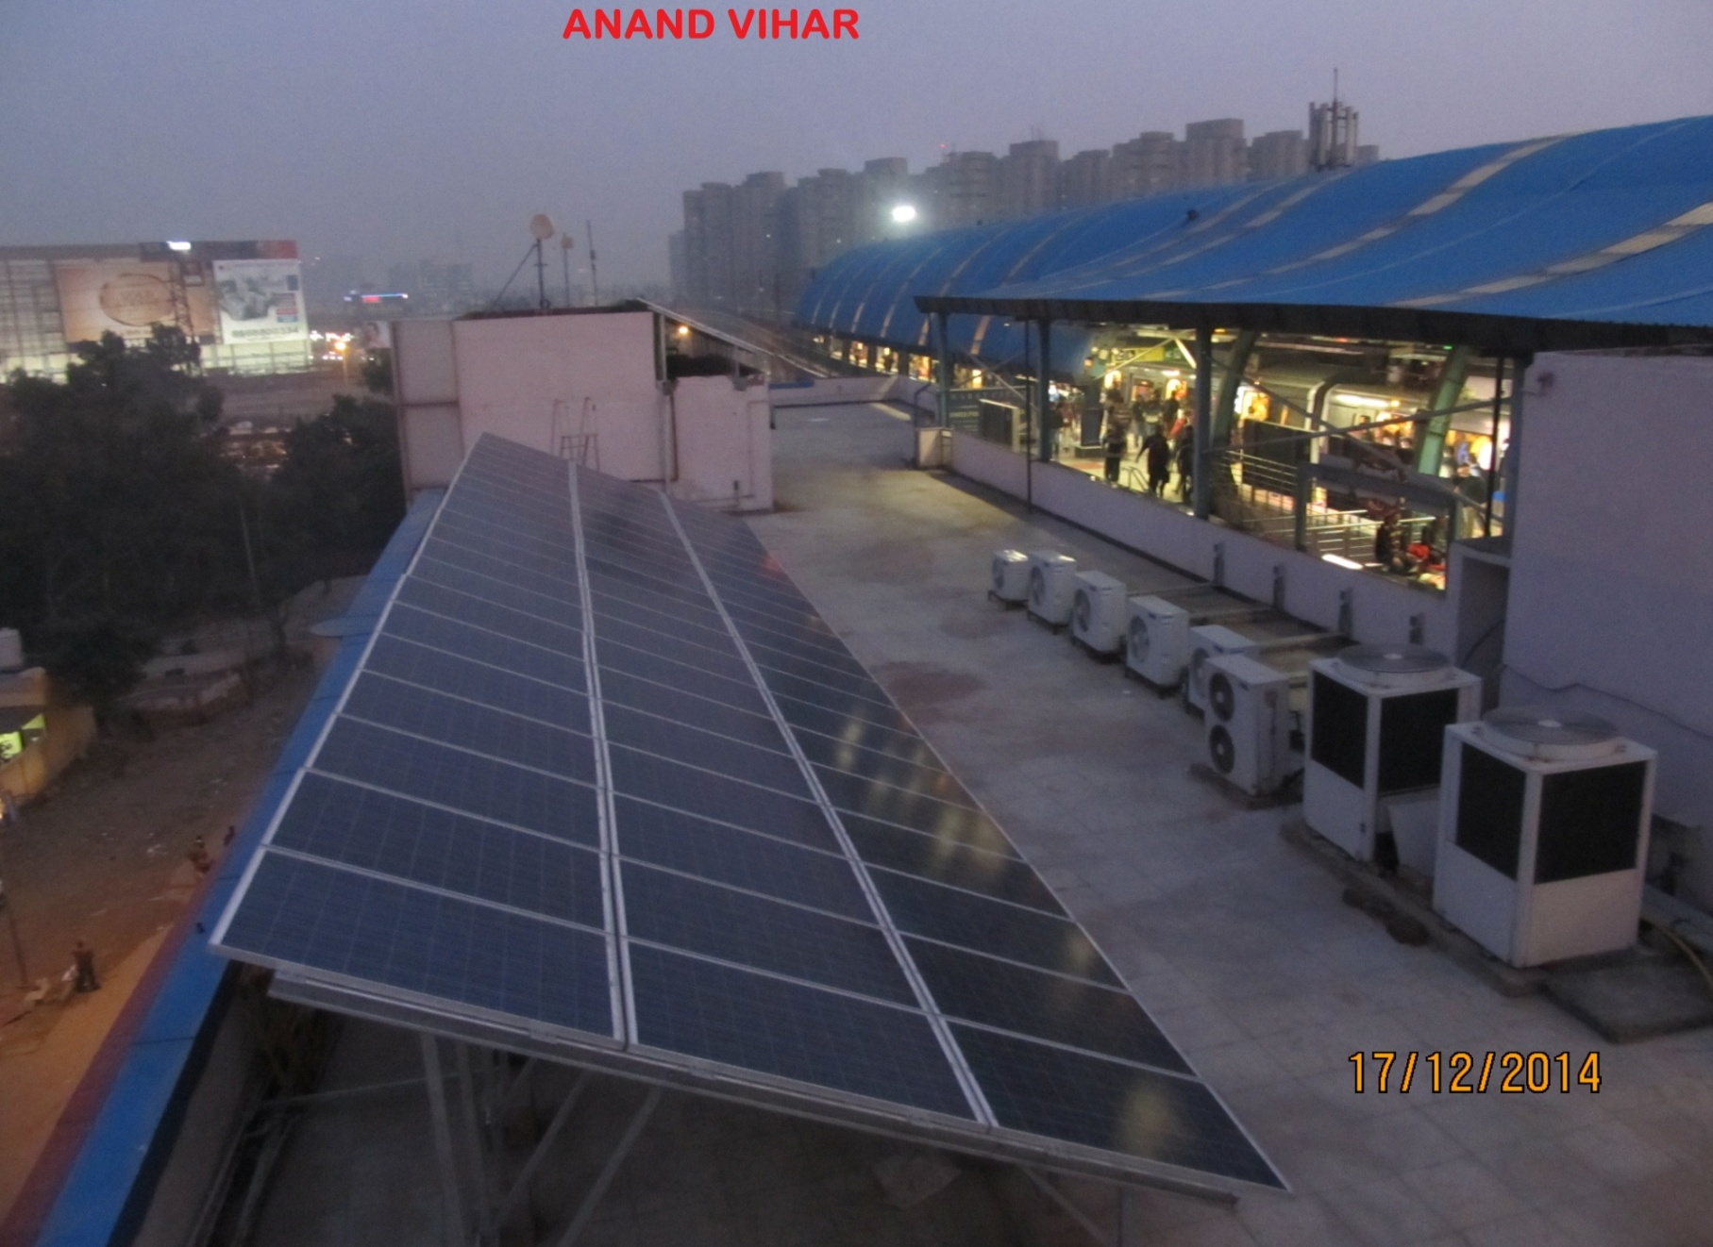
115 kWp - ANAND VIHAR Station
(3 Tier Module, 24º Angle, with Foundation Blocks)

Slide 8
85 kWp - Pragati Maidan Station
(2 Tier Module, 24º Angle, with Foundation Blocks)

Slide 9
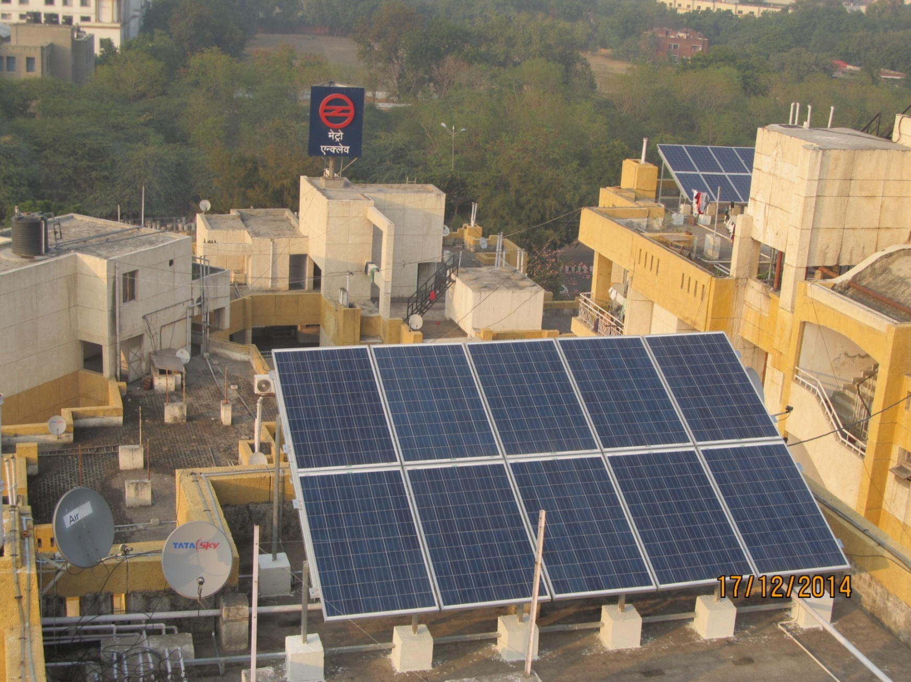
50 kWp - METRO ENCLAVE
(with Net Metering)

Slide 10
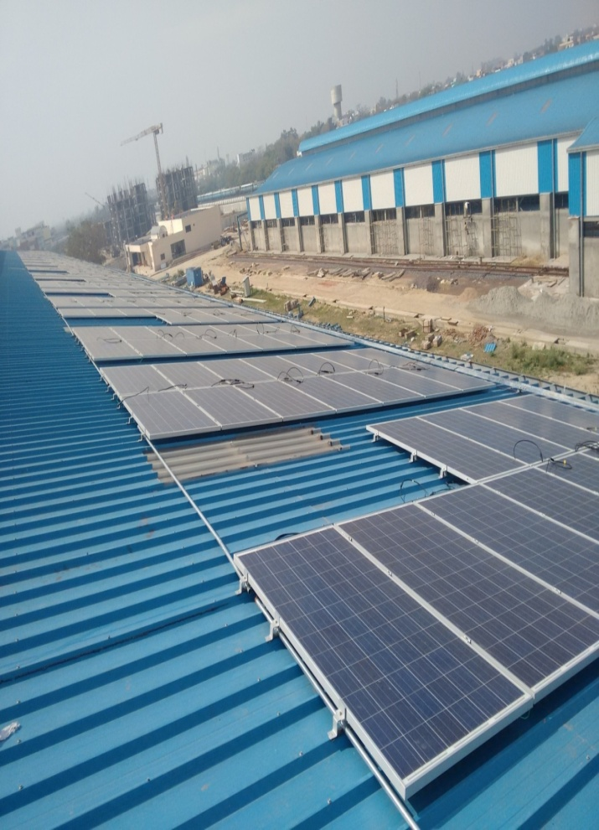
Solar Panels on Inclined Sheds
Inclined Roof

Slide 11
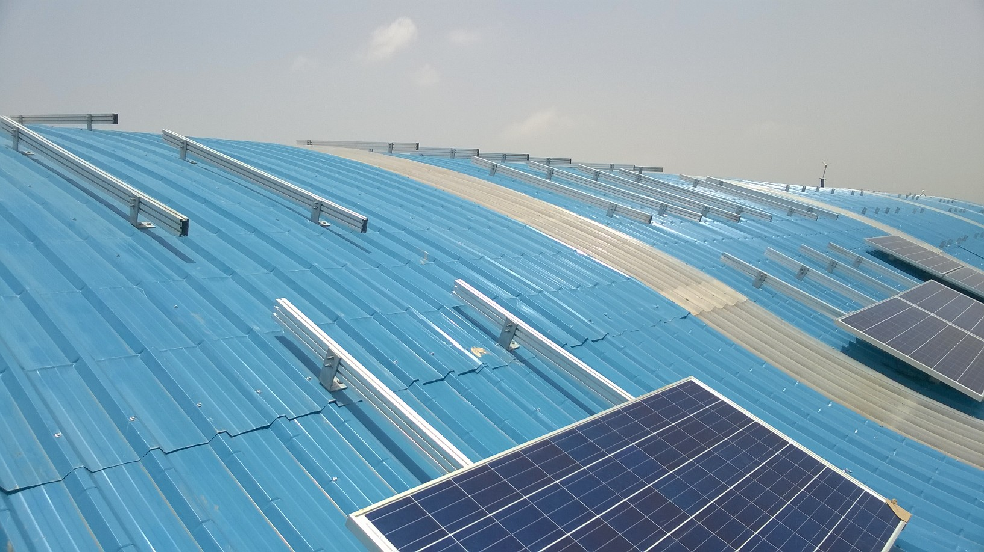
Curved Roof

Slide 12
Curved Roof

Slide 13
Present Status
Total assessed Potential:- 50 MWp.
Rs. 25.50 Crores Central Financial Assistance for 20 MWp Solar Plants approved by MNRE.
PPA signed for 11.0 MWp with Pooled Levelised Tariff of Rs. 6.32 / kWh under RESCO Model.
2.8 MWp capacity is already commissioned.

Slide 14
Learnings and Challenges faced
In Using Curved Roof sheds,
Design clamps / structures for Delhi Wind Load,
(till now only one reputed supplier for clamps in India)
Special Provisions for Sheds. (Ladder, Life Line, etc.)
Existing sheds not Designed / oriented for Solar
Panels, (Ventilation Dome, etc.)
Getting Power Block in Operational areas,
Developers lack experience with Metro / Rail,
Assimilation of Technology Upgrades in PPA.
Premature reduction in Power Output

Slide 15
Provisions in PPA
In PPA, Estimated generation is specified based on minimum Capacity Utilization factor CUF of 15% per annum.
Degradation not to exceed 20% in 25 years.
Release of 15% subsidy is linked to Performance of plant:-
10% on Commissioning of plant (with minimum 75% PR)
2.5% after 1st year of operation (with min. CUF > 15%)
2.5% after 2nd year of operation (with min. CUF > 15%)

Slide 16
PERFORMANCE MONITORING OF PLANTS

Slide 17
Important Terms regarding performance
Performance Ratio
Capacity Utilization Factor
Specific Energy

Slide 18
Performance Ratio
“Performance Ratio” (PR) is ratio of “Energy Measured” to “Energy Modelled”.
PR = (Measured Energy output in kWhr)
(Irradiance in kW/m²) X (Active Area of Panel in m²) X (Module Efficiency).
Range :- 70 – 80 %.
To qualify for release of Subsidy, PR should be minimum 75% at the time of commissioning.

Slide 19
Capacity Utilization Factor
Ratio of annual output of the plant in kWh to installed plant capacity for number of days.
CUF = Annual Energy Output (in kWh)
(Plant installed capacity in kWp) X 365 X 24
In tenders, minimum CUF specified is 15%.

Slide 20
Specific Energy
Specific energy is energy (kWh) generated per one kWp per day.
Specific Energy = Energy generated
(Capacity installed * Time Period )
For our plants, on an average it is 4 Units / kWp per day.

Slide 21
Tabular Comparison of Info on Web

Slide 22
Required Improvements
Performance Ratio
(for whole plant as well as individual inverters on daily basis and on date selection basis)
Plot of Power generated Vs Irradiance
Specific energy (kWh / kWp / Day)
(for each inverter and whole plant.)
Inverter Efficiency Plot
(A.C. Power generated Vs DC power Available)

Slide 23
On closely monitoring,
in Performance of One of the Plant
PREMATURE DEGRADATION
of Power Output was noticed.

Slide 24
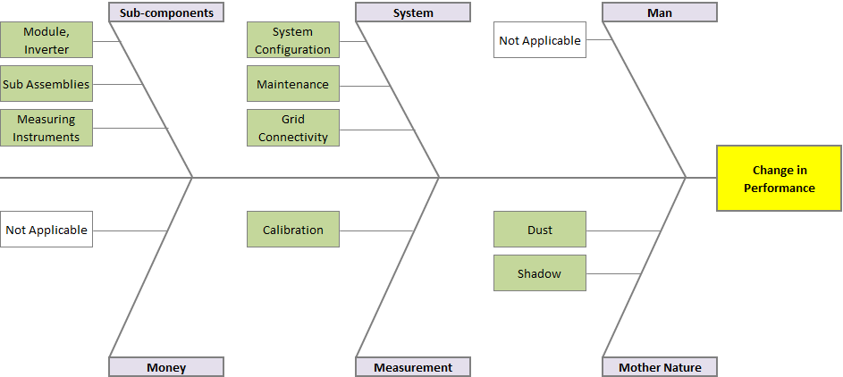
Root Cause Analysis by Developer
On closely monitoring the
Performance of the Solar installation
PREMATURE DEGRADATION
was Observed.

Slide 25
Details of Analysis
String type Inverter : (21.6 KW);
All inverters working at optimum output level – checked DC v/s AC power
No inverter found underperforming – Compared DC current data distribution
Interim maintenance carried out
Pass
Pyranometer: CMP – 11
Installed at Plane Of Array (POA)
No visual defect / damage observed
The instrument is cleaned
Calibration is NOT DUE yet
Pass
Module (300 Wp)
No physical damage observed
No visual defect (discoloration etc.) seen
IV curve test, to check degradation, is planned – could not done due to unfavorable weather at site.
Partially Pass
Environment – Shadow, Soiling
No shadow on structure / module/s
Soiling – Soiling is more being in open area and vicinity to Airport
Fail
25

Slide 26
Around 32 Solar modules
were taken from site
for testing at the factory.
After testing, degradation was attributed to
POTENTIAL INDUCED DEGRADATION (PID).

Slide 27
BRIEF ON POTENTIAL INDUCED DEGRADATION (PID)

Slide 28
What is PID ?
PID is Potential Induced Degradation, a phenomenon which affects some PV modules with crystalline Si cells and leads to Power loss in a module, by electrically modifying solar cell resulting in leakage current.
Deterioration in performance, may be 30% or more in few months / years.
Screening for PID at present is not addressed in IEC
POTENTIAL CAUSES:-
(a) HIGH TEMP.
(b) HIGH HUMIDITY
(c) HIGH VOLTAGE

Slide 29
How PID works ?
A positive charge is built up on the anti-reflective coating at the surface of the cells & the result is a temporary short circuit in the affected cells
This leads to a decrease in cell voltage and a drop in efficiency – an effect that is reinforced by high temperatures & humidity

Slide 30
PID Testing
As per IEC 62804 under drafting, the PID testing involves a test run of 100 hours with Voltage applied to Test panel’s corresponding to maximum system voltage (as per panel datasheet) and exposed to environment with temperature and humidity of 60°C (± 2°C) and 85% (± 5%) respectively in a chamber .
PID testing procedures, in many labs involves comparison of visual inspection, I-V measurement and EL testing prior to and after the actual PID testing.
After the test, Module must not show any major defects and should not have power loss more than 5%.

Slide 31
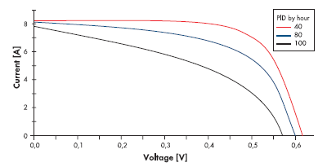
V-I Curve of the Module

Slide 32
Comparison of EL images of Modules

Slide 33
Impact of Potential Induced Degradation
Risk in achieving 25 years warranty life,
Gets worse with high temperature & high humidity
At early stage, PID is reversible by reverse voltage bias.
If allowed to progress, degradation becomes irreversible.

Slide 34
Challenges and solutions for PID
Since, environmental factors can not be controlled.
The Three level strategy with important factors is :-
Cell level – Anti reflective coating (ARC).
Panel level – Encapsulation Material,
System level – Negative Grounding or PV Offset Box.
(Grounding is possible in Central Inverters and not in
String Inverters, normally used for small capacity Plants)
In all new plants of DMRC PV offset boxes are used.

Slide 35
Action Plan to Reverse PID at site

Slide 36
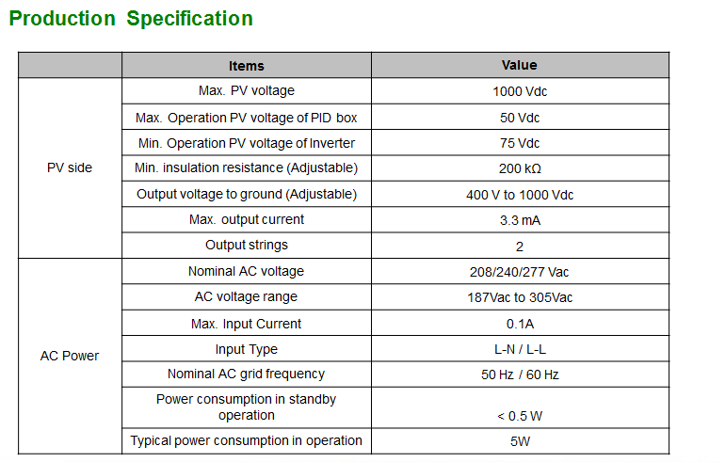

Slide 37
CONCLUSION

Slide 38
CONCLUSION
Performance parameters must be standardised to compare different Plants of developers on equal footing.
Potential Induced Degradation can seriously impact the Pay-back of the plants. While, entire PV system interacts to cause PID, the failure occurs in the modules.
While environmental factors are hard to control, the best solution is to minimize or eliminate PID by making design changes at the system, module and / or cell levels.

Slide 39
CONCLUSION (Contd...)
Many module manufacturers have taken steps to produce PID resistant modules, which currently are nearly 4 to 5% costlier than Normal module.
Early finalisation of IEC for testing the modules, is likely to help in proper certifications of “PID-resistant” modules.
Design of Solar Plant with string based Inverters must analyse grounding requirements carefully and include PV Offset Box.

Slide 40
THANK YOU

