Slide 1
Initiatives on Solar Energy on Northern Railway
By A K Singhal CESE/NR
04th August’2015

Slide 2
Northern Railway – statistics
784 stations over Northern Railway
2714 level crossing gates over five divisions
Consumes over 300 MUs of energy per annum for non traction purposes
Energy bill is over Rs. 200 Cr for non traction
All railway stations are connected to the grid supply
There has been a growing demand for additional power requirements for platforms/shelter illumination, fans, air conditioning, circulating area illumination and other passenger amenities

Slide 3
Solar energy – Vision 2020
Environmental sustainability is addressed as one of the four strategic national goal of IR
Reducing hazardous carbon emissions that have triggered climate change
Sourcing of atleast 10% of energy used from renewable sources such as solar power
Savings up to 15% of energy through improved energy efficiency in non traction use

Slide 4
Solar energy – Why?

Slide 5
Solar energy - advantages
Inexhaustible source of energy
Clean and environment friendly source
Noise free
Potential to meet significant portion of Railways present and future energy needs
Most promising renewable source of energy

Slide 6
Solar energy – Road blocks
Higher initial cost
Large area requirements
Location and orientation of the power panels
Low efficiency
Low reliability as dependent on weather and available only in day time
Reduced power output due to Pollution

Slide 7
Consumption of Electrical Energy on Northern Railway (Non traction)
Year | Energy Consumption (MUs)
2010-11 | 321.36
2011-12 | 316.06
2012-13 | 317.74
2013-14 | 322.70
2014-15 | 335.37

Slide 8
Solar Energy technology – Lead time
Type of power plant | Lead time (from decision to start up) in years
Hydro electric plants | 20
Nuclear Plants | 8-10
Coal/Oil fired plants | 5-7
Gas turbine power plant | 2
Solar PV panel based power plant | 1

Slide 9
Solar energy – applications

Slide 10
Solar energy application areas
Railway Stations
Railway Coaches
Office buildings
Educational/Institutional buildings
Level crossing gates
Street lights
Running rooms
Hospitals

Slide 11
Potential of Solar Power Panels (Roof top of station and other institutional building)

Slide 12
Solar energy – opportunities
Conducted preliminary survey over five divisions to identify the available roof top area at railway stations, office buildings, hospitals and other institutional buildings
3,50,000 sq m approx. roof top area has been identified which shall be verified for its suitability for harnessing the solar energy
In addition, 1,90,000 sq m of land area has also been identified over the five divisions
This has a potential of 100 MW approx. as per the present solar potential norm of 4-5 kwh/sqm/day

Slide 13
Solar energy – Issues
Mitigation measures
Adaptation of solar energy
Technical matters
Policies
Finances, subsidies

Slide 14
Solar Powered plants on roof top of buildings (completed projects)

Slide 15
Solar power panels installed on Roof top of railway stations, office buildings and hospitals
Capacity of solar power panels | Railway Stations | Office buildings | Hospital and other institutional buildings
Up to 4 KWp | 08 | 04 | --
10 KWp | 19 | 08 | 01
20/25 KWp | 04 | 03 | --
1 MWp | 01 | -- | --

Slide 16
Solar Powered Plants Installed on Roof Top of Railway Stations, Office Buildings and Hospitals

Slide 17
Solar panels installed at level crossing gates and stand alone solar street lights on NR
1. No. of level crossing gates | 2714
2a) No. of level crossing gates with solar lights | 519
2b) No. of level crossing gates with solar and SEB lights | 326
2c) No. of level crossing gates with solar lights – planned for 2015 | 350
Total | 1195
3. No. of solar street lights (stand alone) | 404

Slide 18
Installation of Solar Power Panels (Roof top of station building)

Slide 19
10 KWp SOLAR POWER PLANT AT TALWANDI RAILWAY STATION, FZR

Slide 20
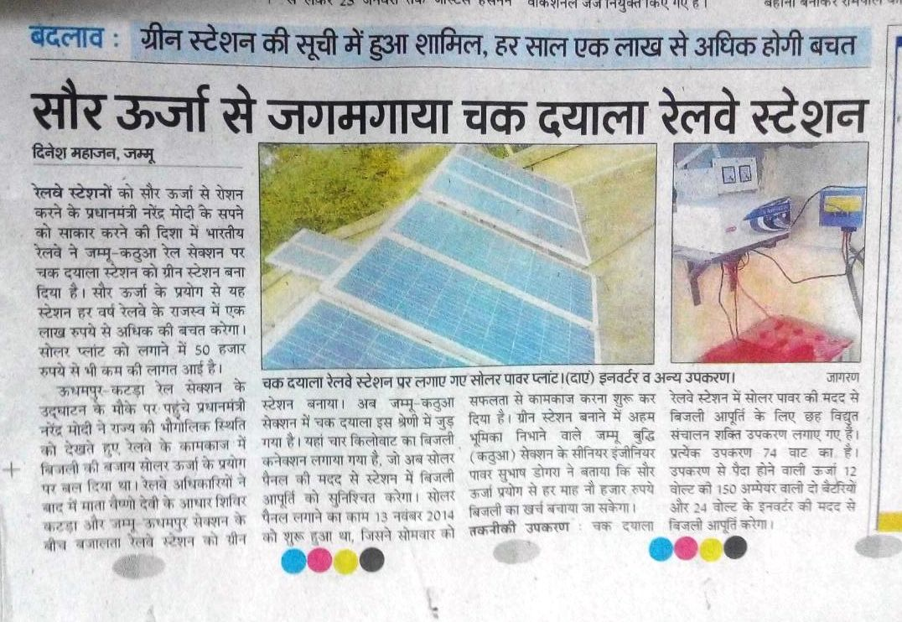
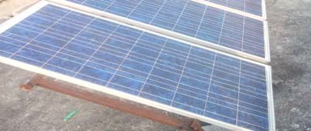
SOLAR POWER PANEL AT CHAK DAYALA RAILWAY STATION, FZR

Slide 21
30 KWp SOLAR POWER PANELS AT GGN RAILWAY STATION, DLI

Slide 22
30 KWp SOLAR POWER PANELS AT RAIL BHAWAN, DLI

Slide 23
Green Initiative on Rail Coaches – A case study of Northern Railway

Slide 24
Use of Solar Energy to Power NG Rail Coaches
Northern Railway for the 1st time experimented feeding of lighting load on Narrow Gauge rail coaches of KLK-SML & Kangra Valley sections by Solar PV cells in 2012
Cost of Electrical energy in SG systems is above Rs 15-20 per unit
Solar PV based electric energy on the top of coaches can power Rail Coaches with benefits of green energy

Slide 25
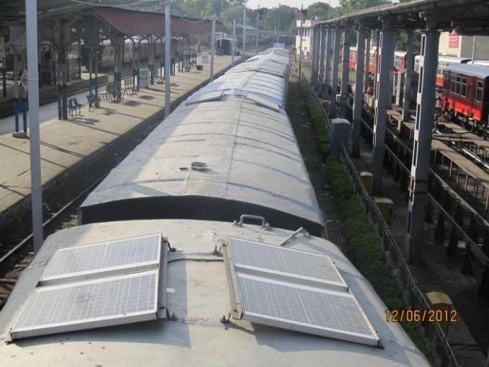
Narrow Gauge Rake with Solar PV cells on the top

Slide 26
APPLICATION ON BG COACHES
One BG GS COACH 20022 was provided with Solar PV Units during December’14 for Technology demonstration
Unit details: Area available on the coach 40 m² 12 Panels of 300Wp each 3.6 kWp Area covered by 12 panels 24 m² Area left uncovered 16 m² Each Module has 72 cells (0.416V) Solar Panel System voltage 120 V Rating of Charge Controller 110V, 30A (Voltage range 90-135 V DC) Total weight of system @ 22 Kgs/module 264 Kgs
System uses existing coach battery of 120Ah, 110V

Slide 27
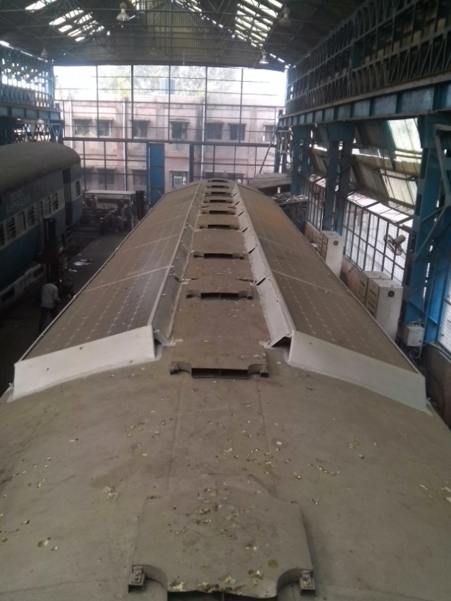
BG Coach with Solar PV cells on the top

Slide 28
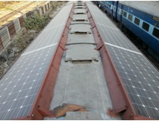

Slide 29
Trial run results
During Winter: Generation period 7 Hrs
Average generation is about 6.5 A
Maximum current generated 13.5 A
Average Power generated 5.1 kWh
Power req. with 12 hrs working/day in winters with LED lights 3.17 kWh

Slide 30
Trial run results
During Summer: Generation period 7 Hrs
Average generation is about 22.2 A
Maximum current generated 33.5 A
Average Power generated 23.3 kWh
Power req. with 12 hrs working/day in winters with LED lights 19.2 kWh

Slide 31
Challenges in system installation
Design the system to take care of wind pressure loads up to a speed of 120 kmph
Giving aerodynamic shape to the complete assembly
Matching the channel of the panel with the coach body channels
Taking extra precaution by strengthening & welding the bolts & channel together
Ensure no water leaks from the bolt fixing point

Slide 32
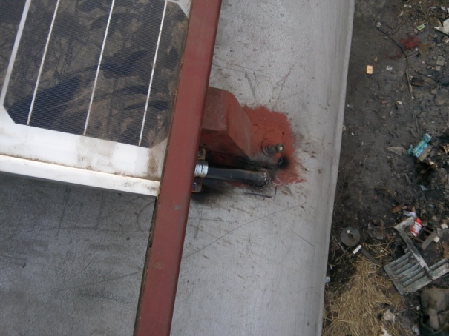

Slide 33
Challenges in system installation (contd.)
Keeping height of panel within SOD
Reducing coach electric load by providing LED lights & BLDC fans
Fixing of Charge Controller inside the coach above Rotary Junction Box
Providing facility of connection with the adjoining coach

Slide 34
Solar Energy – challenges ahead

Slide 35
Challenges ahead for solar energy
Proper installation of solar panels
Cleaning of solar power panels
Reduced cost of solar energy per unit
Proper metering
Proper use of generated solar power
Training needs

Slide 36
Future Ahead for Solar panels on coaches
A system can be adopted wherein the solar PV module fitted coach can work independently without alternator & having TC with the adjoining coach
Increase the coach availability as line failures on account of Alternator/Belt would reduce
Higher capacity PV cells to be explored to enhance generation capacity
PV cells may be of laminated type and provided as part of roof only
Higher capacity VRLA battery bank be used

Slide 37
Solar Energy – Opportunities and Barriers

Slide 38
Solar energy – opportunities
Energy Access It was a challenge to provide electrical energy at remotely located level crossing gates and way side stations. In 2011, more than 165 LC gates lacked access to electricity. While all the stations are connected with grid today, all the LC gates shall have the access to electricity by end’2015.
Energy Security It is robustness against (sudden) disruptions of energy supply. More specifically, availability and distribution of resources, as well as variability and reliability of energy supply is ensured.
Climate Change mitigation and reduction of environmental and health impacts It is one of the key driving forces behind a growing demand for RE technologies. In addition to reducing GHG emissions, RE technologies can also offer benefits with respect to air pollution and health compared to fossil fuels.

Slide 39
Solar energy – Barriers
Institutional and policy barriers Enabling environment for innovation and Revised Technical regulations
Socio-cultural barriers Impacts on natural habitats, natural and human heritage sites including impacts on biodiversity and ecosystems, landscape aesthetics, and water/land use rights as well as their availability for competing uses
Information and awareness barriers Energy standards, information campaigns and technical training

Slide 40
Installed solar power on Northern Railway
Divisions | Installed capacity (KWp)
DLI | 302
UMB | 185
MB | 139
LKO | 202
FZR | 1114
Total | 1942

Slide 41
Solar energy – Future ahead……
Water pumping
Solar heating
Solar illumination – day light pipes
Solar panel based shelters at stations

Slide 42
THANK YOU

Slide 43
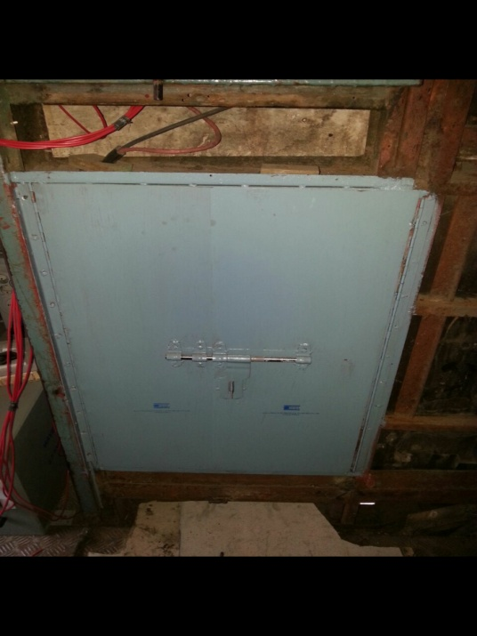
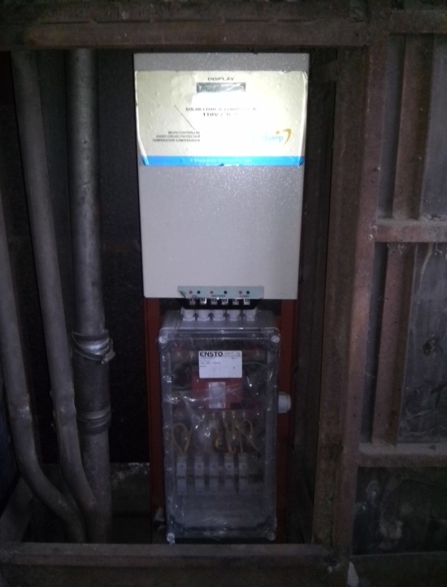
Shifted Rotary Junction Box
Charge Controller

Slide 44
Schematic diagram
 |  |  |  | 300Wp |  |  |  |  |  |  |  | 300Wp
 |  |  |  | 300Wp |  |  |  |  |  |  |  | 300Wp
 |  |  |  | 300Wp |  |  |  |  |  |  |  | 300Wp
 |  |  |  | 300Wp |  |  |  |  |  |  |  | 300Wp
 |  |  |  | 300Wp |  |  |  |  |  |  |  | 300Wp
 |  |  |  | 300Wp |  |  |  |  |  |  |  | 300Wp
 |  |  |  |  | JUNCTION BOX
EXISTING BATTERY BANK, 110V, 120Ah |  |  |  | CHARGE CONTROLLER, 110V, 30A
 |  |  |  |  | LOAD
Solar Module

Slide 45
Coach with Solar panel without alternator |  | Normal Coach with 4.5 kW alternator |  | Coach with Solar panel without alternator |  | Normal Coach with 4.5 kW alternator

Slide 46
Financial viability of system with complete roof covered with PV modules
Cost of provision of solar panel = 6.0 Lacs/coach
Saving with solar panels/coach/annum = Rs 1.27 Lacs Av. Generation by solar energy for the complete year = 9.55 Units/Day Saving with solar panel per annum = 3486 Units Saving of revenue @ 15.88/Unit = Rs 55,358.00/Annum Saving due to low maintenance = Rs72,000.00/Annum Effective saving per year = Rs 1,27,358.00/Annum
ROR is about 5 years

Slide 47
Saving due to maintenance in solar coach
For a rake of 20 coaches Minimum 2 skilled & 2 unskilled staff are deputed for underframe
Minimum staff/day/coach = 0.1 skilled & 0.1 unskilled
Staff expenditure/coach/month 6000.00 Staff expenditure/coach/year 72000.00

