Slide 1
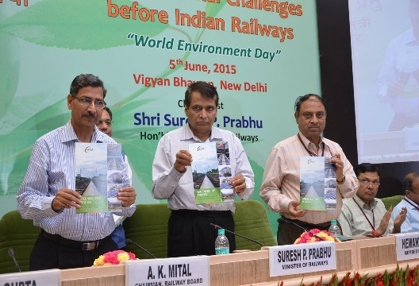

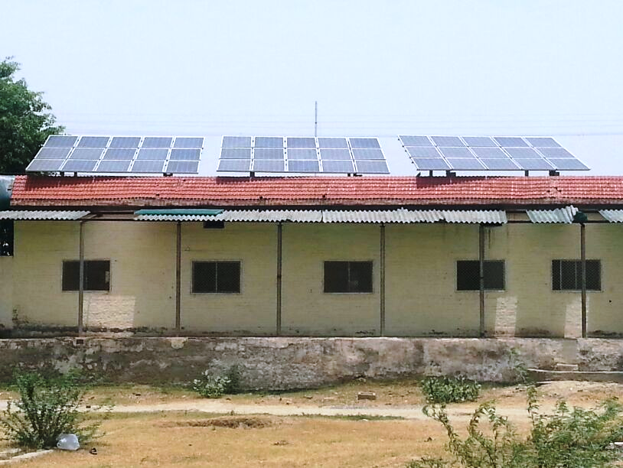
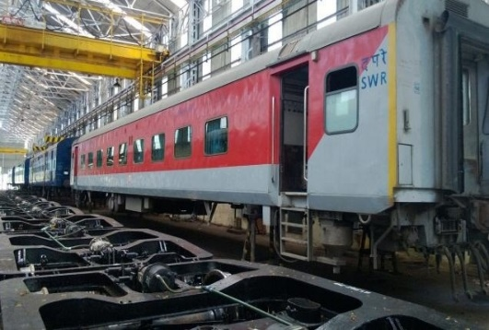
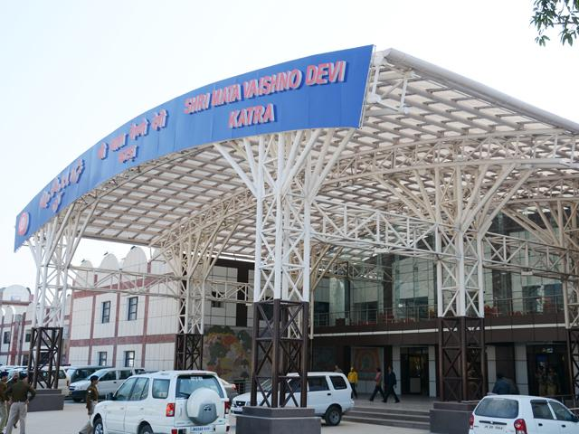

Indian Railways: Greening the tracks
Achieving the 1 GW solar PV target
Aditya Ramji
Junior Research Associate
Council on Energy, Environment and Water
Solar Energy Opportunities in the Rail Sector
New Delhi, 4 August 2015
© Council on Energy, Environment and Water, 2015
Image Source: Ministry of Railways, Govt. of India

Slide 2
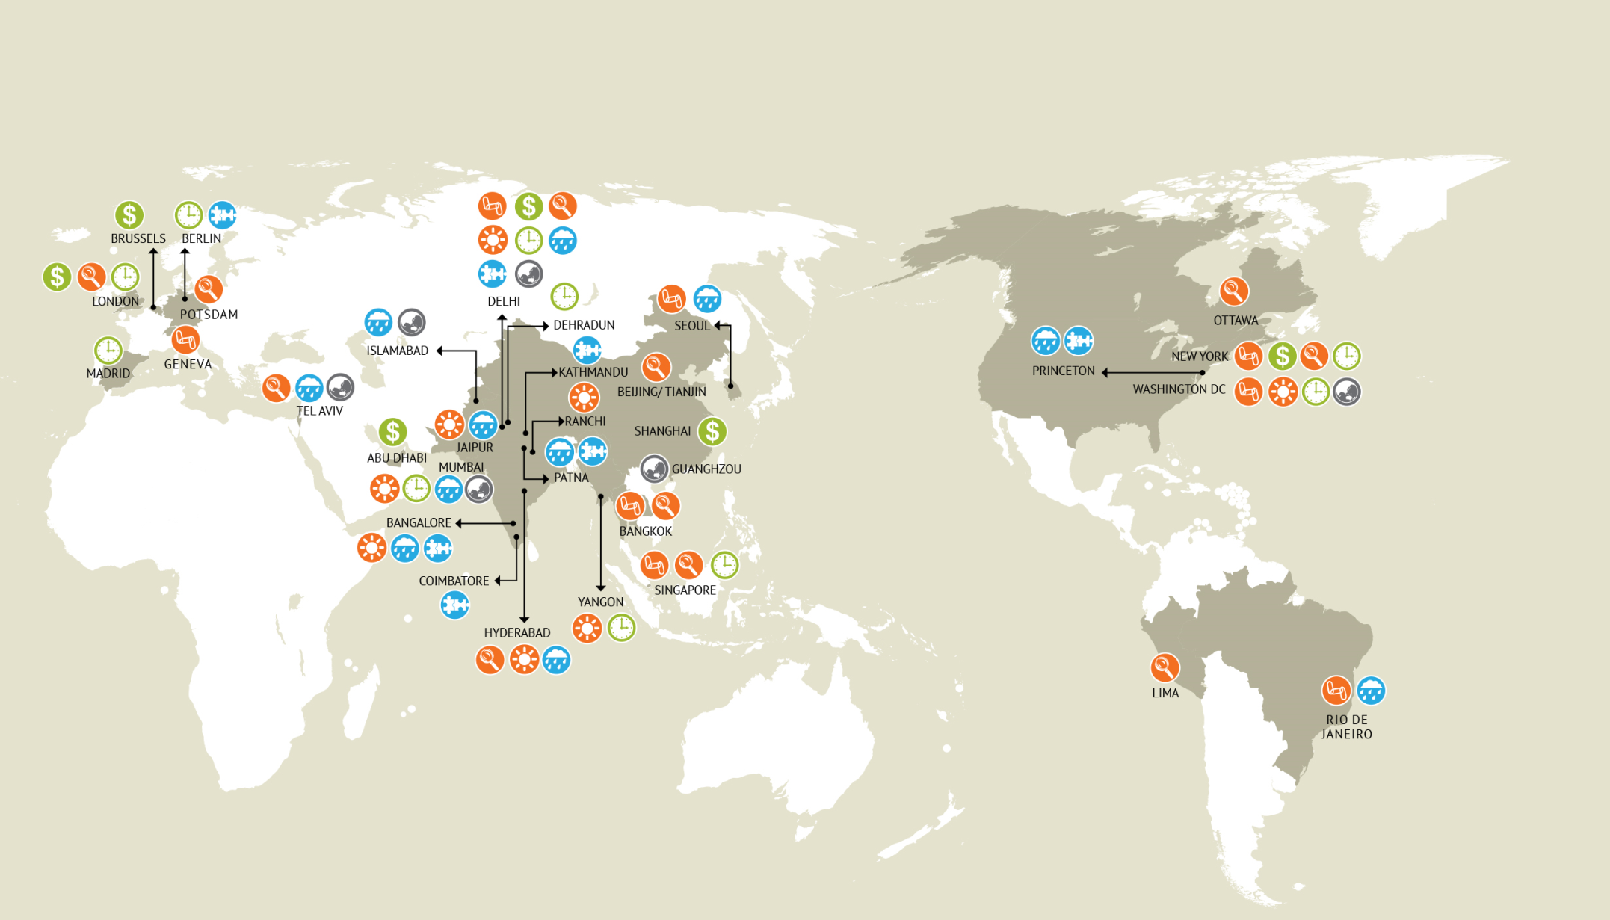
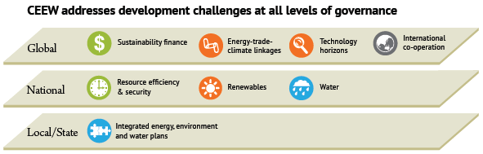
CEEW: one of India’s leading think-tanks

Slide 3
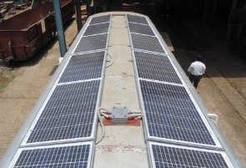
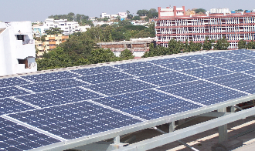
Indian Railways: Towards a sustainable transport system
Realising a cost-effective energy system with least environmental impact ?
Union Rail Budget 2015-16
Integrated Transport Solutions
Vision 2020
Efficiency
Affordable
Environmentally Sustainable
Renewable Energy
SOURCE: CEEW 2015

Slide 4
Assessing the potential of solar PV in IR
Assumption | Scenario 1 (Optimistic) | Scenario 2 (Conservative)
Availability of rooftop area in diesel sheds, electric sheds, and workshops | 70% of total covered area | 50% of total covered area
Railway stations | All railway stations (over 8000) would have a 10kWp system, at a cost of INR 1,25,000 per kWp, including battery based storage | All Class-E railway stations (about 4000) would have a 10kWp system, at a cost of INR 1,25,000 per kWp, including battery based storage
Use of vacant railway land | 5% of vacant railway land to be diverted for installation of large solar PV | 1% of vacant railway land to be diverted for installation of large solar PV
 | The land required for setting up 1 MW of large scale solar PV is 5 acres. Cost is assumed to be INR 6.5 crore for projects of sizes 1 – 10 MW. Given that land availability is not contiguous in nature, most projects will be in the range of 1 – 10 MW.
    Techno-economic analysis considering non-traction operations
    Sixteen Zones: Loco-sheds (diesel and electric), workshops, stations, offices, LCGs, railway land
    Cost-Benefit Analysis: 100kWp plant @ INR 5.51/kWh, with payback of 10 years
SOURCE: CEEW 2015

Slide 5
Estimated solar PV potential
 | Railway Unit | Optimistic |  | Conservative
 |  | Capacity (MW) | Costs (INR crore) | Capacity (MW) | Costs (INR crore)
1 | Diesel/Electric/EMU Sheds | 16.33 | 122.45 | 11.66 | 87.46
2 | Railway Workshops | 67.82 | 508.62 | 48.44 | 363.30
3 | Railway Stations
3.1 | Already proposed (REMCL) | 5.25 | 52.50 | 5.25 | 52.50
3.2 | Additional potential | 79.70 | 797.00 | 41.58 | 415.80
4 | Level Crossing Gates (LCGs) | 6.10 | 97.60 | 6.10 | 97.60
5 | Street Lights | 0.22 | 0.44 | 0.22 | 0.44
6 | Railway Offices (Proposed by Ministry of Railways) | 0.76 | 23.73 | 0.76 | 23.73
7 | Total (1-7) | 260.32 | 2237.40 | 174.11 | 1491.59
8 | Large PV potential
8.1 | 5% land utilization | 1109.35 | 7210.80
8.2 | 1% land utilization |  |  | 221.87 | 1441.16
9 | TOTAL (7-8) | 1369.67 | 9444.20 | 395.98 | 2933.75
SOURCE: CEEW 2015

Slide 6
Emission savings across railway operations
Cumulative emission savings over a 25 year period
~ 12.5 Mt CO₂ in the ‘Conservative Scenario’
~ 45 Mt CO₂ in the ‘Optimistic Scenario’
SOURCE: CEEW 2015

Slide 7
Achieving targets: The way forward
Could lead to returns of about 7% – 9 % over the project life time
Unleashing finance through a participative approach
      Guaranteed consumer – low risk to developer
      Developer owned or railway owned
      Leveraging NCEF and proposed mechanisms under the draft RE Act
Use of railway land: Asset or liability ?
      Zero risk in terms of land-acquisition
      Opportunity cost ?
      Case to case basis for planning & execution
Streamlining institutional mechanisms
      Energy audits and integrated infrastructure development
      Monitoring system and documentation
      Coordination between nodal departments and training programmes
Phase-wise planning is critical
      Northern, Central and South-Central Railway can be focused on for Year 1
SOURCE: CEEW 2015

Slide 8
THANK YOU
http://ceew.in

