Slide 1
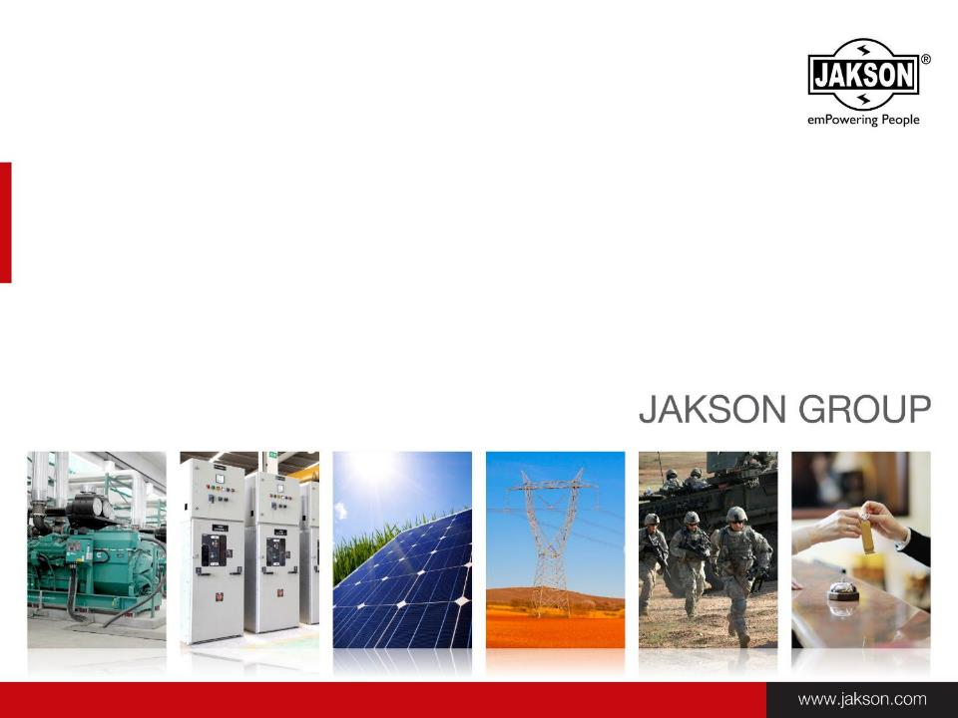

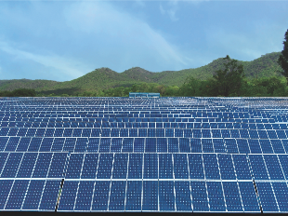
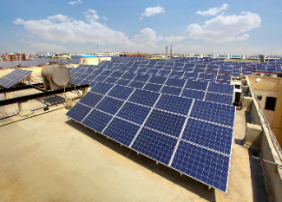

Solar Rooftops for the Railway Sector
4th August, 2015
www.jakson.com

Slide 2
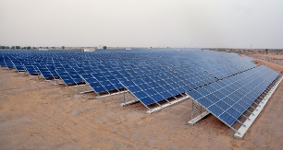
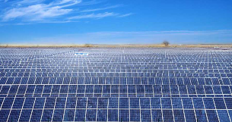
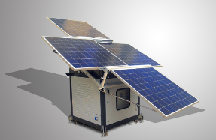
Our Solar Business
Solar IPPs
Solar EPC & Components
Solar Products & Systems
Selling power to Govt. entities and private customers through long term PPAs
Turnkey EPC for Utility scale & Rooftop power plants
On-grid & Off-grid solar systems
PV plant components
Portfolio of innovative solar products
Mini/Micro Grids
Solar Pumping Systems
Solar Street Lighting Systems

Slide 3
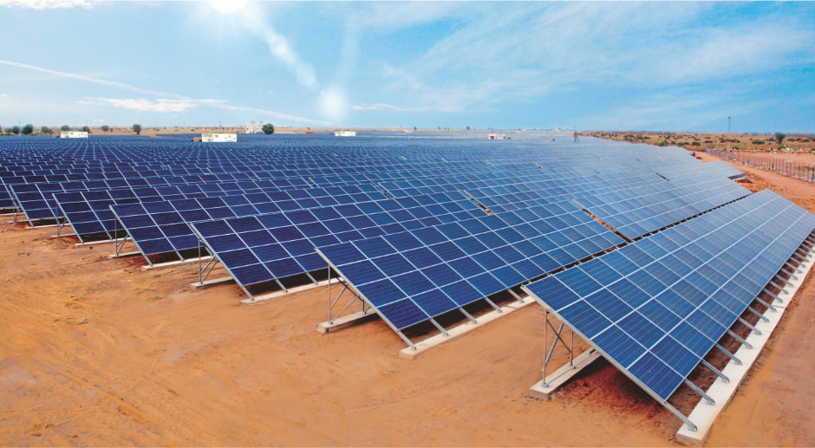
Solar IPP
Key Offerings
Setting up of MW scale land based Solar Power Plants under long term PPAs to sell power to Government entities.
Setting up rooftop solar power plants on BOOT/ BOO basis under long term PPAs to sell power to private customers.

Slide 4
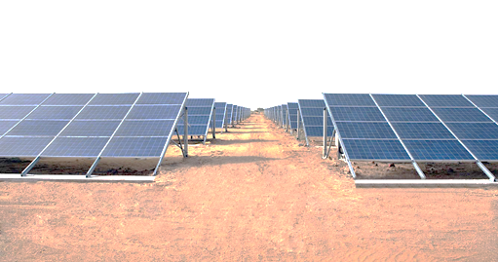
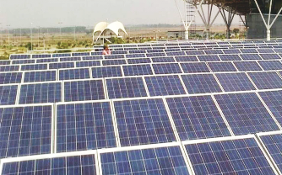
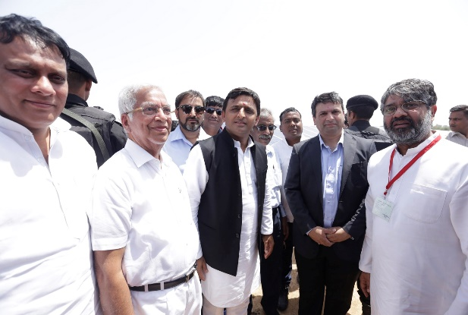
Solar IPP
Current Land Based IPP’s - 60 MW
20 MW Solar Power Plant in Bap, Rajasthan in operation since March 2012
10 MW Solar Plant in Uttar Pradesh commissioned in March, 2015
30 MW Solar plant in UP . Plant to be commissioned by March, 2016
Current Rooftop IPP’s – 2 MWp
  250 kWp for Delhi Metro Rail Corporation, Delhi
  400 kWp for Delhi Development Authority, Delhi
  100 kWp for Airport Authority of India, Raipur
  200kWp for Shriram Properties, Chennai
  200 kWp for Maharashtra Sadan, Delhi
  450 kWp for CPWD, Delhi
  100 kWp for UPSC, Delhi
Plan to own 200 MW solar power plants in three years
* Bap, Rajasthan
* AAI, Raipur
Launch of 10 MW Solar Power Plant at Laiatpur UP

Slide 5
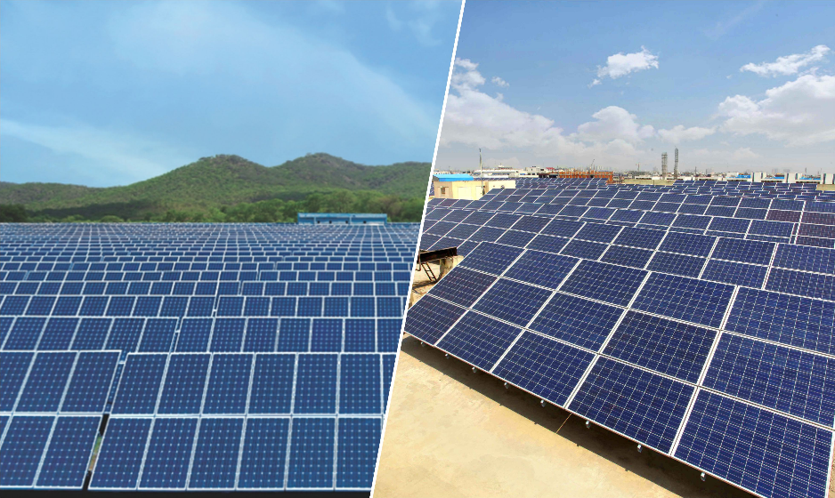
Solar EPC & Components

Slide 6
Solar EPC & Components
Key Offerings
Turnkey EPC and O&M services for Utility scale solar power plants
Turnkey EPC and O&M for Rooftop solar power plants
Supply of Solar Power Plant Components for MW projects
  Solar Inverter Sub-station (SISS)- Introduced in 2012
  String Combiner Box ( SCB)- Introduced in 2012
  Module Mounting Structures (MMS)- Introduced in 2014
  PV Modules- to be introduced in Aug 2015
Site Survey
Design & Engg.
Equipment Supply
Installation & Comm.
O&M

Slide 7
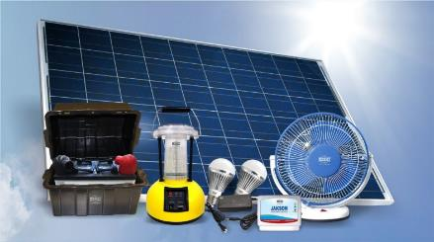
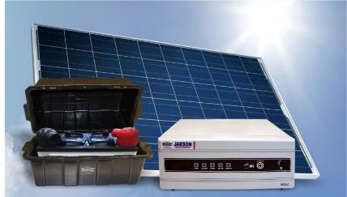
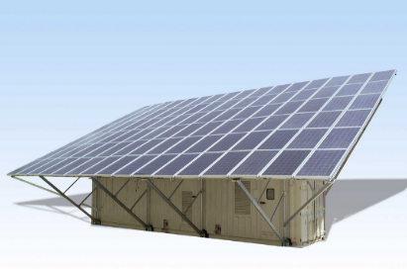
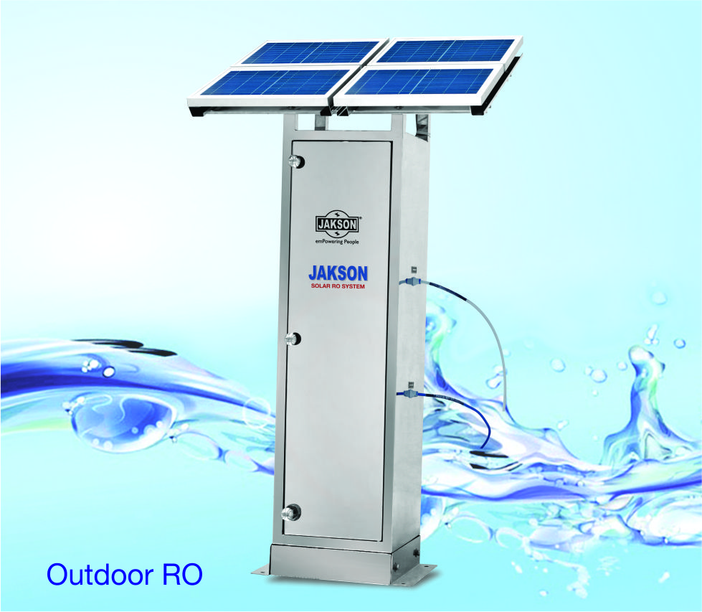
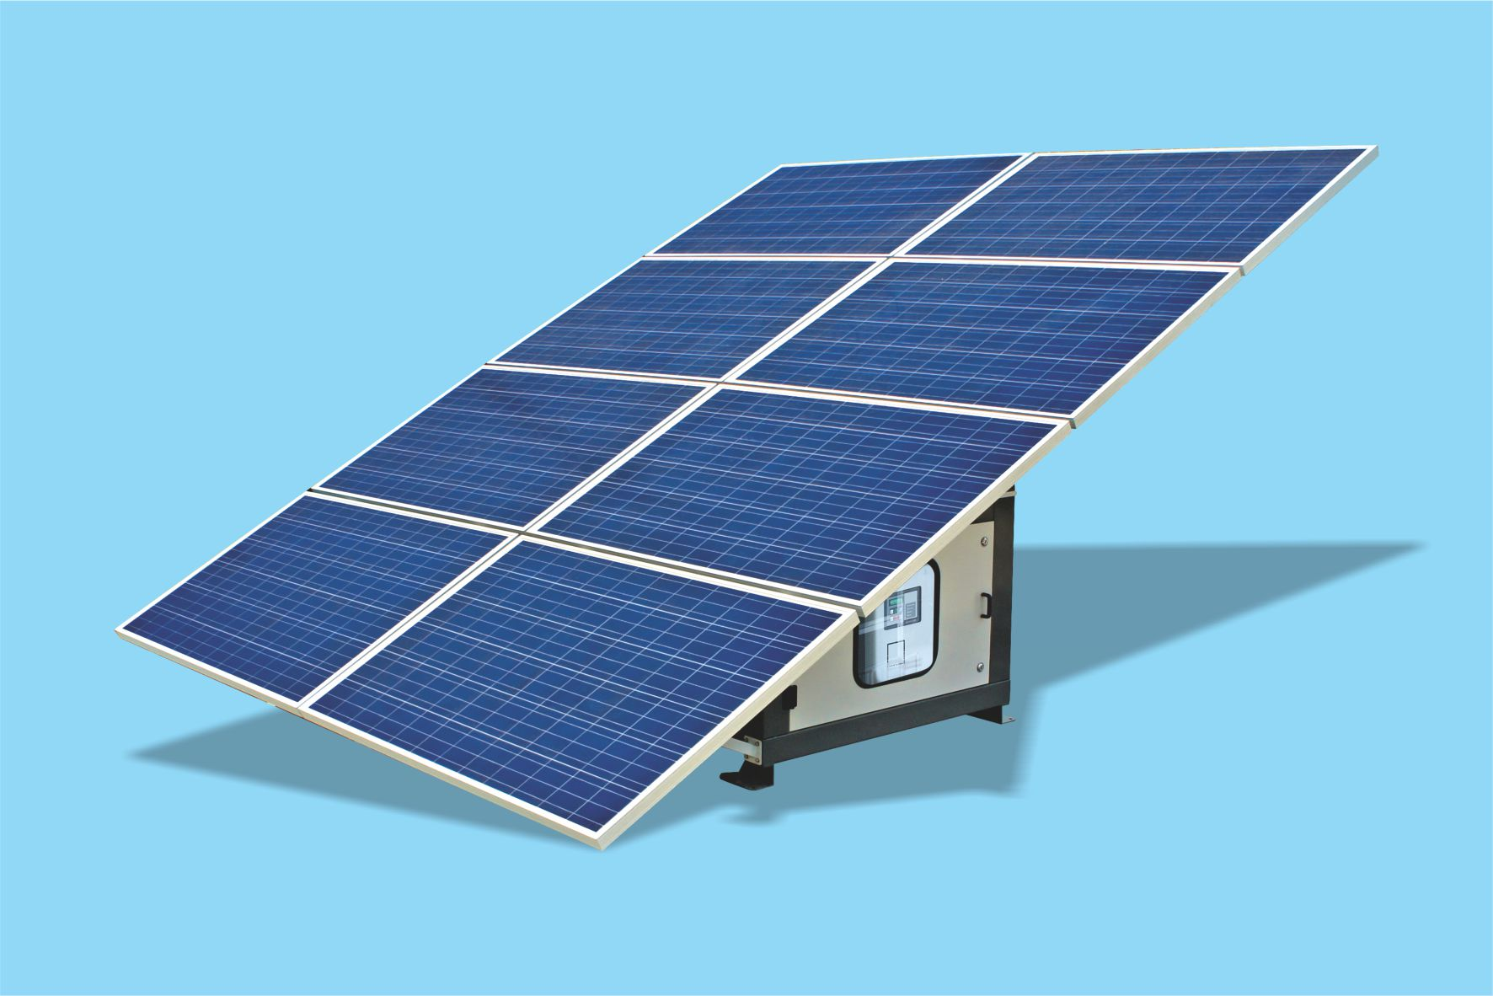
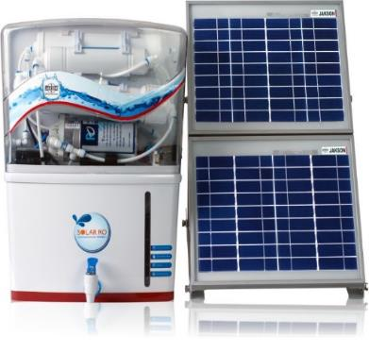
Solar Various Products Ranges
40 & 100 Wp DC HLS
150 & 250 Wp AC HLS
Containerized Solar
Generator 15 KW- 30 KW
Solar Generator
1 – 4 KW
Solar RO System For Various
Indoor & Outdoor Application

Slide 8
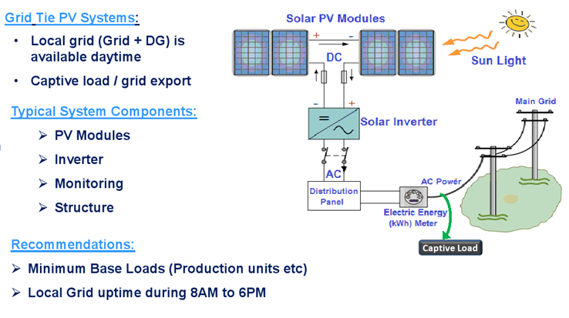
Solar PV Systems (On-Grid)

Slide 9
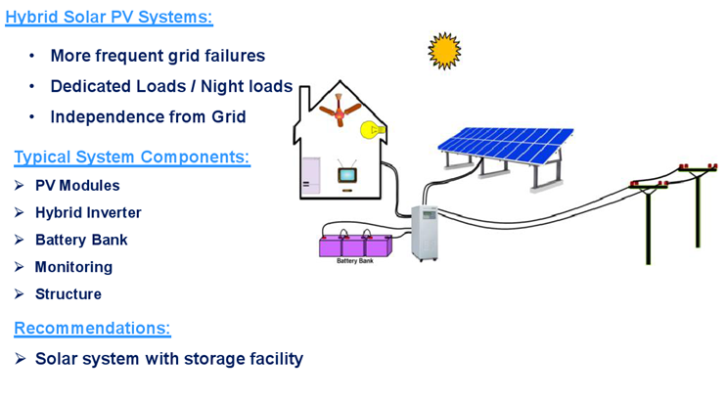
Solar PV Systems (Off Grid)

Slide 10
DMRC’s Solar Need
Major Highlights:
Present Demand of around 150 MW.
Monthly Power Bill of approx Rs. 40 Cr.
Approx. 45% of Total expenditure.
Delhi Metro is the 13th largest metro rail system in the world in terms of length. Power Demand is more in Summers due to increase in air conditioning load at stations and trains. Mostly Electricity is generated from fossil fuels like coal, gas, which generate Carbon dioxide adversely affecting the environment.
To formalize and channelize efforts, Solar Policy was issued on dated 16.07.14. This policy indicates a clear Target of 20 MWp in next 3 years.

Slide 11
DMRC-JAKSON Initiative
Honoring the dedication & implementation of Solar Policy, we JAKSON did the successful execution of following 3 sites;
Anand Vihar Metro Station:- 115 kWp
Pragati Maidan Station:- 85 kWp
Metro Enclave:- 50 kWp
TOTAL :- 250 kWp

Slide 12
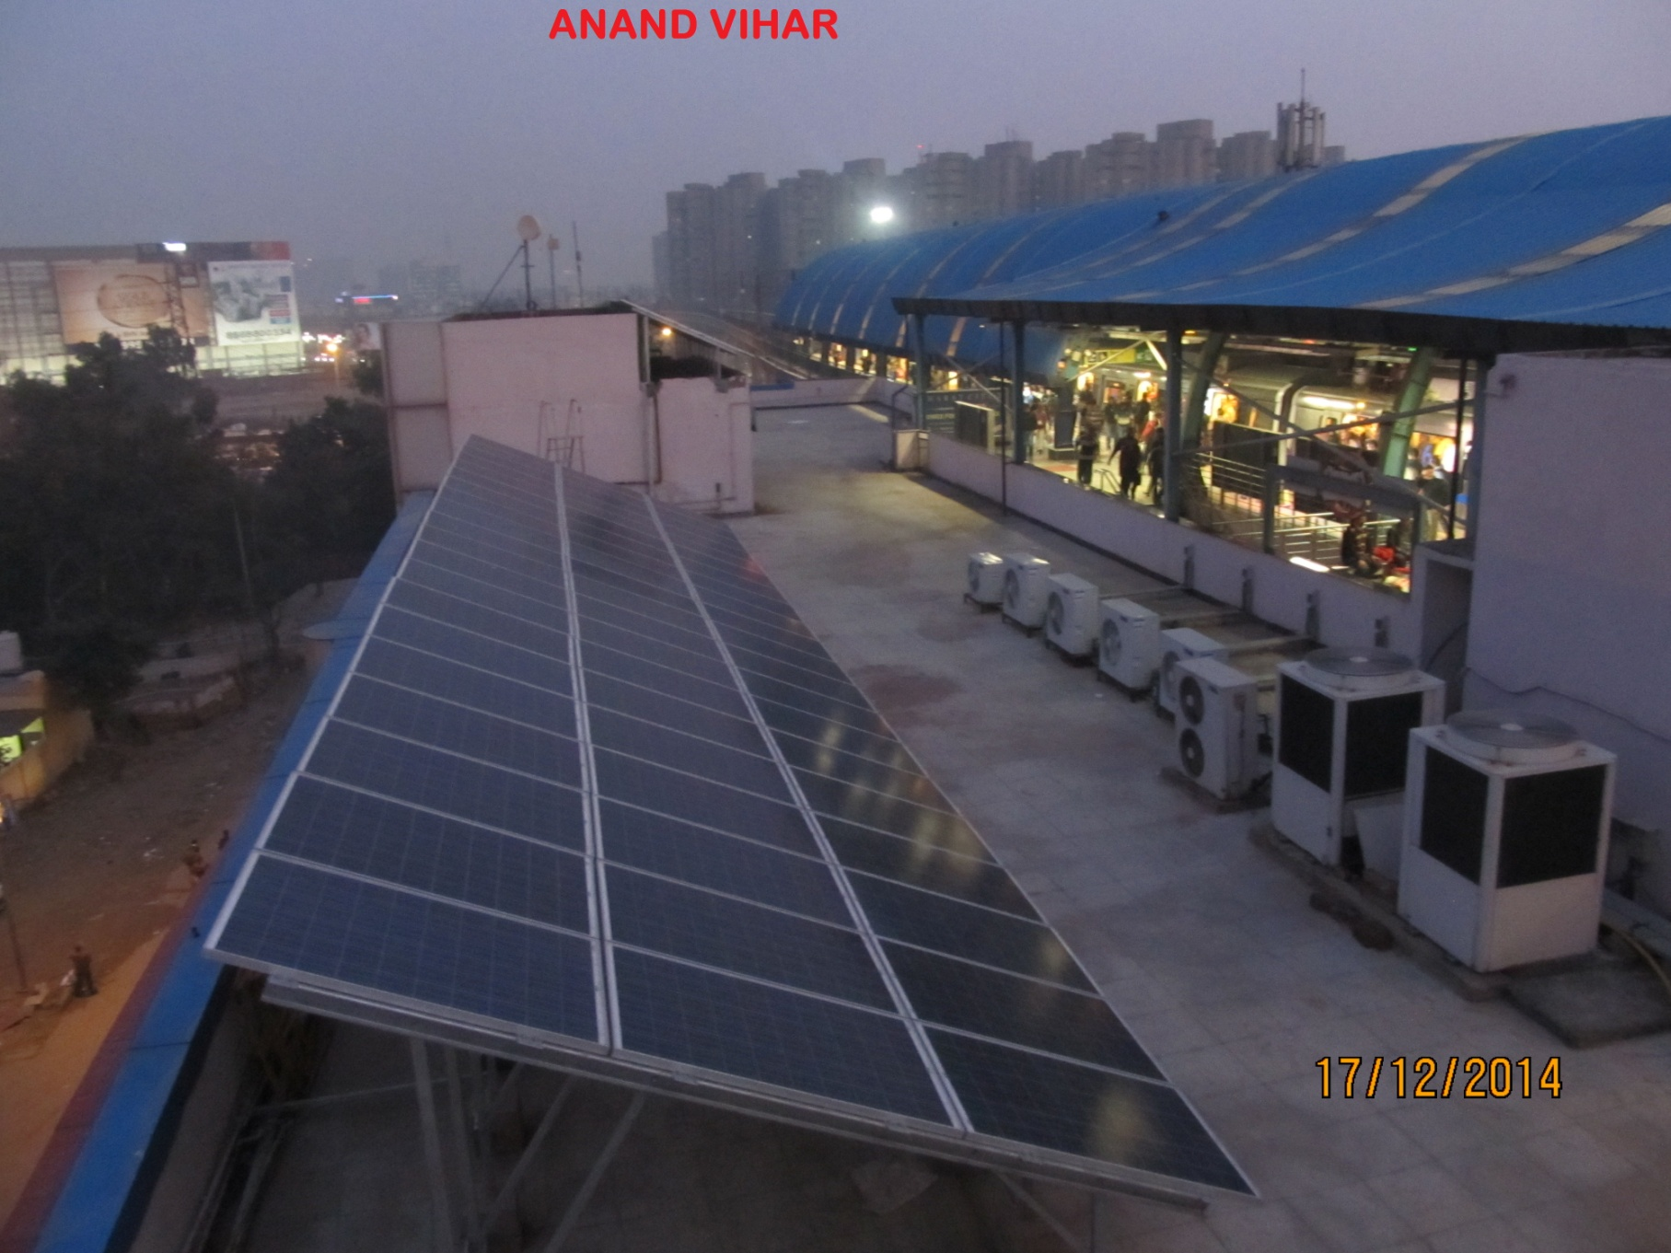
ANAND VIHAR STATION

Slide 13
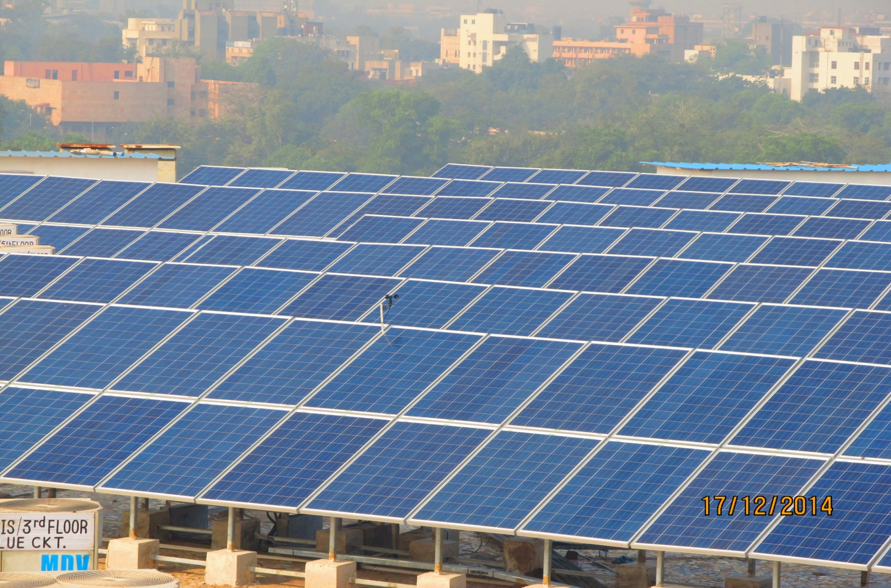
PRAGATI MAIDAN STATION

Slide 14
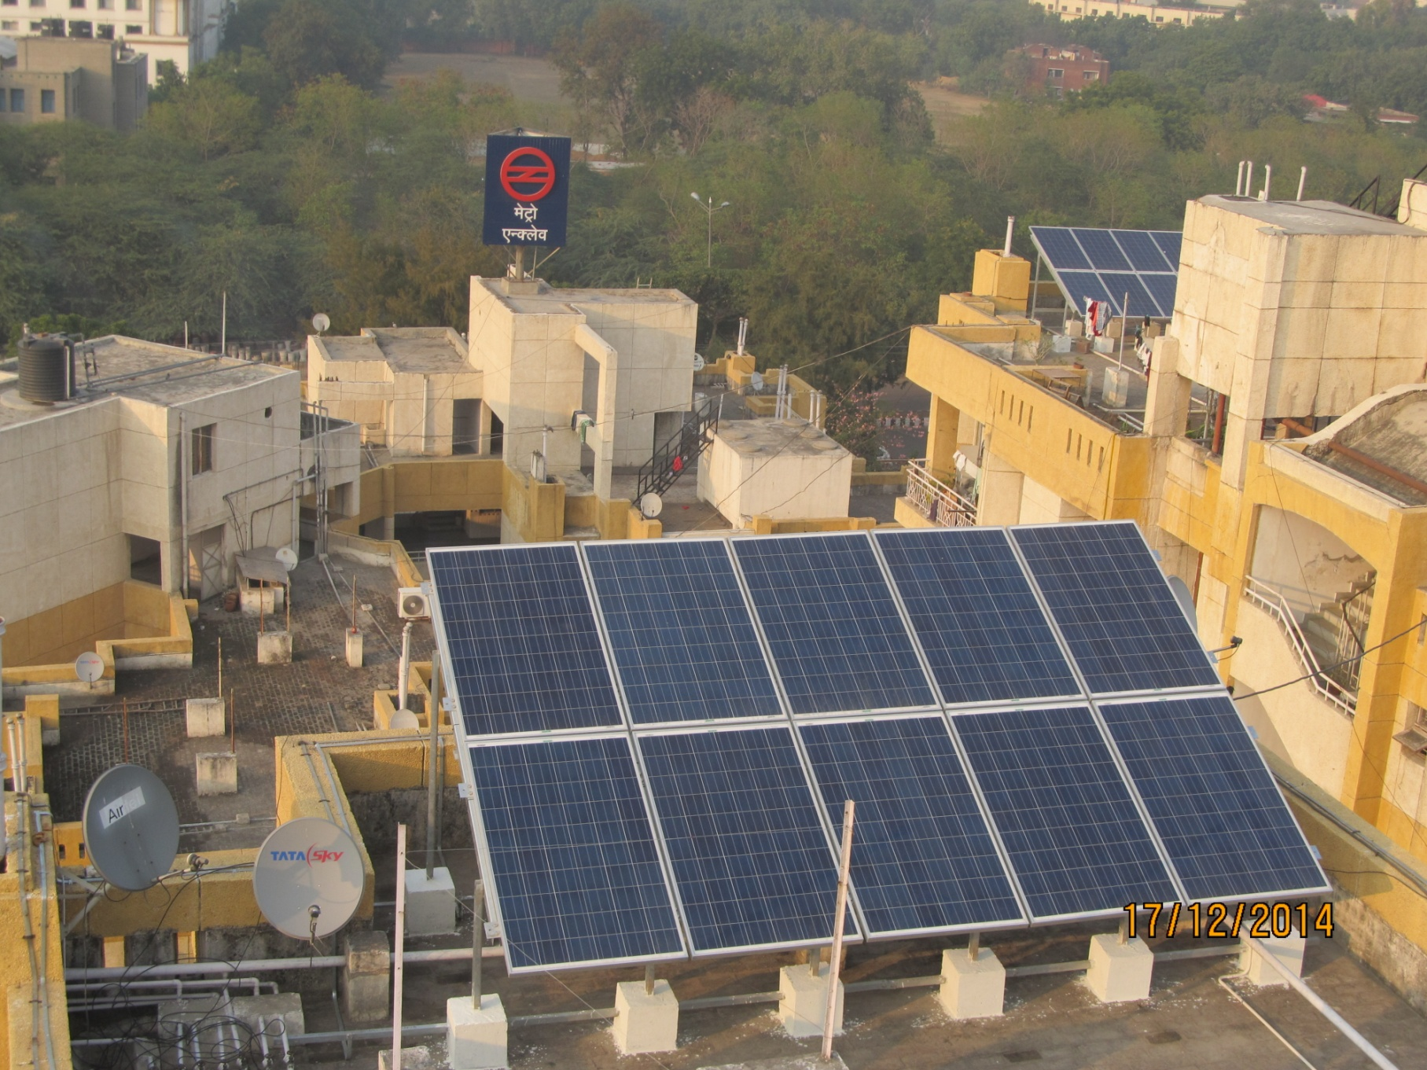
METRO ENCLAVE

Slide 15
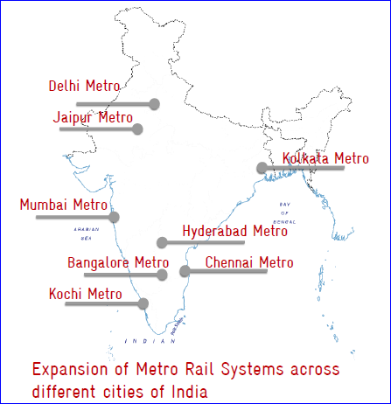
High Solar Potential
After analyzing such a tremendous potential, DMRC has been entitled as an implementing agency for National Solar Mission.
Granted Central Financial Assistance of Rs. 25.50 Cr. (15% of Benchmark Cost) for installing 20 MW.
Other major cities such as Ludhiana, Pune, Lucknow, Ahmedabad, Indore, Bhopal, Chandigarh, Nagpur and Guwahati are also mooting proposals on developing metro rail systems in their respective areas.

Slide 16
Indian Railways(IR)- Potential
An Introduction
The Indian Railways, with a network of over 64,000 route-km, is the fourth largest railway network in the world in terms of length, and the world’s third largest in terms of traffic density, and commonly recognised as the ‘lifeline to the nation’.
Vision
The Ministry of Railways ‘Vision 2020’ document issued in 2009. One of the key targets was to ‘utilize at least 10% of its energy requirement from renewable sources and institute a foolproof eco-friendly waste management system.’ The Union Rail Budget 2015-16 stressed the need for harnessing solar energy and identified railway stations as one of the largest potentials for the same.
Roadmap
IROAF(Indian Railways Organization for Alternate Fuels) will lead the IR in introduction of Solar Energy on rolling stock for train lighting and auxiliary power needs. SPV systems will also be used for augmenting lighting of fixed installations, such as workshops, factories and stations.

Slide 17
Why Solar in IR?
Railway sector growth 8-9%
Progressive shift of freight traffic to railway
80% of rail freight and 60% passenger traffic on electric energy by 2030
Electricity demand to go 100 billion kWh by 2030 for railway sector alone in India
The current trends indicates constraints in indigenous availability of conventional energy resources
World trend to achieve min. 25% through RE by 2020 in transport sector leader Germany, Sweden, USA
No space constraint
Fuel diversity

Slide 18
IR-Energy Utilization Pattern
Electricity Consumption: 16.6 billion units (14.16 billion units Traction & 2.46 billion unit for Non Traction) ~`~ 2500 MW
~~ 3800 MW (peak) , (22 billion unit, 5000 MW XII Plan projected)
Electricity Consumption (Non Traction) - Workshop 25%, Station and service building 35%, pumping 10%, domestic 30%
Share in Total Energy Consumption (NATIONAL) - 2 %
Share in Total Energy Consumption of Transport sector- 5 %
( 77 % diesel, 23 % electricity)
Share of Energy in Total Operating Cost of IR – 24% (18,000 Cr, 8700 Cr for Electricity) (87 % traction, 13 % non- traction)

Slide 19
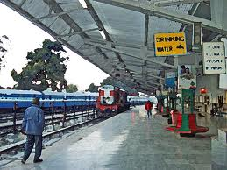
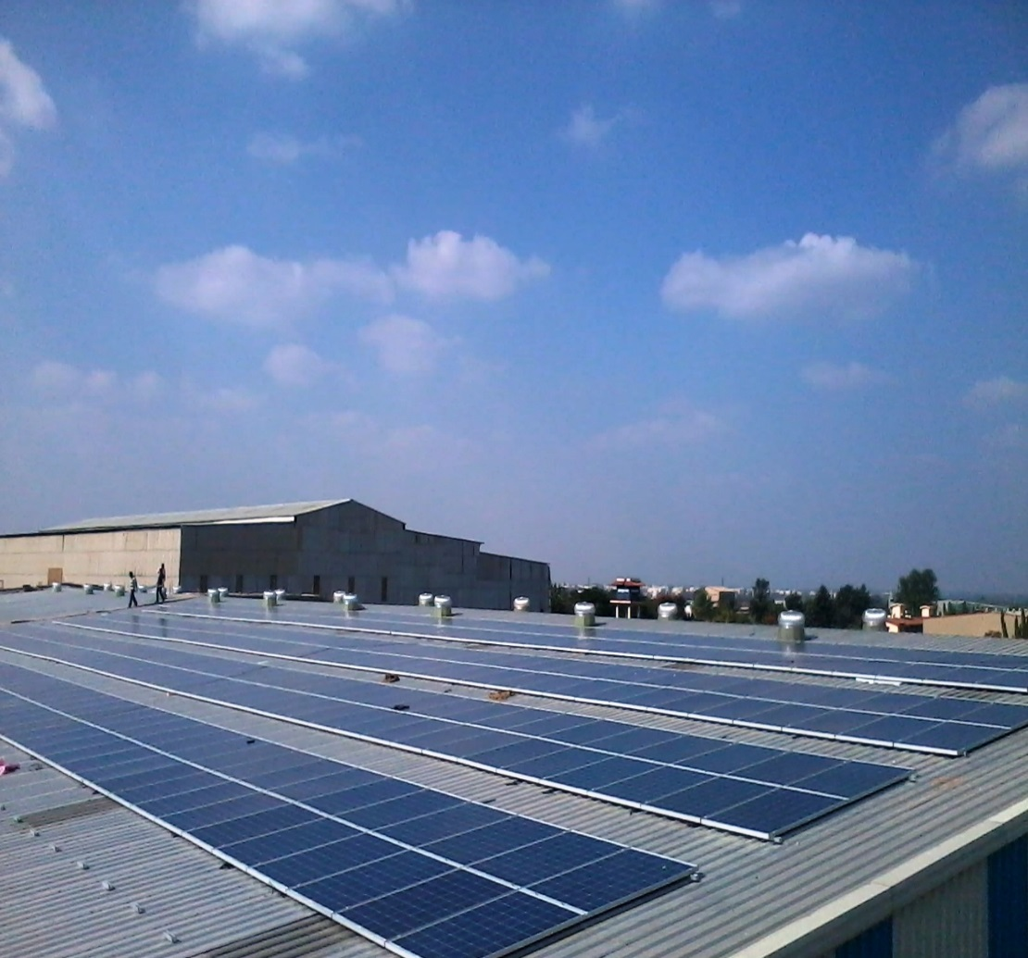
Indian Railways - Solar PV Potential
Roofs of Railway Stations.
Railway Workshops.
Railway Colonies.
Coach factories.
Office buildings.
Loco sheds.
Hospitals.

Slide 20
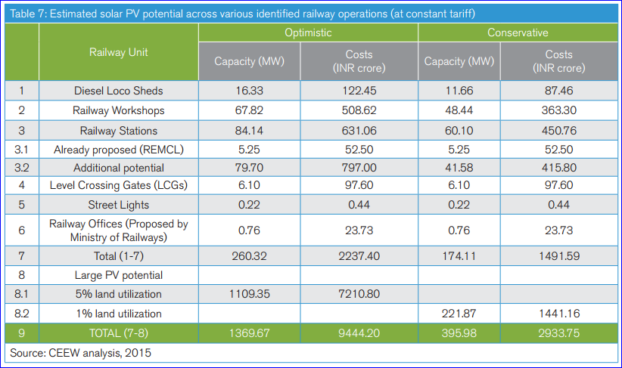
IR- Potential Analysis

Slide 21
IR-Solar Initiatives
  Indian Railways Vision 2020-At least 10% of its total energy to come from renewable sources such as solar power, wind, and biomass etc.” (500MW)
  Achievement so far
    10.50 MW Wind
    4.50 MW solar
    4.69 MW solar PV Plant in progress
Solarization of unmanned Railway Crossings
  For Optical fiber and Integrated Battery bank system
  The system size ranges from 1.4 kWp to 3.5 kWp
  More than 150 systems have been installed nation wide
  The zone covered are Eastern, Nothern railway, Western railway and West central

Slide 22
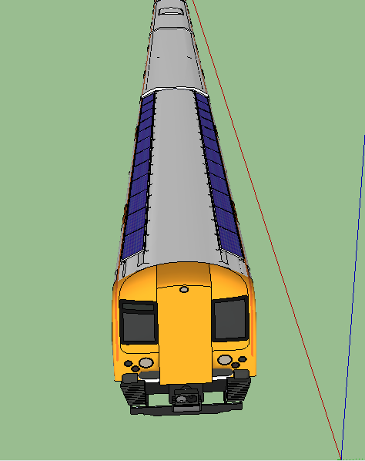
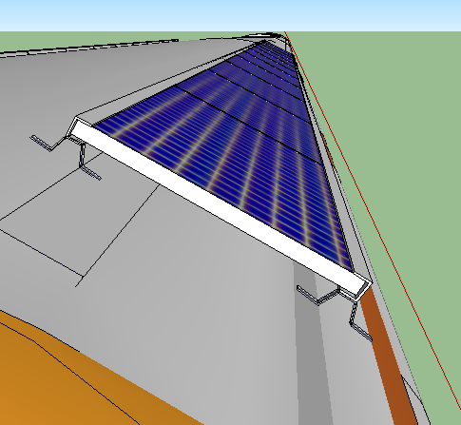
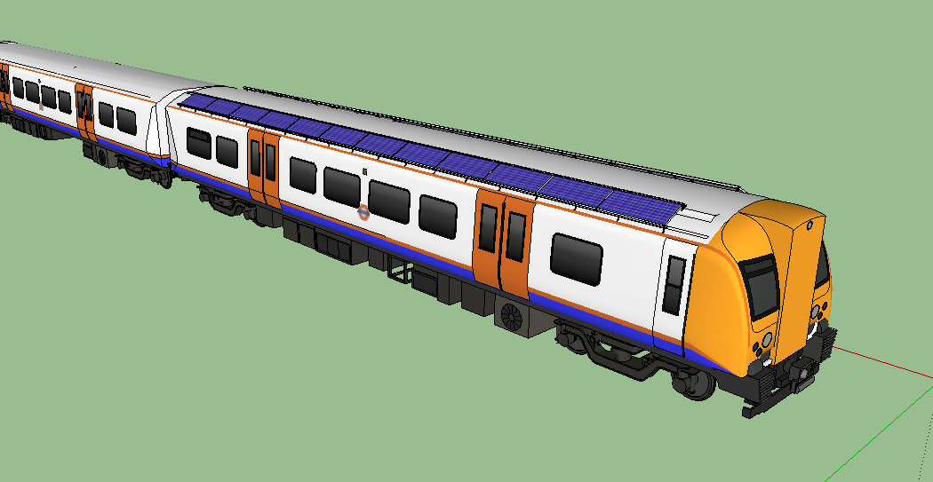
IR-Solar Initiative (Jodhpur Railway: Jakson: L1)
Diesel Electric Multiple Units )
3.6 Kw on each coach
Integrated with existing Load

Slide 23
Key Challenges
Roof Assessment
    Detailed structural analysis and wind load assessment is required to be carried out for realistic SPV design and engineering
    It has been seen that most of the roofs comprise Asbestos Cement Sheets which are brittle in nature and not generally recommended for SPV systems
    SPV systems should be installed on the roofs with metallic tops for longer life and better load-bearing capacity

Slide 24
JAKSON Advantages :
In-house EPC capabilities
Strong focus on identifying and implementing next generation technology solutions – Trackers; partnership with leading technology players
Experienced technical team with a cumulative experience of 500 MW+ of conventional and non-conventional projects
In house R&D
Robust Project Execution & Supply Chain Management
Plan in place to achieve 2-3 month “Implementation to Commissioning” concept
Ability to implement several projects concurrently
In-house Manufacturing of critical components
Ensure technology and innovation lead over competitors
Unhindered access to critical components
Cost optimization
24

Slide 25
Solar EPC- Projects Executed
Solar Power Plants
F. YEAR | Land-based | Rooftop
2011-12 | 1.05 MWp | -
2012-13 | 23.0 MWp | 220 KWp
2013-14 | 10 MWp | 580 KWp
2014-15 | 33.5 MWp | 3 MWp
2015-16 | Approx. 68 MWp | Approx. 6 MWp
TOTAL | Approx. 135 MWp | Approx. 10 MWp

Slide 26
Solar EPC & Components- Projects Executed
Solar Plant Components
F. YEAR | SISS | SCB | MMS
2012-13 | 35 MW | 40 MW
2013-14 | 41 MW | 30 MW
2014-15 | 60 MW | 50 MW | 10 MW
Total | 136 MW | 120 MW | 10 MW

Slide 27

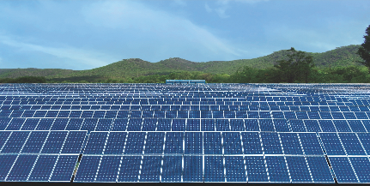
Solar EPC & Components- Land Based Project References
20 MW, JPPL- Bap, Rajasthan
10 MW, NTPC- Talcher, Orissa
Design , Engineering, Equipment Supply,
Installation, Commissioning and O&M
for 25 yrs.
Design , Engineering, Equipment Supply (except PV Modules), Installation, Commissioning and O&M for 1 year.
Three different design of civil foundation used on Ash fill land

Slide 28
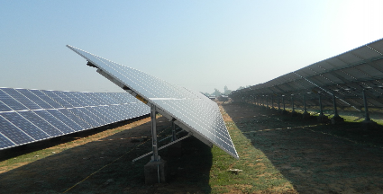
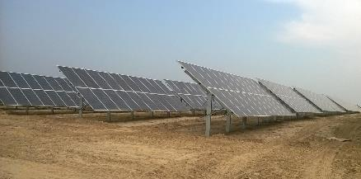
Solar EPC & Components- Land Based Project References
10 MW- Lalitpur, UP
21 MW- Grid Connected Solar Power Project for Punj Lloyd, Punjab
Design , Engineering, Equipment Supply,
Installation, Commissioning and O&M
for 25 years
Design , Engineering, Equipment Supply Installation, Commissioning and O&M for 5 years.

Slide 29

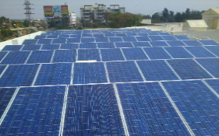
Solar EPC & Components- Rooftop Project References
500 KWp, Haldiram- Noida
80 KWp, KSNDMC- Bangalore
100 KWp- Airport Authority of India, Raipur
Design , Engineering, Equipment Supply , I&C and 2 year O&M
Provides 24x 7 power to all Critical (IT and lighting equipment) for the monitoring Centre
First Rooftop PV Project at Indian Airport
BOO Model with
25 Year PPA & O&M

Slide 30
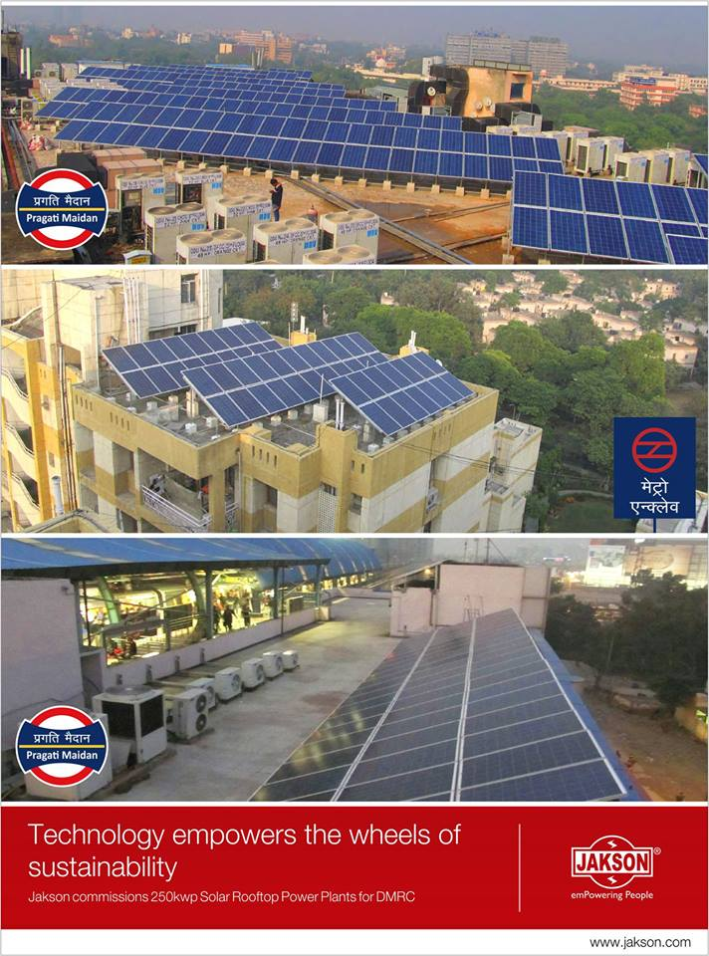
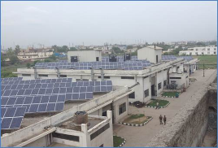
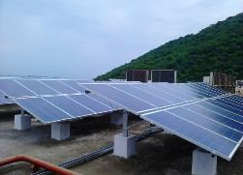
Solar EPC & Components- Rooftop Project References
250 KWp, DMRC- Delhi
300 KWp, Sandhar Auto- Gurgaon
200 KWp- Shriram, Chennai
Design , Engineering, Equipment Supply , I&C
Design , Engineering, Equipment Supply , I&C and 2 year O&M
Design , Engineering, Equipment Supply , I&C
BOOT Model with
15 Year PPA & O&M

Slide 31
Thank You
Jakson Group
A-43, Hosiery Complex
Noida- 201305, U.P.
info@jakson.com
www.jakson.com

