Slide 1



Slide 2

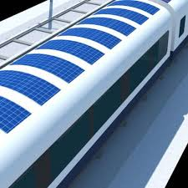
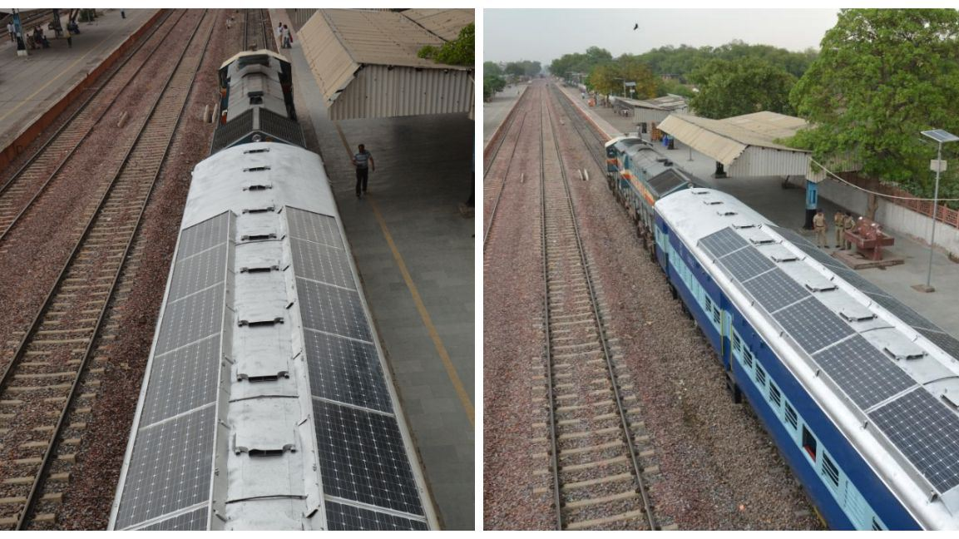
Solar Opportunity for Indian Railway’s
Total Number of Passenger Coaches 62,924 , Surface area per coach : 40 Sq Meter
  Train’s roof top has a total surface area of 40 square meters. Which can be used to install over 6 kW Solar system.
  Total Potential over 380 MW which will produce around 570 Million Units of Electricity in a year to be consumed at generating point only.

Slide 3
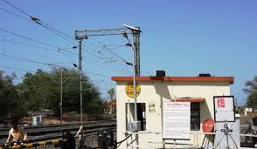
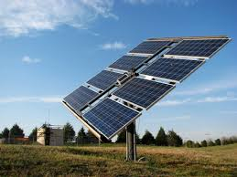
Solar Opportunity for Indian Railway’s
Total number of Railway Station are 8000, which can easily install over 800 MW of Solar Power Plants
Railways Crossings : 18785 manned and 11563 unmanned level crossings can be made self sufficient using solar and storage systems
Warehouse : Indian Railway Maintains large number of warehouse which can be utilized for electricity generation

Slide 4
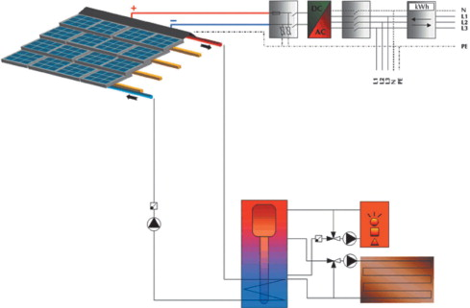
Solar Opportunity for Indian Railway’s
PVT : Photovoltaic thermal hybrid solar collector for Cold Storages
Cold storage warehouses if implemented using PVT can be very efficient and economical.
PVT are systems that convert solar radiation into thermal and electrical energy. These systems combine a solar cell, which converts sunlight into electricity, with a solar thermal collector, which captures the remaining energy and removes waste heat from the PV module.

Slide 5
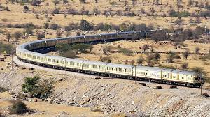
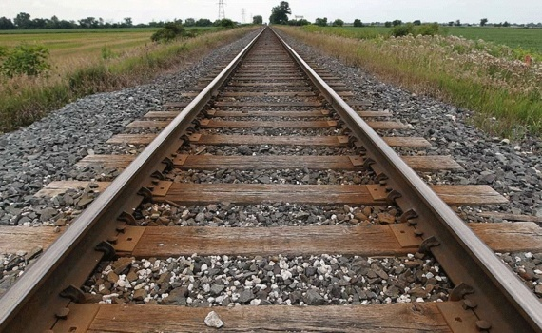
Solar Opportunity for Indian Railway’s
Vacant Land Banks of over 40,000 hectare and bridge’s which can be utilized to generate electricity
We are doing similar work at Morbi Dam, Navi Mumbai

Slide 6
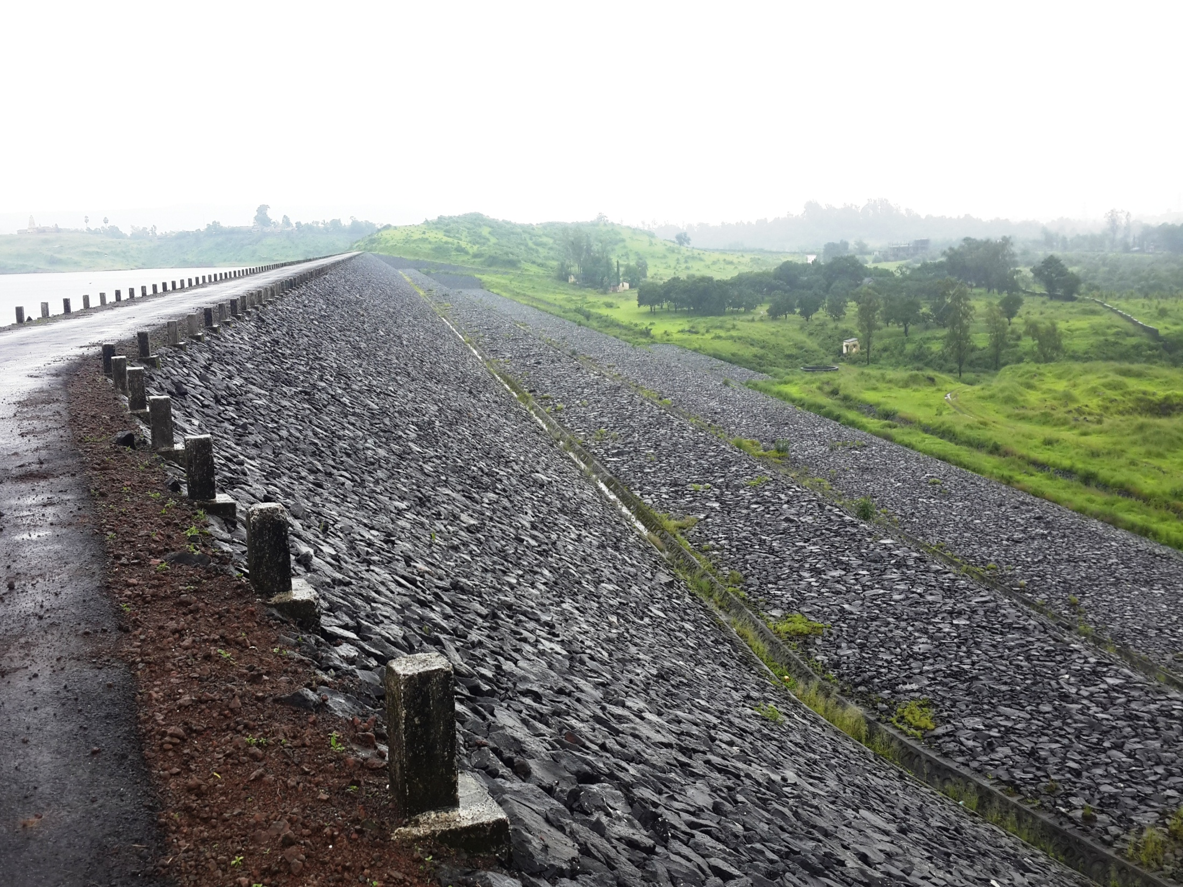
Morbi Dam Project, Navi Mumbai

Slide 7
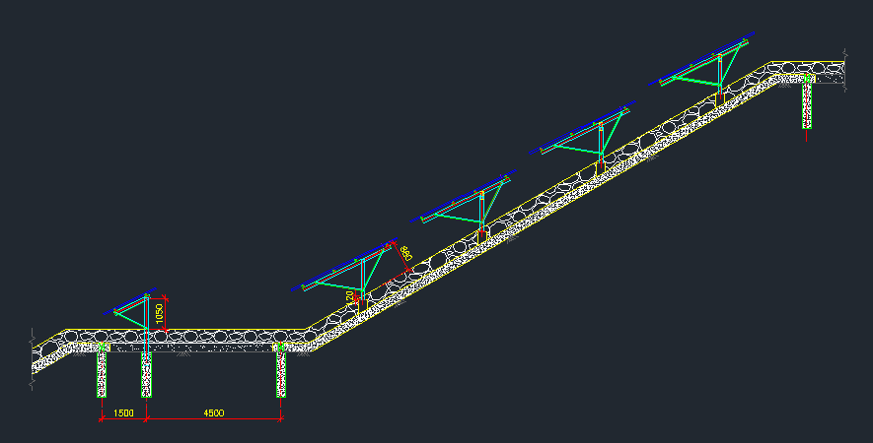
Morbi Dam Project, Navi Mumbai

Slide 8
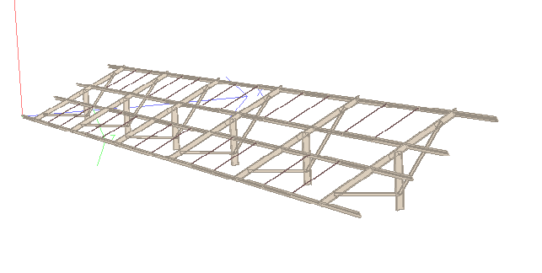
Morbi Dam Project, Navi Mumbai
TYPICAL 2x20 STRUCTURE

Slide 9
Morbi Dam Project, Navi Mumbai
DESIGN PARAMETERS
Modules to be rested on a typical framed Cold form steel structure.
  Design Code: IS:801
  Grade of steel = 350 N/mm2 (Yield Strength)
  Galvanized Steel (as specified in IS codes) shall be used
  Nuts & bolts of class 4.6 to be used for connection
Dead Load
  Self-weight of structure
  Weight of panels (23kg/panel)
Wind Load
  Basic wind speed = 44m/s
  Design wind speed = 39.96m/s
  (calculated for class-A structure, terrain category 1, design life 25yrs, and for an upward slope of 30 degrees)

Slide 10

Rays Expert – At a Glance
RaysExperts provides hassle free solutions by offering 360 degree solutions and services for the solar energy Projects. This covers everything from tendering to land, site identification, supply of solar panels and accessories, development of site infrastructure, installation and commissioning, power evacuation and maintenance over the entire life of the project. Obtaining the necessary permissions and expediting finance from banks etc.
Credentials
Started in 2011. Now an emerging leader of Solar EPC
Experience of over 150 MW out of which 125 MW projects are Successfully Commissioned and performing with High Standards
Captured a market share of 3.5%. Target to maintain & grow in next 5 years.
World’s largest Solar Project on a Dam Under Execution in Navi Mumbai
In house team of engineers, supervisors and relationship managers
Young team of IIT & IIM grads working hard towards a better tomorrow
Best performing plants(CUF), known for Technology & Innovation among clients
Excellent track record. All projects were commissioned before deadlines
Among the top 3 portfolio holders in MW size EPC Companies in India

Slide 11
Leading Solar Company in India
Developer | MW | Policy | Scope | Status
MP Solar Project | 12 | MP Solar Policy | Developer | Under Execution
DMRC | 7 | Rooftop | Developer | Under Execution
Rishabh Buidlwell Pvt Ltd | 10 | JNNSM Phase-II, Batch - I | EPC | Commissioned
Laxmi Diamonds Pvt Ltd | 10 | JNNSM Phase-II, Batch - I | EPC | Commissioned
Solar Energy Corporation of India | 1 | Roof-top Scheme | EPC | Commissioned
Navi Mumbai Municipal Corporation | 20 | State Scheme | EPC | Under Execution
New Delhi Municipal Corporation | 4 | State Scheme | Developer | Under Execution
Rajasthan State Mines & Minerals Ltd | 5 | State Scheme | EPC | Commissioned
Siwana Solar Power | 5 | State Scheme | EPC | Commissioned
Gajner Solar Park | 55 | State Scheme | EPC | Commissioned
Kolyata Solar Park | 25 | State Scheme | EPC | Commissioned
Baap Plants | 2 | State Scheme | EPC | Commissioned

Slide 12
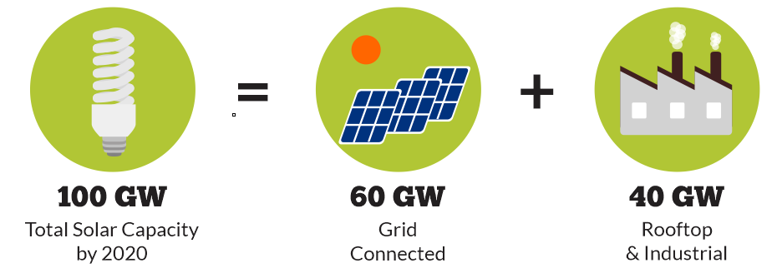
Distributive Systems
100 GW Solar target is consist of 40 GW rooftop projects, we can visualize that post 2016 rooftop’s will be major part of total installations. Therefore, rooftop will be our major focus along with Utility scale projects
Advantage Rays
We have executed over 2 MW rooftop projects which include 300 kw in Udaipur, 100 kW each at Jaipur & Jodhpur Airports and 200 kW in Gurgaon etc.
We are executing 11 MW rooftop projects in NCR region as developer and 10 MW Rooftop EPC across country

Slide 13
DMRC 7 MW Solar Power Project
Sl. No. | Category | Site | DMRC
1 | DEPOT | Mundka | 2043
 |  | Khyber Pass | 1187
 |  | Shastri Park | 1768
 |  | Total | 4998
2 | RSS | Rithala | 37
 |  | Jahangirpuri | 37
 |  | Kashmere gate | 37
 |  | New delhi | 17
 |  | CTST | 70
 |  | Mundka | 37
 |  | Total | 235
3 | Station Roof Shed & Parking Area |  | 2064

Slide 14
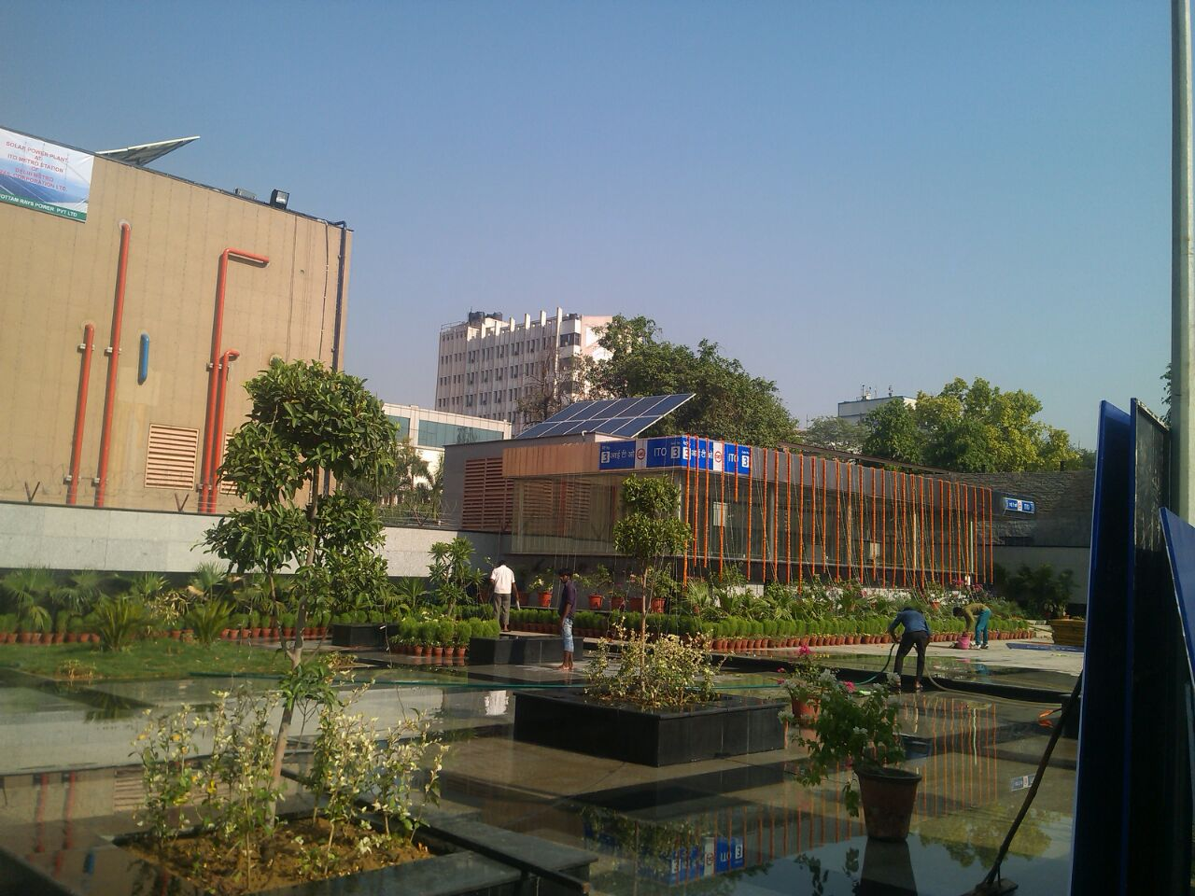
DMRC 7 MW Solar Power Project

Slide 15
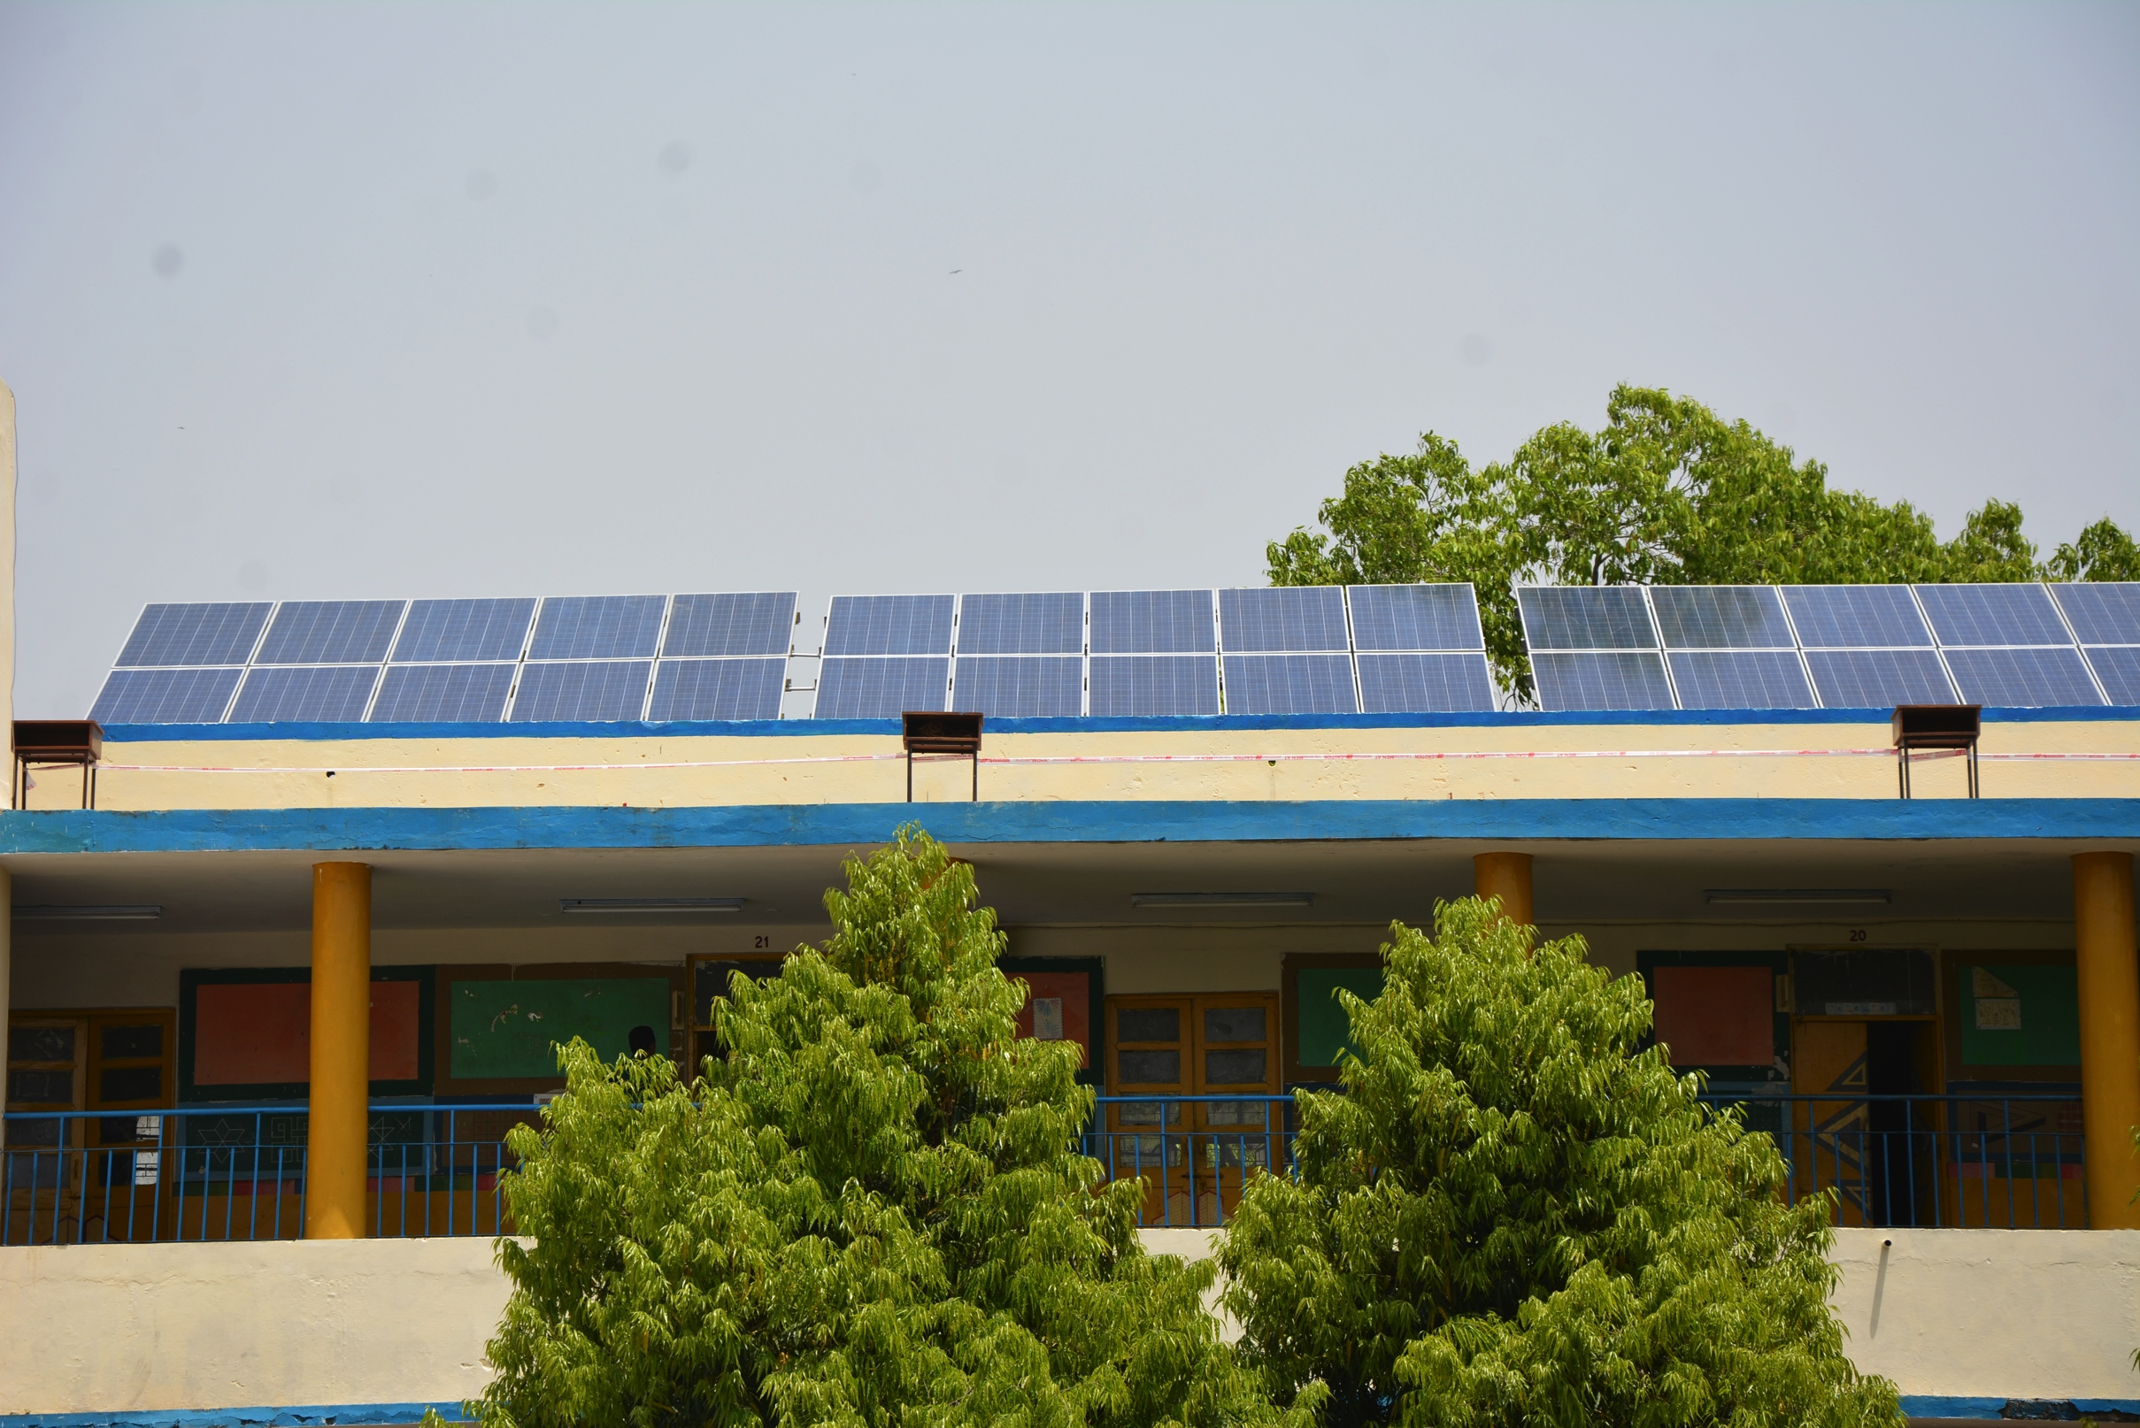
NDMC 4 MW Solar Power Project
Rays Experts is Solarizing over 60 building in New Delhi
50 KW System at N P Bangali Girls Senior Secondary School, Gole Market , New Delhi

Slide 16

Rays Solar Park
A concept developed by Rays Experts and supported by Indian Government
Aimed to help small investors harness the benefits of large solar projects in a safe and assured way

Slide 17
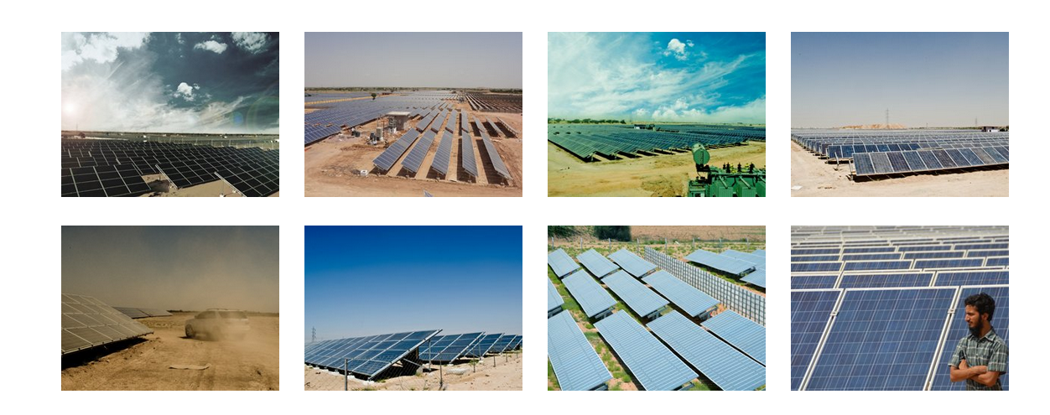
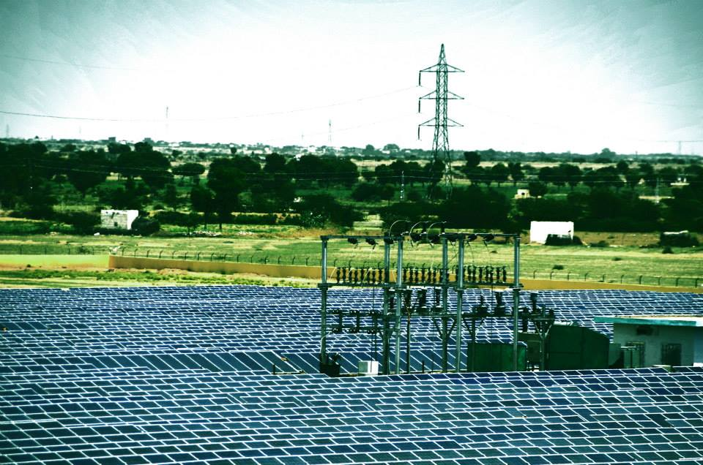
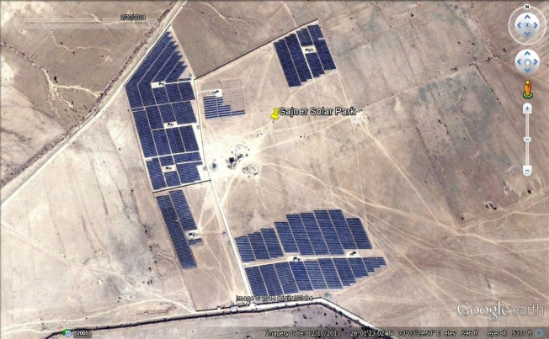
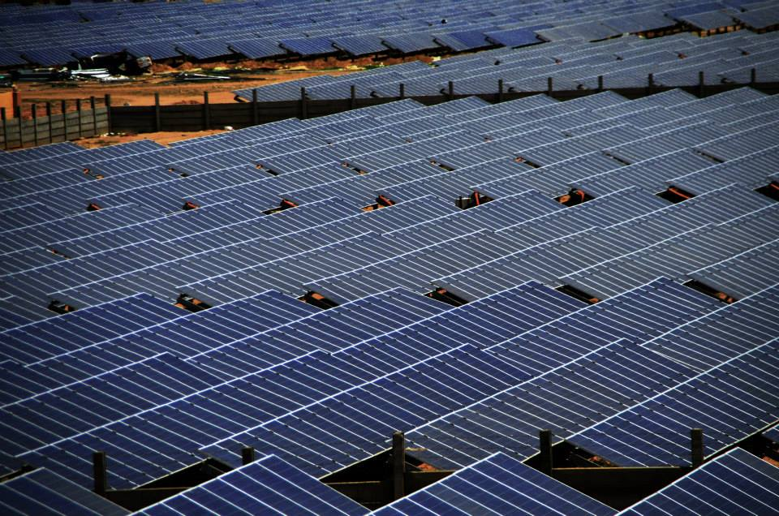
Glimpses of Our Solar Park

Slide 18
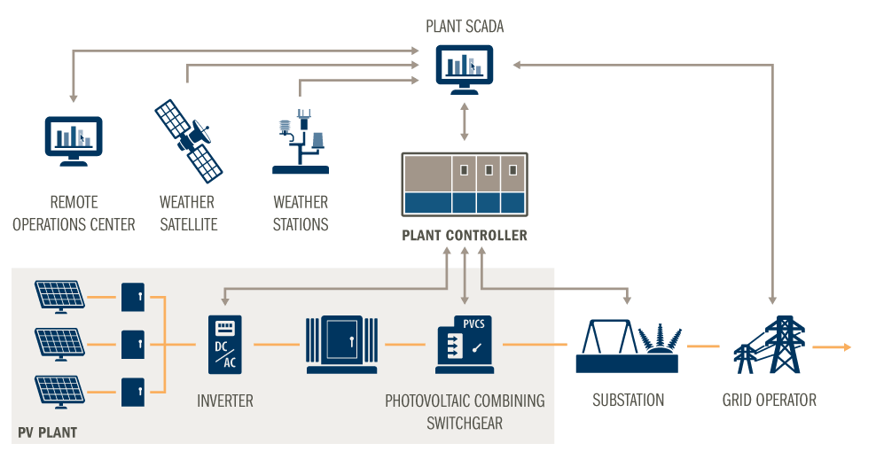
How does Solar Park Work

Slide 19
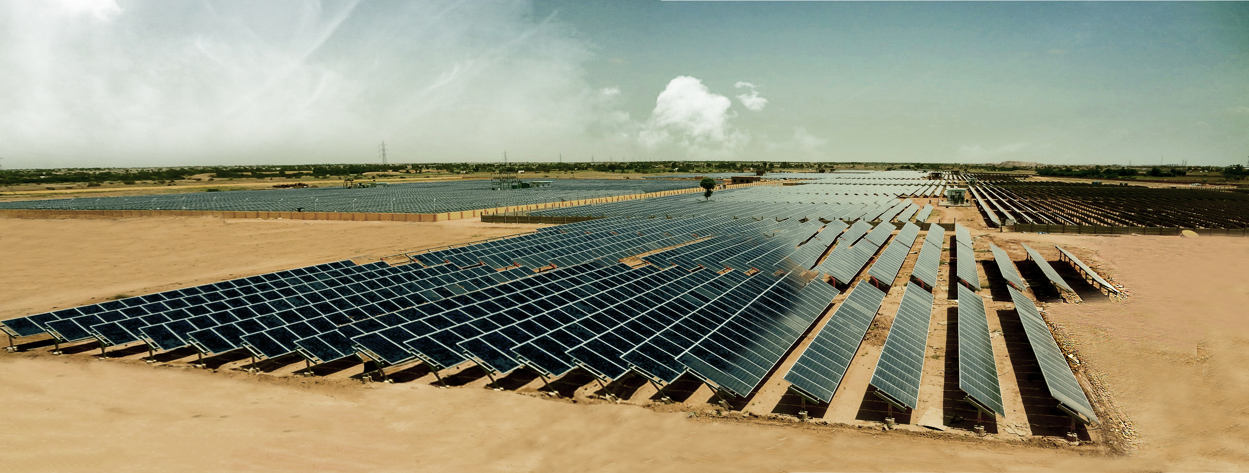



Our Solar Parks

Slide 20
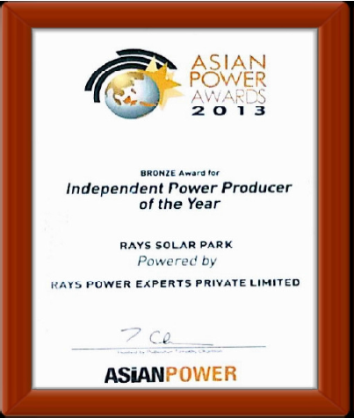
Awards & Recognition
Rays Experts has been awarded following Awards:
Asian Power Award
India Inc. Award
Woman Entrepreneur of the Year
Global Quality Award

Slide 21

Reach Us
We would be happy to discuss more:
Corporate Office:
Unit No. 124-125-126, D-4, Rectangle One, District Center Saket, New Delhi - 110017
Jaipur Offices:
P-25, Pinaki House, Yudhistir Marg, C-Scheme, Jaipur - 302019
Web : www.raysexperts.com
E-mail : info@raysexperts.com
Phone: : +91-124-6637940

