Slide 1
Grid Connected Solar Rooftop Systems
MNRE
Government of India
Ministry of New and Renewable Energy

Slide 2
Road Map for Solar Power by 2022
1,00,000 MW
Till year 2022
MNRE
20,000 MW
20,000 MW
20,000 MW
40,000 MW
Solar Park
Unemployed Graduate
States/Private/Others
Solar Rooftop

Slide 3
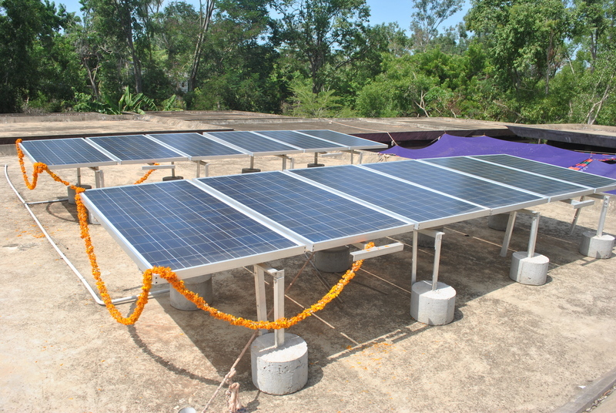
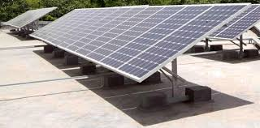
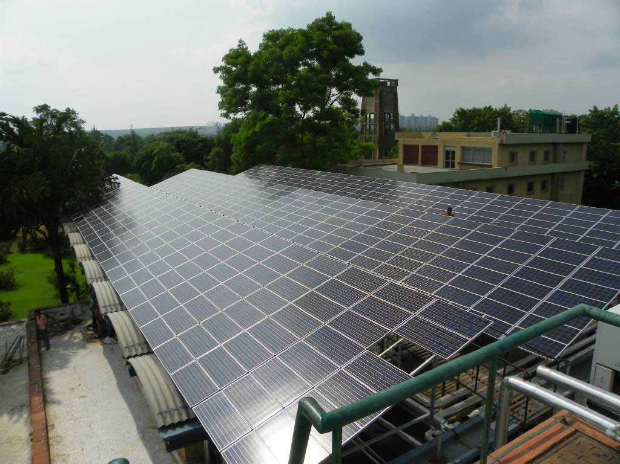
Solar Rooftop PV Systems
MNRE
Solar systems installed on rooftops of residential, commercial, institutional & industrial buildings :
premises.
Electricity generated could be
-fed into the grid at regulated feed-in tariffs or
-used for self consumption with net-metering approach

Slide 4
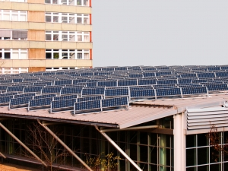
Advantages of solar rooftops
MNRE
Savings in transmission and distribution losses
Low gestation time
No requirement of additional land
Improvement of tail-end grid voltages and reduction in system congestion with higher self-consumption of solar electricity
Local employment generation
Reduction of power bill by supplying surplus electricity to local electricity supplier
Battery elimination makes easy installation and reduced cost of system

Slide 5
All-India Rooftop SPV Potential
MNRE
In India market potential for rooftop SPV is 124 GW.

Slide 6
Estimated Rooftop Solar PV Potential for Central Government Buildings
Methodology
Identification/ Categorization
Identification of Ministries, departments & facilities
Categorization of structures for roof space mapping
Roof space GIS mapping
Sample size
Roof space mapping
Potential estimation
Deriving average usable roof area
Determining rooftop solar potential
Assumptions:
a) 40% of the identified roof space is usable for rooftop solar installation – shading, non-uniform north-facing tilt of roof, etc.; b) Roof has sufficient structural load-bearing capacity to support solar system; c) Sufficient capacity is available at distribution transformer level; d) Estimates based on roof-space image mapping from Google Earth.

Slide 7
Estimated Rooftop Solar PV Potential
Ministry | MW Potential
Ministry of Agriculture | 12
Ministry of Chemicals and Fertilizers | 401
Ministry of Civil Aviation | 620
Ministry of Coal | 53
Ministry of Commerce and Industry | 2
Ministry of Consumer Affairs, Food and Public Distribution | 2314
Ministry of Culture | 2
Ministry of Defence | 281
Ministry | MW Potential
Ministry of Food Processing Industries | 22
Ministry of Health and Family Welfare | 45
Ministry of Heavy Industries and Public Enterprises | 271
Ministry of Housing and Urban Poverty Alleviation | 2
Ministry of Human Resource Development | 497
Ministry of Micro, Small and Medium Enterprises | 4

Slide 8
Estimated Rooftop Solar PV Potential
Ministry | MW Potential
Ministry of Petroleum and Natural Gas | 1009
Ministry of Railways | 1369
Ministry of Road Transport and Highways | 0.4
Ministry of Shipping | 51
Ministry of Steel | 224
Ministry of Textiles | 5
Ministry of Tourism | 6
Ministry of Youth Affairs and Sports | 6
TOTAL
7196.4 MW

Slide 9
ENERGY USE IN RAILWAYS
FOR
Rolling stock manufacture, maintenance and
disposal
Train operation.
Infrastructure construction and maintenance
Administration of transport business.
Energy production and trade.
TIME
24 X 7 X 365
SOURCES
GRID Power+ DG Set + Renewable (very Low)

Slide 10
SPACE/COST REQUIREMENT FOR RE TECHNOLOGY
RE Technology | Useful life (years) | Space | Cost
Solar based power Plant (PV/Thermal) | 25 | PV: 4-6Acres/MW Thermal: 5-6.5 acres/MW | PV: 6-7 Cr/MW Thermal: 10-12 Cr/MW
Wind based power Plant | 25 | 5 Acres/MW | 5.75 Cr/MW
Small Hydro | 35 | 2 Acre/MW | 5.5 -7.7 Cr/MW
Biogas | 20 | 500 sq. m / 1 Ton/day plant | 30 lac/Ton
Biomass | 20 | 1 Acre/MW | 4.5-5 Cr/MW

Slide 11
SPACE/COST REQUIREMENT FOR RE TECHNOLOGY
RE Technology | Useful life (years) | Space | Cost
Solar thermal (flat plate ) | 25 | 2 M²/100 LPD | Rs. 20000-22000/100 LPD
Solar thermal (concentrated ) | 25 | 35 sq m/one dish 16 sq m aper.area | 12000-14000/sq m (single axis) 14000-16000/sq m (double axis) 20-30% for accessories
Solar thermal air conditioning plant | 25 | 10 sq m /TR | 2.5 Lakh/TR

Slide 12
RE for Indian Railways
Wind Energy
On-site power generation
Off-site power generation
Solar Energy
Roof-top solar PV plants
MW Solar PV/Thermal plants
Flat plate/Concentrating solar thermal system for (water heating, steam generation, cooking etc.)
Small Hydro Energy (Off site power generation)
Waste to Energy generation
From Kitchen Waste, Solid Waste, Sewage waste water Agri. Waste on Railway Lands.

Slide 13
ROOF TOP SPV PLANT AT STATIONS
Station | Number | Electrical Load | Renewable Potential
Category A1 | 58 | 6 MW/2MW | 30 MW
Category A | 284 | 100kW/500kW/1 MW | 104 MW
Category B | 237 | 25kW/200 kW | 12 MW
Category C | 429 | 10kW/100 kW | 15 MW
Category D | 932 | 10kW/50kW/100kW | 7 MW
Category E | 4274 | 5kW/10kW/50kW | 25 MW
Category F | 2027 | 2kW/5kW/10kW | 7 MW
TOTAL | 8241 |  | 200 MW
Potential At Station Load Varies from station to station because of Scale of amenities, signalling load, yard size, Maintenance facility, PRS/UTS location, Pumping installation, Inclusion of quarter load, Parcel, More space more facility creation, more load requirement

Slide 14
ROOF TOP SOLAR PV PLANT
Item | Number | Electrical Load | Renewable Potential
Work shop/shed | 45/101 | 500 KW-1-3 MW | 15 MW
Administrative building | 105 | 100 kW-500KW-2MW | 5 MW
Freight terminal (goods shed) | 1772/992 | 5 KW to 10 KW | 15 MW
College/School | 1/221 | 10-50 KW | 3 MW
Training school | 300 | 10-50 KW | 3 MW
Hospital | 125/586* (health unit) | 100 kW-1 MW | 3 MW
L-xing | 32735 (14896 UM) | <500W/xing | 1.5 MW
Quarter | 3,00,000 | 1 KW to 5 KW | 20MW
Total |  |  | 65 MW

Slide 15
SOLAR THERMAL (FLAT PLATE) SYSTEMs
Item | Number | Requirement assessment | Potential LPD
Workshop/shed | 45/101 | 50000lpd | 22.5 lakh
Base kitchen | 796(IR+IRCTC)+ 243 Canteen | 300lpd/ Base Kitchen, 100lpd/canteen | 3 lakh
College/school | 1/221 | (44792 wards ) | 1 lakh
Quarter | Type IV & above | 100lpd | 8 lakh
Hospital | 125 | 1000lpd | 1.25 lakh
Division(crew lobby, retiring room, dormatory, rest house, etc) | 68 | 70000lpd | 50 lakh
Manufacturing unit | 8 | 1,00,000lpd | 8 lakh
Institutes | 6 | 1000lpd | 6000
Total |  |  | 93 lakh

Slide 16
SOLAR THERMAL (CONCENTRATED) SYSTEM STEAM COOKING/APPLICATION
Item | Number | Requirement | Potential
Base kitchen | 796(IR +IRCTC) | 1000-8000 meal per day* | 50,000 sq mt
Institutes College/ school / training school | 6/ 1/221/300 | 150-750 meal per day* | 16,000 sq m
Mechanized Laundry | 52(10 functional) | 7 Ton and above | 400 sqm (flat plate air collector)/1.5 ton /batch
Total |  |  | 66000 sq m
* 3-4 dish sufficient for 250 meals, bigger size lower heat loss..

Slide 17
SOLAR THERMAL AIR-CONDITIONING SYSTEM
Item | Number | Electrical load | Potential
Adm Building(Zonal rly ,Manufacturing unit, Institute, DRM office head quarter office), | 105 | 50 kW-500 kW | 50-100 kW/Admn building
A1/A class station | 58/284 | 100 kW-250 kW | 50-100 kW/station
Can help in reduction of maximum peak demand and associated tariff.

Slide 18
ARUN160, installed at Latur for milk pasteurisation and its focus on focus plate– June 2005

Slide 19
Present Status in India
360.81 MW of Solar Rooftop Projects sanctioned
by MNRE and 54.187 MW commissioned
MNRE
Sector | Installed by SECI (MW) | Installed by States (MW) | Total installed (MW)
Commercial | 10.90 | 17.22 | 28.91
Government | 3.04 | 4.893 | 7.253
Hospital | 1.6 | 0.47 | 2.07
Institutional (Schools, Collages) | 2.19 | 5.131 | 8.346
Religious institution | 0.62 | 7.52 | 7.64
Residential | 0 | 0.298 | 0.298
Total | 18.35 | 35.532 | 54.187

Slide 20
Present Status: Policies and Regulations
MNRE
13 States have come out with Solar Policy supporting grid connected rooftop systems :
Andhra Pradesh Chhattisgarh, Gujarat, Haryana, Karnataka, Kerala, Manipur, Punjab, Rajasthan, Uttar Pradesh, Tamil Nadu, Uttarakhand and West Bengal.
SERCs of 19 States/UTs have notified regulations for net metering/feed-in-tariff mechanism :-
Andhra Pradesh, Chhattisgarh, Delhi, Haryana, Karnataka, Kerala, Tamil Nadu, Uttarakhand and West Bengal, Andaman & Nicobar, Chandigarh, Dadra & Nagar Haveli, Daman & Diu, Lakshadweep, Pondicherry, Goa, UP, Rajasthan and Odisha.
Remaining States are requested being pursued to come out with their policies/regulations.

Slide 21
Present Status: Policies and Regulations
Following remaining States should notify regulations and policy for grid connected rooftop systems:-
Arunachal Pradesh, Bihar, Himachal Pradesh, Jammu & Kashmir, Gujarat, Jharkhand, Telangana, Assam, Madhya Pradesh, Maharashtra, Manipur, Meghalaya, Mizoram, Nagaland, Punjab, Sikkim, Tripura

Slide 22
Financing by Banks
Department of Financial Services has advised all Public Sector Banks to provide loans for grid connected rooftop solar systems as home loan/ home improvement loan.
So far, nine PSBs namely Bank of India, Syndicate Bank, State Bank of India, Dena Bank , Central Bank of India, Punjab National Bank, Allahabad Bank, Indian Bank and Indian Overseas Bank have given instructions to their branches.
However, it is yet to be made effective at field level as no branches of these banks are providing such loans.
Department of Financial Services may issue appropriate instructions to make it more effective.

Slide 23
Financing by Banks
Reserve Bank of India on April 2014 has included renewable energy projects under Priority Sector Lending for which bank loans up to a limit of Rs. 15 crore to borrowers will be available for renewable energy projects including grid connected solar rooftop and ground mounted systems.
For individual households, the loan limit is Rs. 10 lakh per borrower.
This is yet to be mad effective at field level.

Slide 24
Fiscal and Financial Incentives
The following benefits are available in commercial & industrial categories:-
Custom Duty Concessions
Excise Duty Exemptions
Accelerated Depreciation
Fiscal and other concessions from State Governments
15% CFA is available for residential, institutional and social sectors

Slide 25
Summary of Survey Conducted in Govt. Buildings as per 30.06.2015
Data received from Govt. Buildings | 844 nos.
Average Tariff | Rs. 9.37 per kWh
The maximum tariff paid by building | Rs 15.78 Per KWh
The minimum tariff paid by building | Rs 1.34 per KWh
The potential estimated for rooftop installation | 1450.51 MW
No. of Institutes paying above Rs. 7.0/- per Kwh | 394 nos. (46.7%)
No. of Institutes paying above Rs. 8.0/- per Kwh | 226 nos. (26.8%)
No. of Institutes paying above Rs. 9.0/- per Kwh | 134 nos. (15.9%)
No. of Institutes paying above Rs. 10.0/- per kwh | 89 nos. (10.5%)
No. of Institutes paying above Rs. 11.0/- per Kwh | 51 nos. (6.0%)

Slide 26
Tariff range paid by Govt. Buildings

Slide 27
Business Models for Rooftop SPV
Grid-connected SPV Rooftop systems
MNRE
Rooftop Solar PV System
Project Ownership
Self-Owned
Third Party Owned
Financing Options
100% Equity
Debt & Equity
100% Equity
Debt & Equity
Modes of Funding
Self
Bank
Govt. financing
Self
Bank
Govt. financing
Revenue
Revenue Net-metering
Gross-metering
Revenue Net-metering
Gross-metering
Solar PPA
Solar Leasing
Net/Gross metering
Solar PPA
Solar Leasing
Net/Gross metering

Slide 28
Business Model Gross Metering – Self Owned
Grid-connected SPV Rooftop systems
MNRE
Bank
EMI Payments
Loan
Consumption Payment
System Owner
Utility
Generation Revenue
Installation Payment
Subsidy
Installer

Slide 29
Business Models Net Metering – Self Owned
MNRE
Bank
EMI Payments
Loan
System Owner
Consumption Payment
Utility
Installation Payment
Installer
Subsidy
Notes:
Loss of revenue is a long term risk for the Utility

Slide 30
Business Models Gross Metering – Third Party Owned
MNRE
Subsidy
Roof Owner
Utility
Generation Payment
Roof Rent
Third Party
Loan
Repayment
Bank
Notes:
Risks are:
Grid availability
Loan default
System performance and O&M

Slide 31
Business Models Net Metering – Third Party Owned
MNRE
Roof Owner
Consumption Payment
Utility
PPA
Third Party
Subsidy
Consumption Payment
Loan
Repayment
Bank

Slide 32
Few Large rooftop installations
MNRE
Location of PV POWER STATION | COUNTRY | Capacity (MWp)
Radha Soami Satsang Beas, Amritsar | India | 7.52 MW (Single Roof)
Constellation energy- Toys R Us Flanders, NJ | USA | 5.38 MW
Boeing 787 assembly building South Carolina | USA | 2.6 MW
Southern California Edison, Fontana, CA | USA | 2.0 MW
Antwerp Belgium | Belgium | 40 MW (In Campus)
Bay Resort DLR Group -Mandalay Convention Center, Las Vegas NV | USA | 6.4 MW

Slide 33
Role of DISCOMs
Simplification of process for inviting Applications
Fast Track approvals for feasibility, connectivity and installation of meters
Not to treat rooftop as their competitor but to come forward to become facilitators.
DISCOMs to take lead in implementation of rooftop scheme
Can set annual targets for themselves and work with MNRE and SECI

Slide 34
Role of DISCOMs Contd….
DISCOMs to form a dedicated Cell / team for coordinating with various entities (both internal and external agencies).
As the number of plants increase, there may be requirement of frequent coordination with different entities, consumers etc.
DISCOMs to earmark at least 10% of IPDS and Deendayal Uppadhayay Gram Jyoti Yojana (DDUGJY) scheme funds for rooftop
Consumers awareness about benefits of installations of rooftop systems

Slide 35
Role of DISCOMs Contd….
Creating a consumer Helpline for resolving customer’s queries related to grid connectivity
A telephone helpline will be quite useful to the consumers, as they can call and resolve there queries readily
Putting a list of permissible meters with costs and vendors on their website
Putting a list of distribution transformer capacities along with permissible solar PV capacities on their website
Updating the respective billing mechanisms

Slide 36
Actions desired from States/UTs
States to bring out policies which have not announced so far. (Bihar, Delhi, Gujarat, Jammu & Kashmir, Jharkhand, Madhya Pradesh, Maharashtra, Odisha, Arunachal Pradesh, Assam, Sikkim, Nagaland, Tripura, Mizoram, Meghalaya, Andaman & Nicobar, Chandigarh, Daman & Diu, Puducherry, Lakshadweep, Dadra & Nagar Haveli, Goa).
Issue Governments orders to ask Urban Local Bodies to make solar rooftop mandatory in building bye-laws.
Provide rebate on property tax.
Ensure capacity building of concerned State Officials including DISCOMs.
To simplify procedure for installation of solar rooftop systems preferably through single window clearance mechanism.

Slide 37
Actions desired from DMRC/Railways
Ensure publicity, marketing, capacity building and awareness for solar rooftop systems.
Conduct survey for assessment of rooftop potential in the State, District wise.
Interact with banks to ensure low cost financing for solar rooftop systems.

Slide 38
Scheme for setting up 1000 MW of Grid-connected Solar PV Power Projects by CPSUs under various State Schemes with Viability Gap Funding
This scheme is to motivate CPSUs to procure equipment from domestic manufacturers.
Target Capacity: 1000 MW of solar PV power projects.
Necessary Condition to avail VGF:
Solar PV Power Projects by Central Public Sector Undertakings (CPSUs) and Government of India Organizations under various Central/ State Schemes/ self-use/ 3rd party sale/ merchant sale.
Domestic Content Requirement:
VGF of Rs. 1 Cr/MW with Cells, Modules and Inverters of indigenous source;
OR
VGF of Rs. 0.5 Cr/MW if only Modules and Inverters are of indigenous source.

Slide 39
Scheme for setting up 1000 MW of Grid-connected Solar PV Power Projects by CPSUs under various State Schemes with Viability Gap Funding
PPA to be signed between the CPSU and the concerned State Discom.
Duration of the Scheme: 2015-16 to 2017-18.
Solar Energy Corporation of India (SECI) to manage VGF.
VGF will be released in two tranches as follows:
50% on successful commissioning of the plant;
Balance 50% after one year of successful operation of the Plant.

Slide 40
Funds Requirement
Total requirement of funds of Rs. 1000 Cr. will be as per the details given below:
Year | Amount (Rs.Cr.)
2015-16 | 150
2016-17 | 300
2017-18 | 350
2018-19 | 200
Total | 1000

Slide 41
Status- Capacity Allocated to CPSUs and GOI Organisations
S.No | Name of Organisation | Capacity Allotted (MW)
1 | All Ministries/Department of GOI | 83*
2 | NTPC Ltd | 250
3 | Indian Railways | 200
4 | KVIC | 10
5 | NEEPCO | 100
6 | National Seeds Corpor. | 25
7 | BHEL Hyderabad& Trichi | 4
8 | SECI | 80
 | Total | 752
*All Ministries/Departments have been allocated 1 MW Solar Power Project. Proposals from Ministry of Agriculture, Mines and Silk Board Mysore have been received.

Slide 42
Capacity Under Consideration
Sl.No | Name of Organisation | Capacity
1. | Visakhapatnam Port Trust, Visakhapatnam | 15 MW
2. | Cochin Shipyard Ltd., Kochi | 1060 KW
3. | HPCL, Bangalore | 348 KW

Slide 43
Business Models for installations by Ministries/Departments
MNREs incentive –
Model 1: Self financing of balance cost
Model 2: Installation through RESCO Mode
Model 3: Installation through leasing model
Model 4: Installation through concessional loans
Model 5: Self financing of complete cost without
MNRE incentive

Slide 44
Some Installations of Grid Connected Rooftop Systems in India

Slide 45
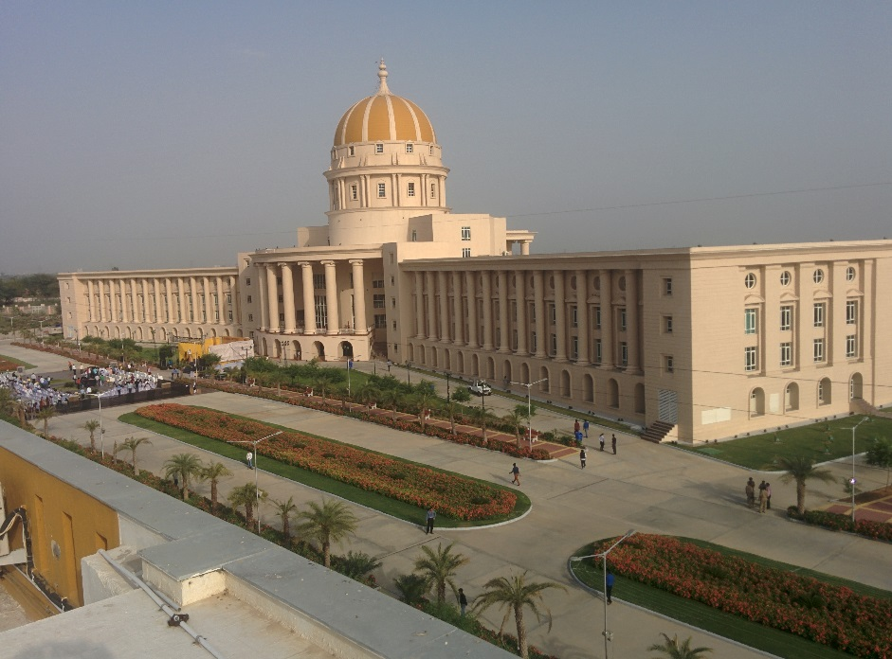
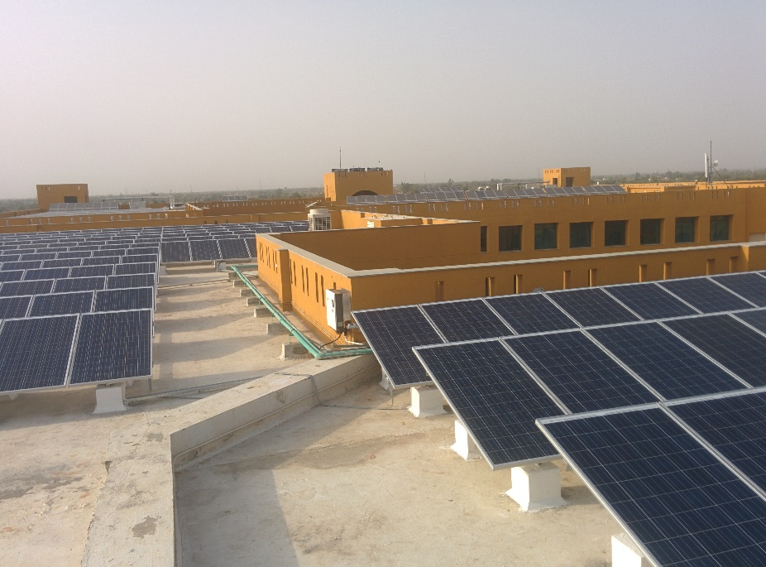
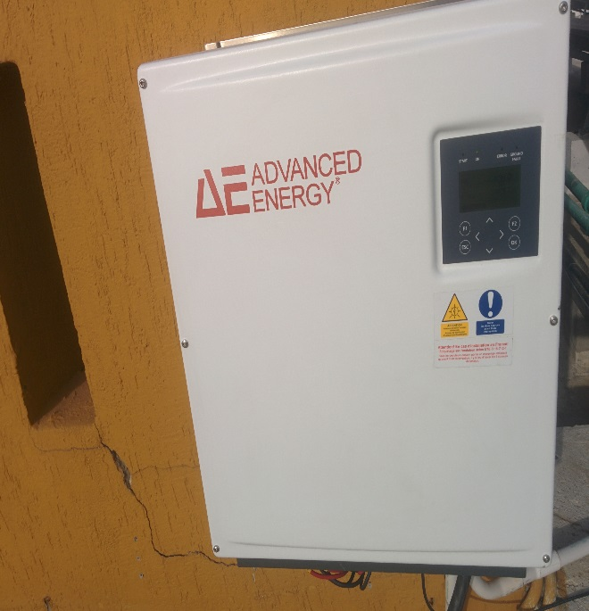
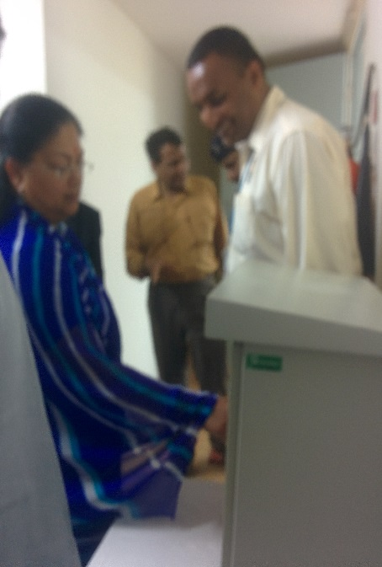
Module | India Make
Aggregate Plant Capacity | 404 kWp
Rooftop Owner | Manipal University
City | Jaipur
State | Rajasthan
Project Cost | Rs. 2.86 Cr
CFA through SECI | Rs. 86 Lakh

Slide 46
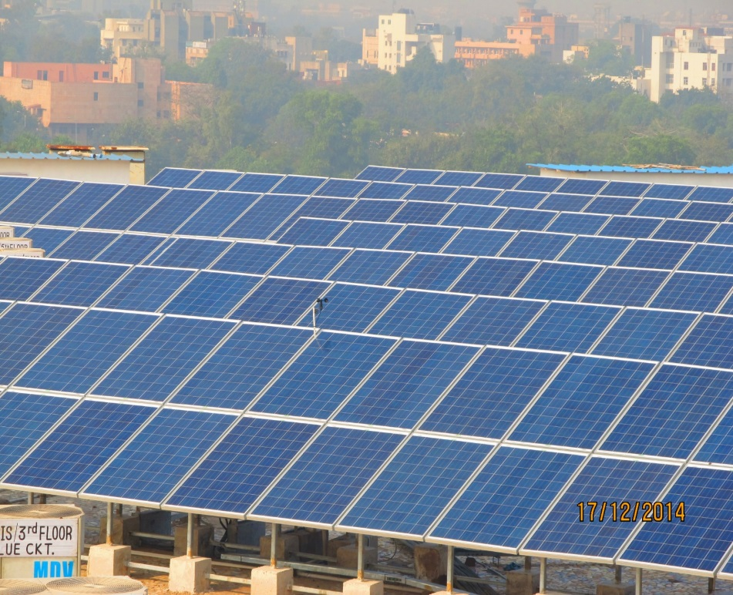
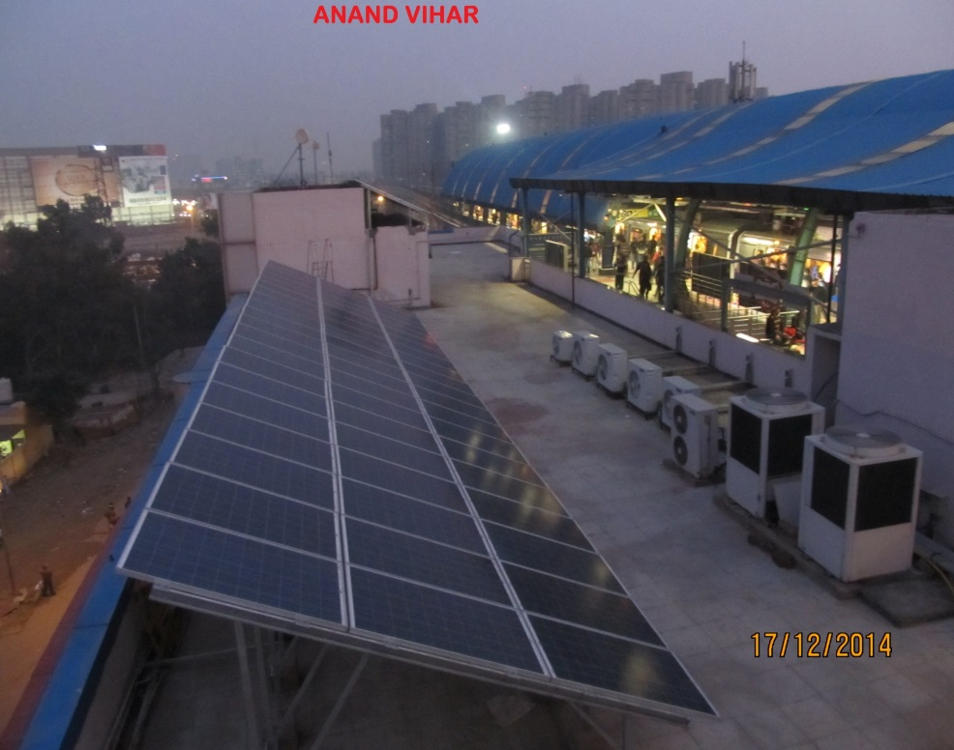
Module | India Make
Plant Capacity | 115 kWp/85 kWp
Rooftop Owner | DMRC
Project Site | Anand Vihar/Pragati Maidan
City | Delhi

Slide 47
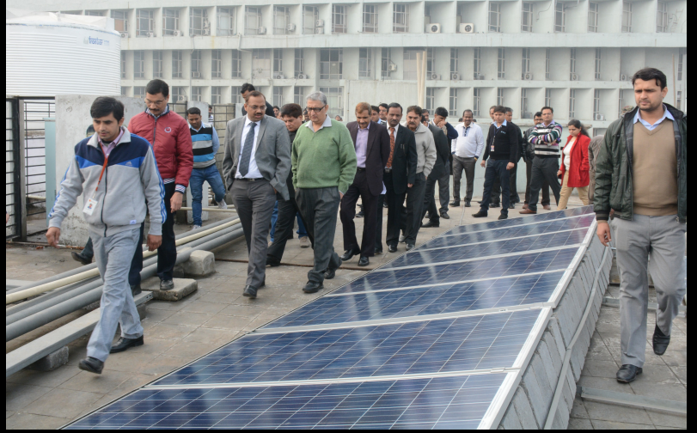
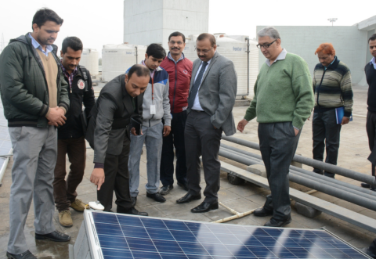
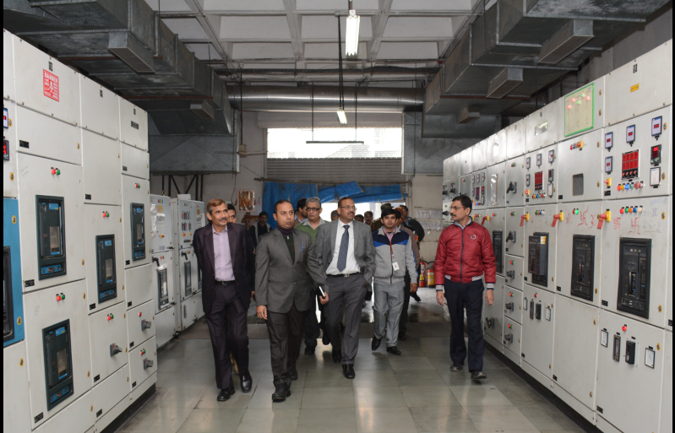
Module | India Make
Plant Capacity | 130 kWp
Rooftop Owner | ISBT Kashmere Gate
City | Delhi
State | Delhi
Project Cost | Rs. 114.3 Lakhs
CFA through SECI | Rs. 30.3 Lakhs

Slide 48
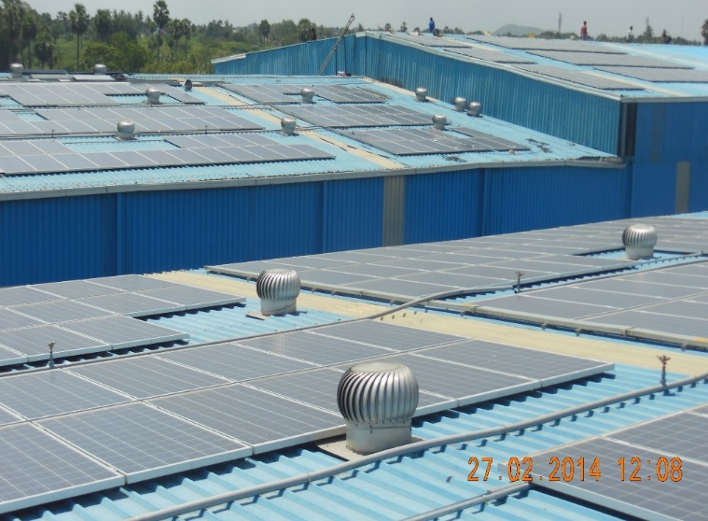
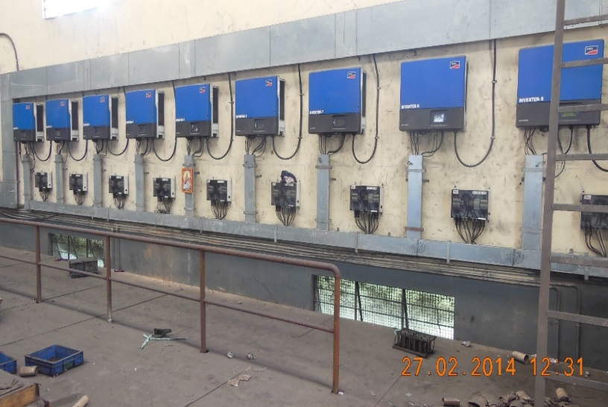
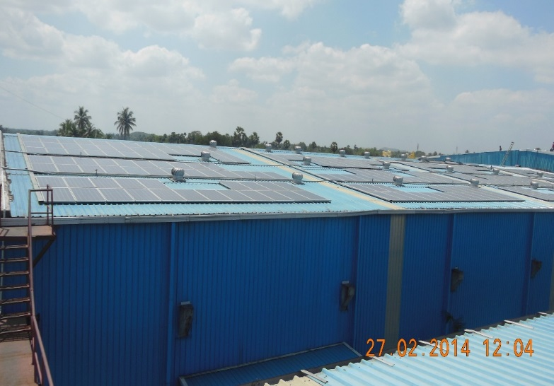
Module | India Make
Plant Capacity | 360 kWp
Rooftop Owner | Super Auto Forge Pvt., Ltd.,
City | Chennai
State | Tamilnadu
Project Cost | Rs. 3.06 Cr
CFA through SECI | Rs. 92 lacs

Slide 49
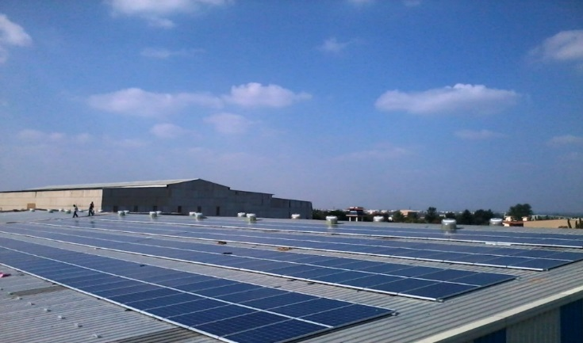
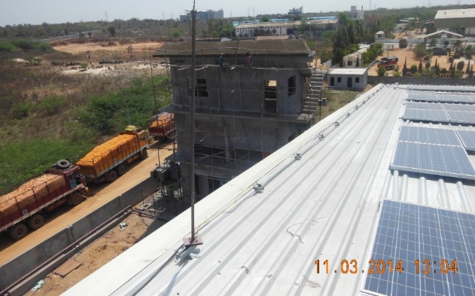
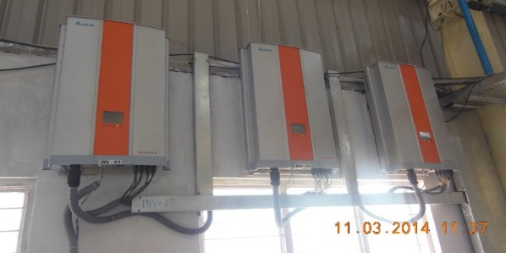
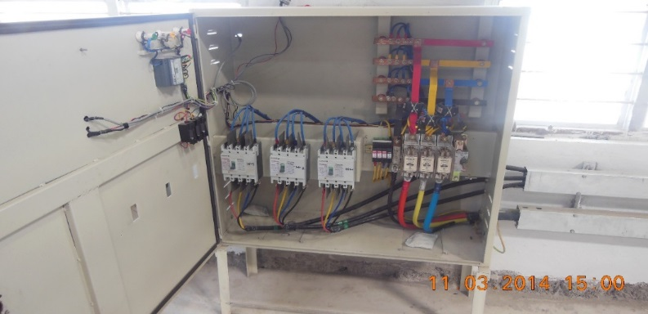
Module | India Make
Plant Capacity | 100 kWp
Rooftop Owner | Rockwell Industries
City | Hyderabad
State | Andhra Pradesh
Project Cost | Rs. 0.74 Cr
CFA through SECI | Rs. 22.2 lacs

Slide 50
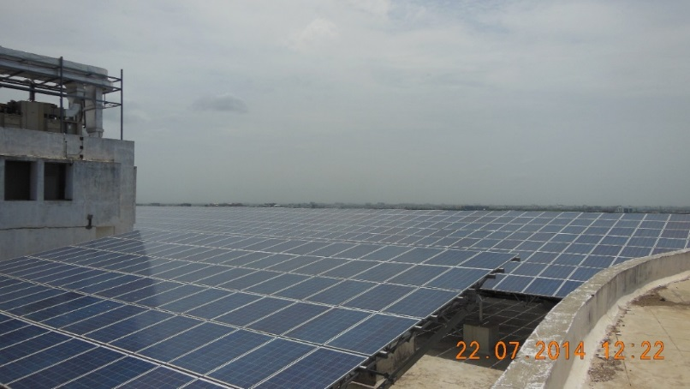
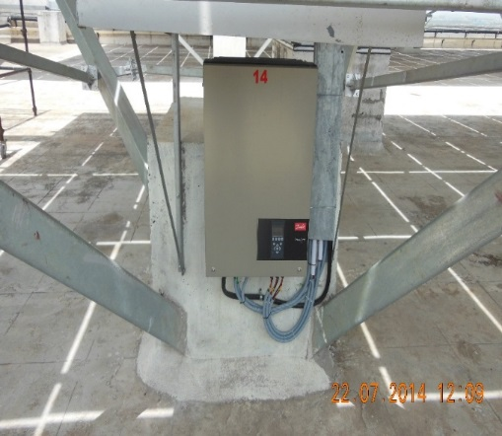
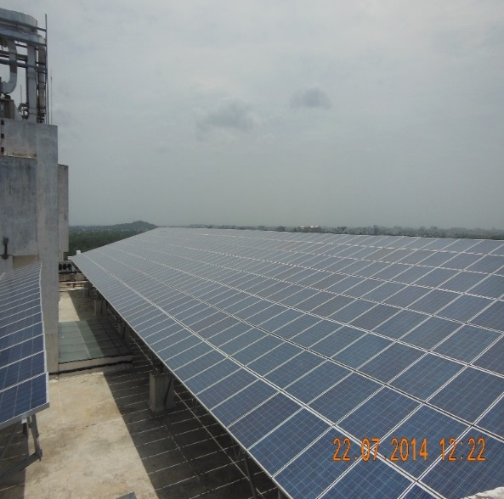
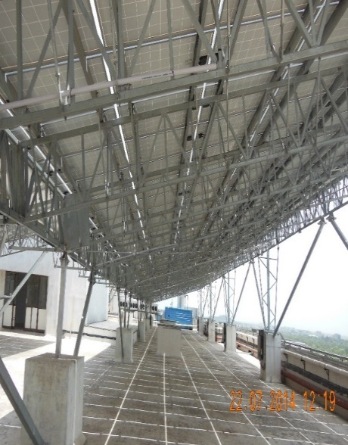
Module | India Make
Plant Capacity | 300 kWp
Rooftop Owner | IIT Madras
City | Chennai
State | Tamilnadu
Project Cost | Rs. 2.49 Cr
CFA through SECI | Rs. 75 lacs

Slide 51
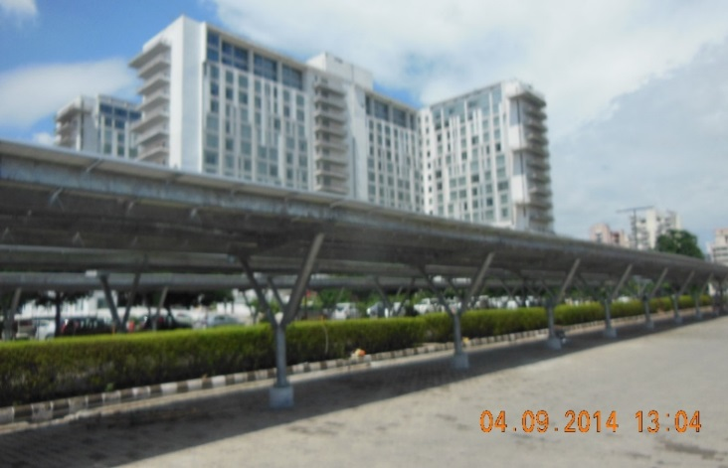
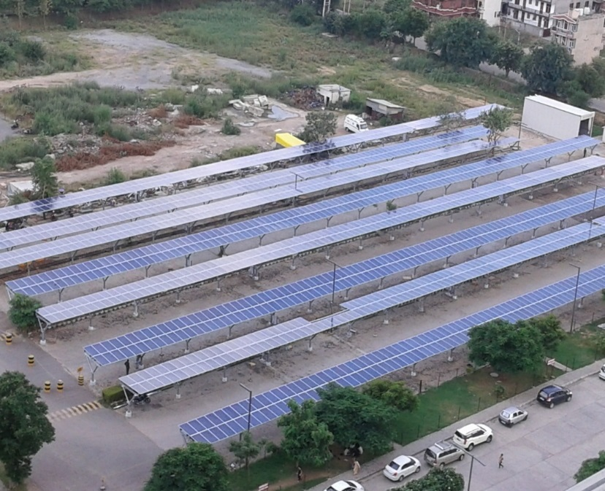
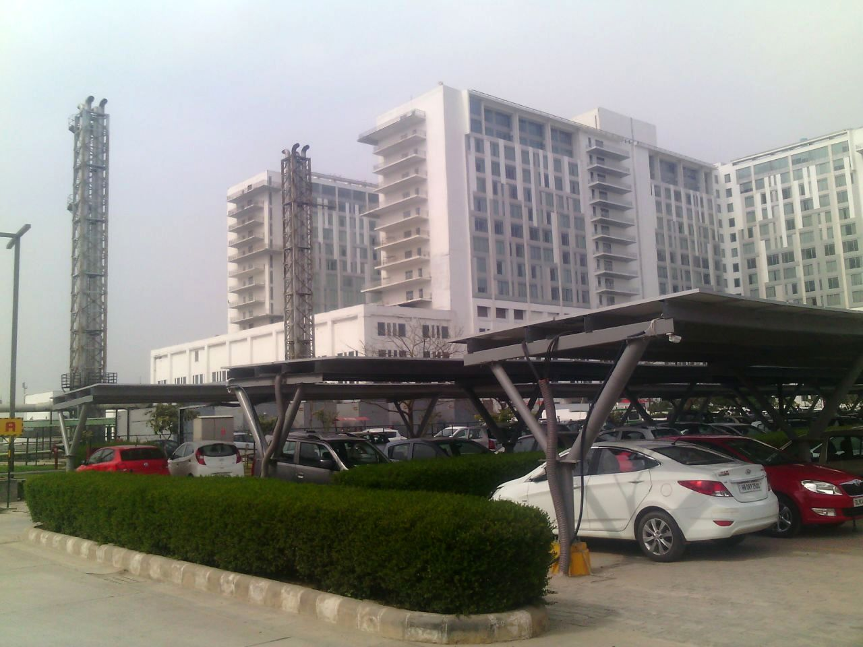
Module | India Make
Plant Capacity | 500 kWp
Rooftop Owner | Medanta Hospital
City | Gurgaon
State | Haryana
Project Cost | Rs. 4.15 Cr
CFA through SECI | Rs. 1.24 Cr

Slide 52
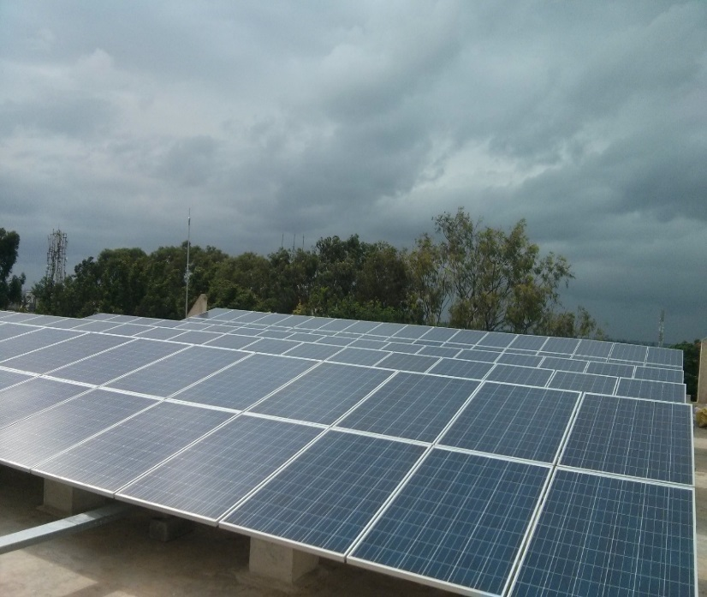
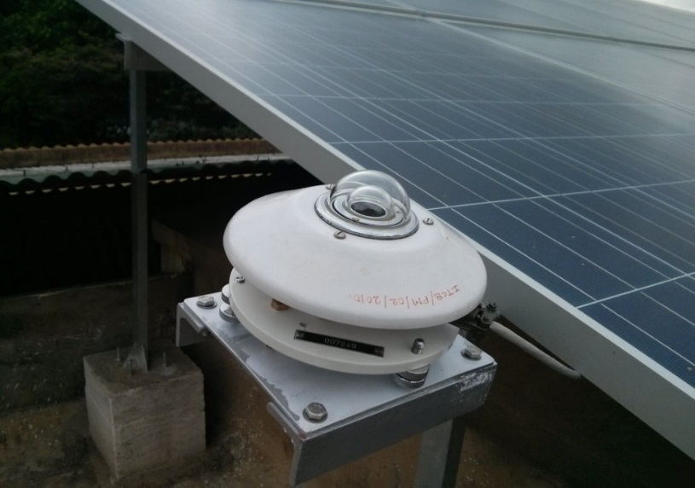
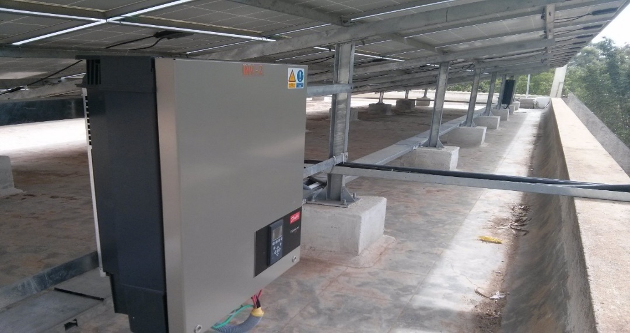
Module | India Make
Plant Capacity | 100 kWp
Rooftop Owner | NIAS
City | Bengaluru
State | Karnataka
Project Cost | Rs. 83 lacs
CFA through SECI | Rs. 25 lacs

Slide 53
Government House, Sector – 7, Chandigarh
MNRE

Slide 54
1.0 MW Rooftop plant at Punjab Engineering College, Chandigarh
MNRE

Slide 55
Government Hospital, Sector – 16, Chandigarh
MNRE

Slide 56
495 kW Rooftop plant at Govt. College for Girls, Sector – 11, Chandigarh
MNRE

Slide 57
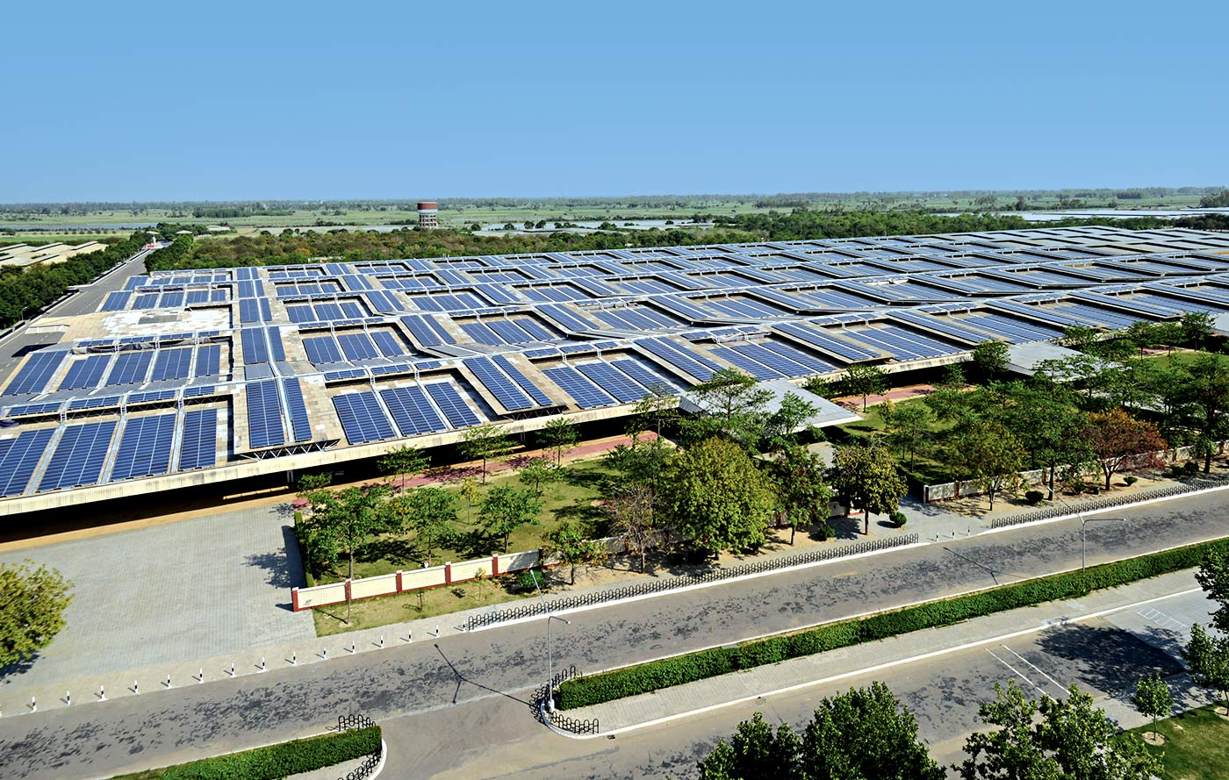
Largest rooftop plant in the world on single roof*
MNRE
7.52MW plant installed by Larsen & Toubro construction in Punjab
L&T installed more than 30,000 PV panels on the rooftop
Power from the plant being fed to the local grid through a PPA signed with the state distribution company
* Claims L&T

Slide 58
IGP Office, Sector – 9, Chandigarh
MNRE
Thank You

