Slide 1
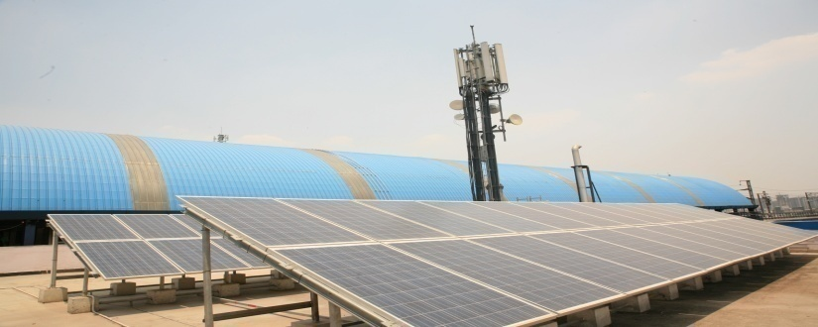
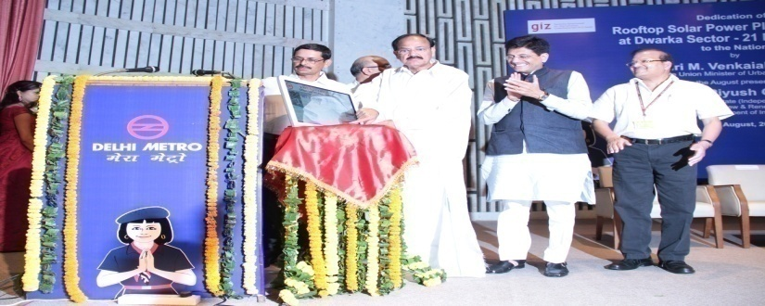
Financial Models for Solar PV Plants in Government Sector S. Sivamathan, GM/Finance

Slide 2
POWER REQUIREMENTS IN DMRC
Electricity is one of the major input for the operation of Metro Rail.
The electricity demand of Delhi Metro is 150 MW
Monthly expenditure on electricity is Rs.35 crores.
Electricity expense constitutes 34% to 40% of the total operating expenditure.

Slide 3
COMPARATIVE POSITION OF O&M EXPENSES
Rs./Crore
Particulars | 2014-15 | 2013-14 | % Increase / (Decrease)
Power | 412.03 | 357.65 | 15.20%
Salary & Wages | 407.69 | 317.45 | 28.43%
Repair & Maintenance and other expenses | 403.92 | 312.83 | 29.12%
Total | 1223.64 | 987.93 | 23.86%

Slide 4
Calculation of % increase in the fare
F_{N} | New Fare | Indices | Weightage
FE_{N} | New Energy price (Jul-2014) | 6.83 | 34%
FE₀ | Old Energy Price | 3.27
CPI_{N} | New Consumer price Index (May-2015) | 258 | 33%
CPI₀ | Old Consumer price Index | 170
AMC_{N} | New Maintenance & Other Cost | 403.92 | 33%
AMC₀ | Old Maintenance & Other Cost | 93.80

Slide 5
BUSINESS MODEL
Various business models were explored and financial calculations were done.
SECI suggested two models:-
CAPEX Model: DMRC will invest and operate.
RESCO Model: Renewable Energy Service Company. The developer shall invest money and also operate the same.

Slide 6
Sept. 2013 – MoU signed with SECI, to execute solar power projects in DMRC Premises.
Feb. 2014 – Power Purchase Agreement (PPA) for 25 years signed with SEI Superior Pvt. Ltd. under RESCO model.
June 2014 – Installation works started and Plant made operational on 27.06.2014.
July-Aug 2015 – Power Purchase Agreement for 25 years signed with M/s Purushottam Rays Power Pvt. Ltd at a levelised tariff of Rs.6.248/Kwh.

Slide 7
CAPEX MODEL
Entire cost of Project to be borne by DMRC (~ 70%)
and
30% subsidy from SECI / MNRE.

Slide 8
RESCO MODEL
RESCO (Renewable Energy Service Company) Model
Project cost to be borne by the Developer identified by SECI and the developer will enter into a PPA (Power Purchase Agreement) for 25 years with DMRC at a mutually agreed tariff. 30% subsidy to the Developer, will be provided by SECI.
No Capital expenditure by DMRC.
Only roof space is provided.

Slide 9
Power Purchase Agreements signed till date
Developer | Capacity | Subsidy | Allocation | TARIFF (in Rs.)
 | (kWp) | @ | By | Levellized | 1st Year | 25th Year
SEI Superior Solar | 500 | 30% | SECI | 6.94 | 6.00 | 8.36
Jakson Engineers | 250 | 30% | SECI | 6.00 | 6.00 | 6.00
Sukam Power System | 250 | 30% | SECI | 5.845 | 5.845 | 5.845
SEI SunScope Energy | 1235 | 15% | DMRC | 6.73 | 6.73 | 6.73
SEI SunScope Energy | 1500 | 15% | DMRC | 6.248 | 6.00 | 6.35
Consortium of Purshotam Industries & Rays Power Experts | 7000 | 15% | DMRC | 6.248 | 6.00 | 6.35
Total | 10,735 | or 10.7 MWp
Pooled Levellized Tariff : Rs. 6.32 / kWhr

Slide 10
APPROVALS FROM M.N.R.E.
Entitled DMRC as implementing agency for National Solar Mission.
Granted Central Financial Assistance (CFA) of Rs. 25.50 Crores (15% of Benchmark Cost) for installing 20 MWp of Solar Plants in two installments for 10 MWp each.
For SECI tendered plants – 30% subsidy from MNRE is availed.
Of 30% subsidy – 3% is retained by SECI (as consultancy fees) 27% to be released in stages linked to plant performance in first 2 years.

Slide 11
Details of sanctioned CFA by MNRE
S. No. | Aggregate Capacity | Benchmark Cost per MWp | 15% of Benchmark Cost per MWp | Estimated CFA approved
1 | 10 MWp | Rs. 9.0 Crores | Rs. 1.35 Crores | Rs. 13.5 Crores
2 | 10 MWp | Rs. 8.0 Crores | Rs. 1.20 Crores | Rs. 12.00 Crores
Total Approved CFA |  |  |  | Rs. 25.5 Crores

Slide 12
LEVELISED TARIFF OF CURRENT OFFER
Discount rate assumed* | 10% | (long term fixed deposit interest)
Offer from SunEdison
Year | 1 | 2 | 3 | 4 | 5 | 6 | 7 | 8 | 9 | 10
Tariff offered (INR/kWh) | 6.0 | 6.0 | 6.0 | 6.2 | 6.3 | 6.5 | 6.7 | 6.9 | 7.1 | 7.3
Annuity Factor | 1.00 | 0.91 | 0.83 | 0.75 | 0.68 | 0.62 | 0.56 | 0.51 | 0.47 | 0.42
Year | 11 | 12 | 13 | 14 | 15 | 16 | 17 | 18 | 19 | 20
Tariff offered (INR/kWh) | 7.5 | 7.7 | 7.9 | 8.1 | 8.4 | 8.4 | 8.4 | 8.4 | 8.4 | 8.4
Annuity Factor | 0.39 | 0.35 | 0.32 | 0.29 | 0.26 | 0.24 | 0.22 | 0.20 | 0.18 | 0.16
Year | 21 | 22 | 23 | 24 | 25
Tariff offered (INR/kWh) | 8.4 | 8.4 | 8.4 | 8.4 | 8.4
Annuity Factor | 0.15 | 0.14 | 0.12 | 0.11 | 0.10
Levellised Tariff (INR/kWh) | 6.94 |  | (Vetted by GIZ, Germany)

Slide 13
TARIFF COMPARISON

Slide 14
Thank You !!
DMRC Ltd.
Metro Bhawan
Fire Brigade Lane
Barakhamba Road
New Delhi-110001

