Slide 1
PV-DIESEL POWERED TRAINS

Slide 2
TWO TRAINS WITH SOLAR PANELS IN INDIA

Slide 3
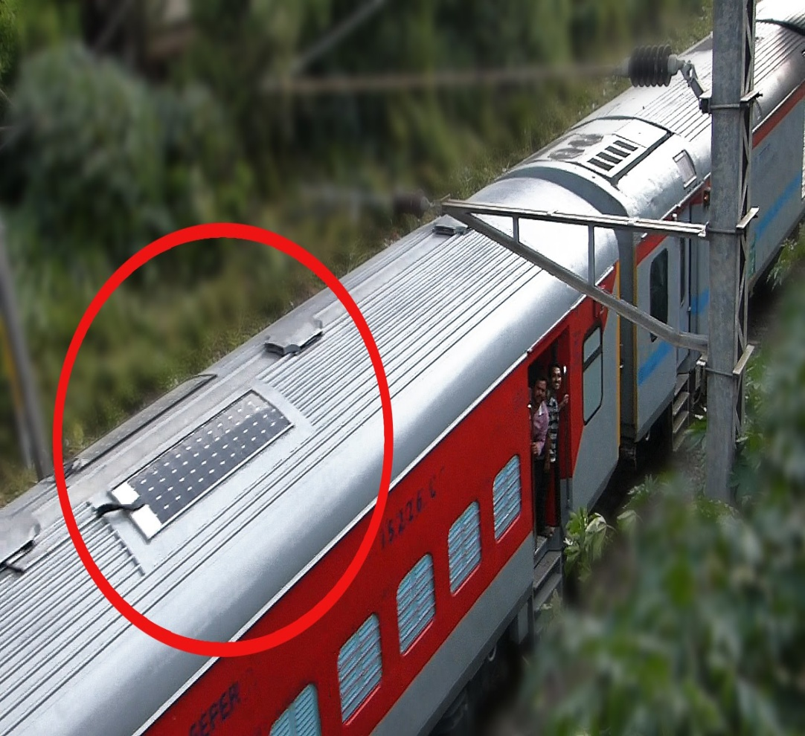
SOLAR PANEL ON TOP OF CHENNAI-COIMBATORE SHATABDI EXPRESS

Slide 4
Diesel Generators in Trains
Self-generation philosophy, where in Generators are mounted at respective coaches and are driven by pulley-belt arrangement, driving pulley being mounted on coach axle is not used mostly.
End-On-Generation, where two power cars carrying the Generators situated at each end of the train is mostly implemented.
Self Generation, with generators kept at individual coaches

Slide 5
Trains as Microgrids
With generators being at the end and solar at the roof top, combinedly supplying the loads on board-they make the trains as moving Microgrids.
With different sources comes the problem of properly controlling them.
The loads are lamps, fans, air-conditioning, laptop/mobile phone chargers and other miscellaneous loads.
The loads determines the operating conditions of the sources.
There is a minimum power generation point for the diesel, below which it should not be operated and there is a maximum power limit.
The difference of diesel generator power and load power is supplied by PV panels.

Slide 6
SINGLE LINE DIAGRAM OF THE MICROGRID IN TRAINS
*IM-Air conditioning units uses Induction motors as fan motors

Slide 7
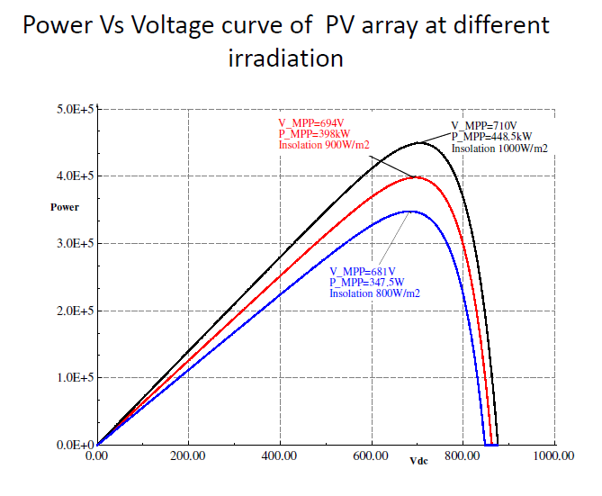
PV MPPT (MAXIMUM POWER POINT TRACKING)

Slide 8
P&O MPPT algorithm and working principle
Here dc voltage reference (V_{dcref}) is perturbed with a fixed amount (∆V) and the next perturb is decided based on the status of change in power (∆P).
For correct execution of the P&O MPPT, f_{MPPT} should not be greater than the inverse of 20ms (settling time).
The sensing of Ipv and Vpv done at higher frequency than the frequency of updating (the V_{dcref}), f_{MPPT} may result in erroneous results since the decision of perturb is taken based on an unsettled outputs as it may destabilize the system.

Slide 9
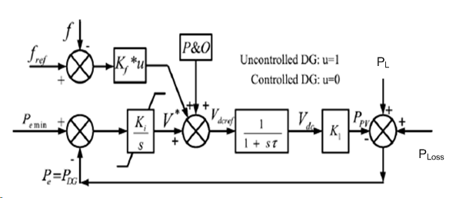
Various Control loops
Voltage Control Loop
I_{qref} is the set point
Frequency Control Loop
P_{m} is the set point
PV Active Power Control Loop
V_{dcref} is the set point

Slide 10
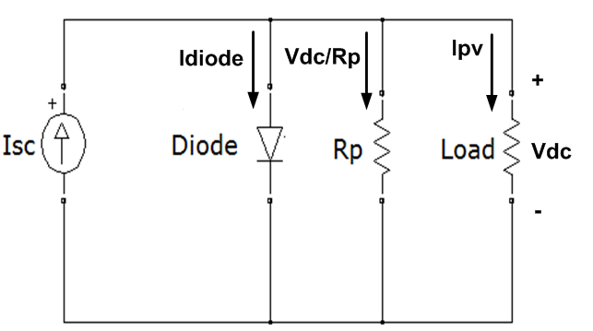
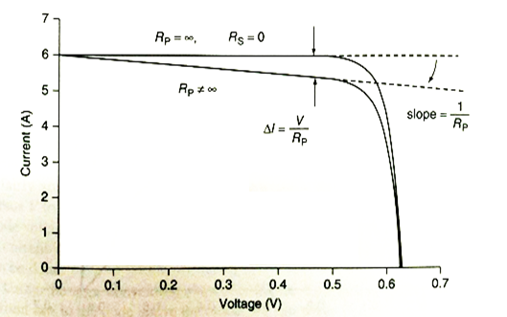
Impact of parallel leakage resistance on IV characteristics
In ideal PV cell
$I_{PV}=I_{sc}−I_{diode}$; where $I_{sc}$ is the short circuit current and assume $R_{s}=0$ and $R_{P}=∞$
When parallel leakage resistance is considered
$I_{PV}=I_{sc}−I_{diode}−\frac{V_{dc}}{R_{P}}$; keeping $R_{S}=0$.
This shows that at any given voltage load current will be decreased by ($\frac{V_{dc}}{R_{P}}$) from the load current obtained with ideal PV cell
Due to this reduction of current (equal to$\frac{V_{dc}}{R_{P}}$), the IV characteristics shows a slope of $\frac{1}{R_{P}}$; as shown in figure.
For a cell to have less than 1% loss due to the parallel resistance, $R_{P}>\frac{100V_{oc}}{I_{sc}}$

Slide 11
Impact of series resistance on IV characteristics
Series resistance includes
Contact resistance associated with the bond between the cell and its wire leads
Resistance of the semiconductor
In ideal PV cell
$I_{PV}=I_{sc}−I_{diode}$; Assume $R_{s}=0$ and $R_{P}=∞$
Diode current is given by $I_{diode}=I_{rs}(\exp\left(\frac{qV}{kT_{c}A}\right)−1)$
When series resistance is considered keeping $R_{P}=∞$
There is a voltage drop in the series resistance
So the voltage across the diode is $V_{diode}=V+I_{PV}R_{s}$ and the diode current becomes $I_{diode}=I_{rs}(\exp\left(\frac{q(V+I_{PV}R_{s})}{kT_{c}A}\right)−1)$
The PV current equation becomes $I_{PV}=I_{sc}−I_{diode}=I_{sc}−I_{rs}(\exp\left(\frac{q(V+I_{PV}R_{s})}{kT_{c}A}\right)−1)$

Slide 12
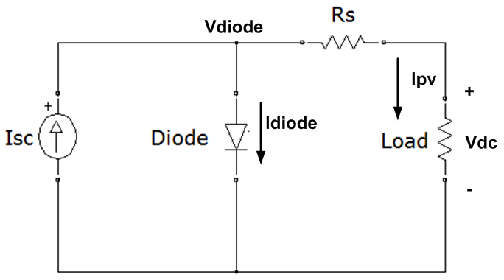
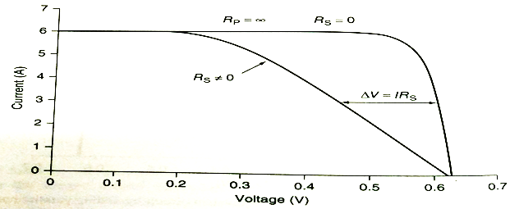
Impact of series resistance on IV characteristics (cont.)
Thus at any given current the voltage gets shifted by $∆V=I_{PV}R_{s}$
For a cell to have less than 1% loss due to the series resistance, $R_{S}<\frac{0.01V_{oc}}{I_{sc}}$

Slide 13
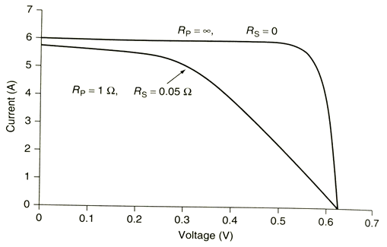
IV characteristics considering impact of both series and parallel resistance
When both the series and the parallel resistances are considered both voltage and current reduction is observed and the overall characteristics is shown in the figure

Slide 14
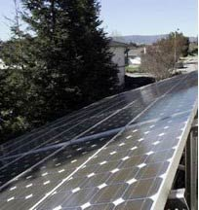
Impact of Shading
Few or all the cells may be completely or partially under shading because of cloud movement, shadow of trees etc.
This can cause problems like drop in output power, heating of cell etc.

Slide 15
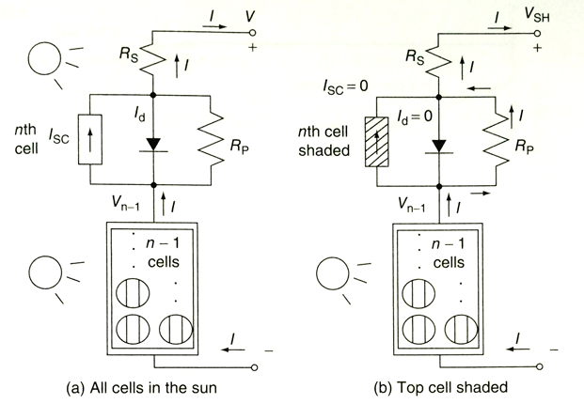
Impact of Shading Scenario of one of the series connected cells getting completely shaded
Let n be the number of cells connected in series
Under normal operation, i.e. when all the cells are in the sun, all cells produce same voltage and short circuit current
When any 1 of the cell is completely shaded, the Isc of that particular cell drops to 0. The current which is flowing through the remaining (n-1) cells flows through the parallel resistance ($R_{P}$) of the shaded cell

Slide 16
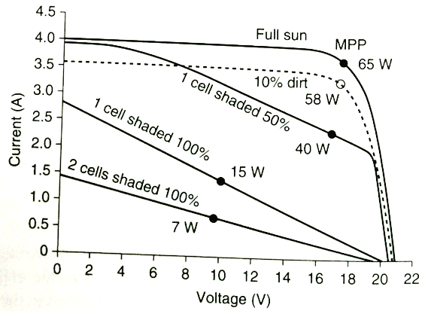
Effect of partial shading of the panels
With PV panels on top, the movement of trains makes the insolation to vary and momentary partial shading of the panels will be occurring.
The figure below explains the effect of shading of the cells:

Slide 17
Shade mitigation
The problems arising due to shading can be taken care by the use of
Bypass diode
Blocking diode

Slide 18
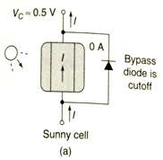
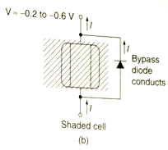
Shade mitigation using bypass diode
The problem of voltage drop and hot spot formation is solved using a bypass diode
A bypass diode is connected in antiparallel to the diode of the cell
As shown in (a)
The cell is under sun and gives voltage rise
The bypass diode is reverse biased and no current flows through it
This is operation of a normal cell where bypass diode is not even present
As shown in (b)
The cell is under shading and does not produce any current
The current has to flow through the parallel resistance leading to voltage drop across the cell
This drop makes the bypass diode forward biased and all the current flows through the diode and no current flows through the cell (resistance)
This leads to a small voltage drop of the range 0.2 V to 0.6 V depending on the type of diode used rather than the large voltage drop ($∆V=V/n+IR_{P}$) that may occur without it.

Slide 19
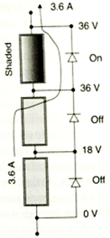
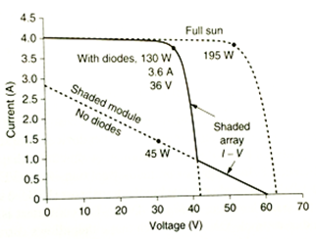
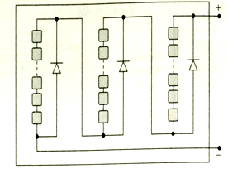
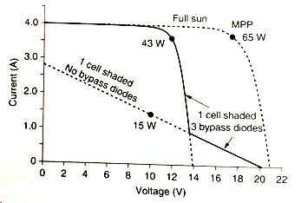
Shade mitigation using bypass diode (cont.)
Generally bypass diode is not provided across each cell in a module
Few diodes are used such that each covers a number of cells within the module (Figure (a))
With the use of these bypass diodes more power is obtained as compared to a module without bypass diode (Figure (b))
Similar to a bypass diode covering cells in a module; bypass diodes are used across modules in a string in an array (Figure (c))
(a) Three bypass diodes, each covering one – third of the cells in a module
(b) IV characteristics and maximum power of a module with 3 bypass diodes and one cell shaded
(c) Use of bypass diode in a string of modules

Slide 20
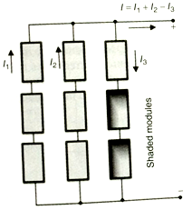
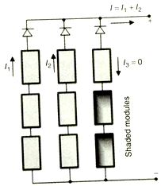
Shade mitigation using blocking diode
When strings are connected in parallel
Instead of supplying current, the shaded string can withdraw current from rest of the parallel connected strings (Figure (a))
This problem is solved by using blocking diode; also known as isolation diode
The blocking diode is placed at top of each string
The diode blocks the reverse current withdrawn by the shaded string (Figure (b)).
(a) Without blocking diode
(b) With blocking diode

Slide 21
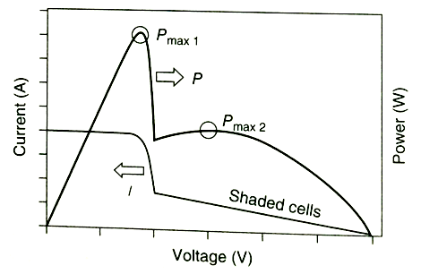
Effect of partial shading of the panels
Based on the complex I-V characteristics, which comes as a result of operation of bypass diode, there may be multiple local maximum power points.
Use of Blocking diode

Slide 22
Effect of partial shading of the panels
Problems arising due to shading can be taken care by the use of
Bypass diode,
Blocking diode.
Use of Bypass diode

